Slide 1
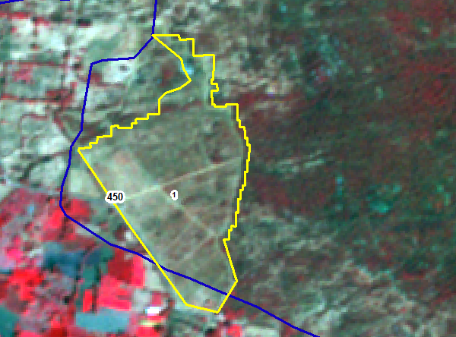
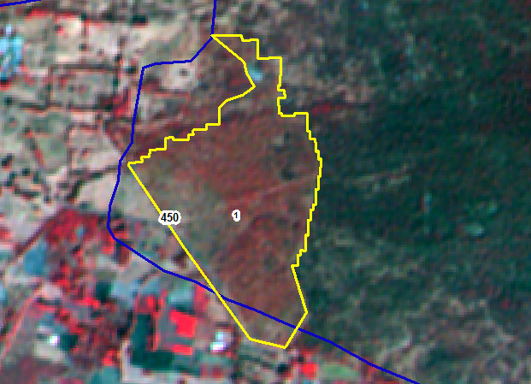
IRS_R2_LISS4_101-64-a-22-02-2018
IRS_R2_LISS4_101-64-a-24-jan-2019
SNO | Division | Range | Section | Beat | Block | Comp | Class | Change | Area_Ha | Longitude | Latitude | VSS | Sanctuary
1 | CHITTOOR EAST | CHITTOOR EAST | CHITTOOR | CHASIS HILLS | Chasses Hil | 450 | NF TO SF | POSITIVE | 11.57 | 79.12875 | 13.19231

Slide 2
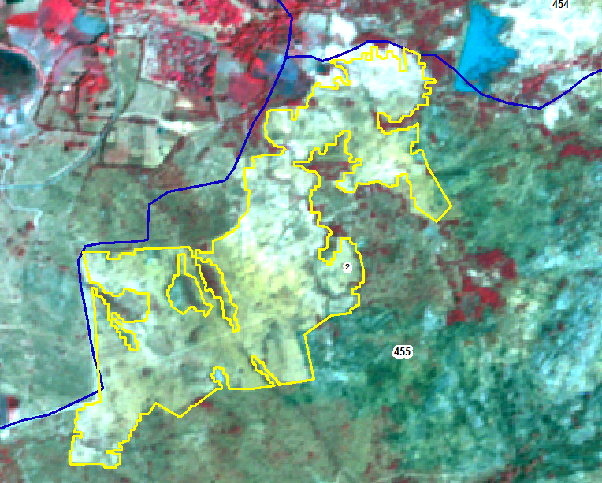
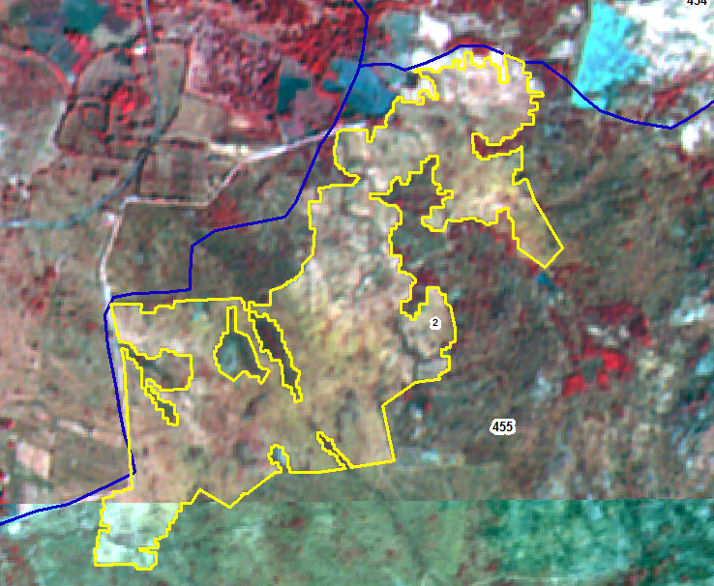
IRS_R2_LISS4_ 101-64-b-6-mar-18
IRS_R2_LISS4_101-64-a-24-jan-2019
SNO | Division | Range | Section | Beat | Block | Comp | Class | Change | Area_Ha | Longitude | Latitude | VSS | Sanctuary
2 | CHITTOOR EAST | CHITTOOR EAST | CHITTOOR | CHITTOOR | Cheepalli | 454 | NF TO SF | POSITIVE | 38.83 | 79.16255 | 13.12706 | Ramapuram

Slide 3
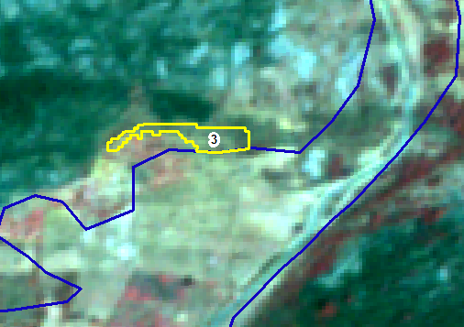
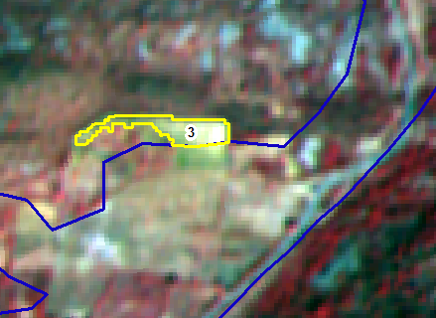
IRS_R2_LISS4_ 101-64-b-6-mar-18
IRS_R2_LISS4_101-64-a-24-jan-2019
SNO | Division | Range | Section | Beat | Block | Comp | Class | Change | Area_Ha | Longitude | Latitude | VSS | Sanctuary
3 | CHITTOOR EAST | CHITTOOR EAST | PENUMUR | ODDEPALLI | Adenapalli | 436 | SF TO NF | NEGATIVE | 0.39 | 79.16578 | 13.43229

Slide 4
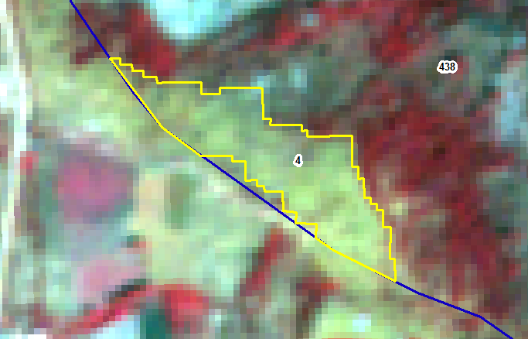
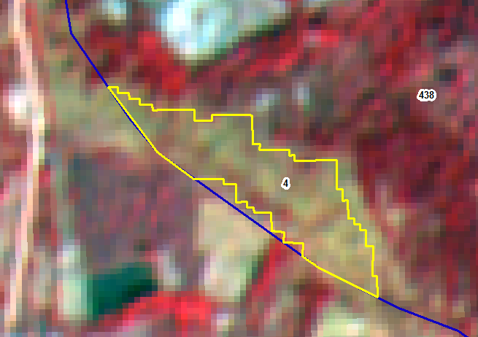
IRS_R2_LISS4_ 101-64-b-6-mar-18
IRS_R2_LISS4_101-64-a-24-jan-2019
SNO | Division | Range | Section | Beat | Block | Comp | Class | Change | Area_Ha | Longitude | Latitude | VSS | Sanctuary
4 | CHITTOOR EAST | CHITTOOR EAST | PENUMUR | PATHAGUNTA | Panapakam Extn | 438 | NF TO SF | POSITIVE | 1.27 | 79.22932 | 13.4443

Slide 5
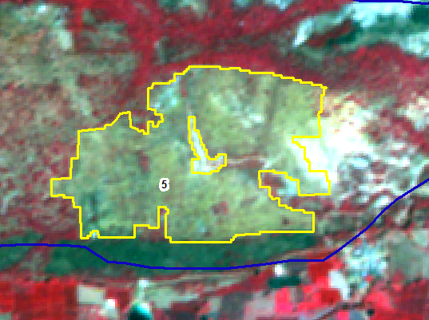
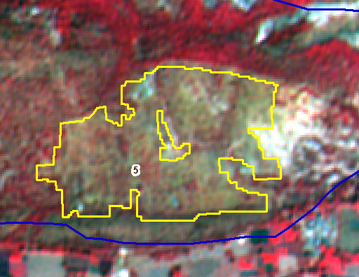
IRS_R2_LISS4_ 101-64-b-6-mar-18
IRS_R2_LISS4_101-64-a-24-jan-2019
SNO | Division | Range | Section | Beat | Block | Comp | Class | Change | Area_Ha | Longitude | Latitude | VSS | Sanctuary
5 | CHITTOOR EAST | CHITTOOR EAST | PENUMUR | PATHAGUNTA | Panapakam Extn | 440 | NF TO SF | POSITIVE | 14.3 | 79.25071 | 13.42171

Slide 6
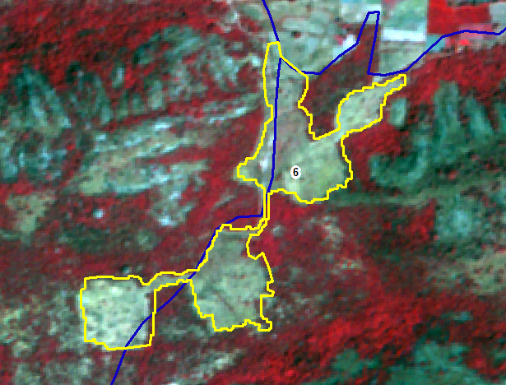
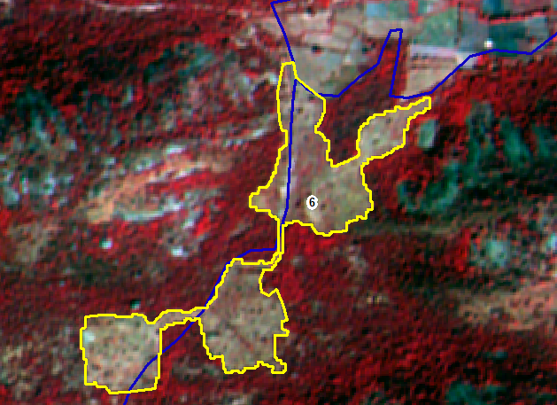
IRS_R2_LISS4_ 101-64-b-6-mar-18
IRS_R2_LISS4_101-64-a-24-jan-2019
SNO | Division | Range | Section | Beat | Block | Comp | Class | Change | Area_Ha | Longitude | Latitude | VSS | Sanctuary
6 | CHITTOOR EAST | CHITTOOR EAST | PENUMUR | PATHAGUNTA | Panapakam Extn | 437 | NF TO SF | POSITIVE | 13.88 | 79.21615 | 13.43246 | Nachukur Bc

Slide 7
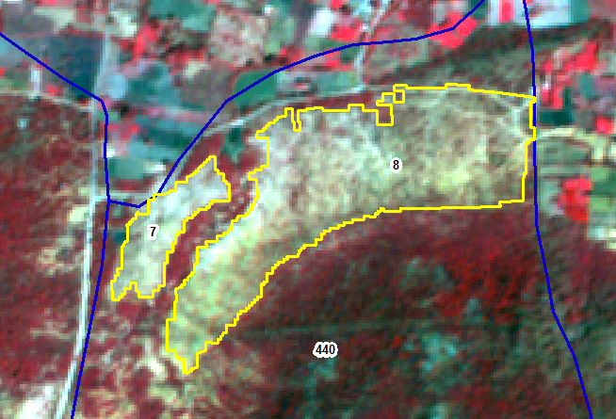
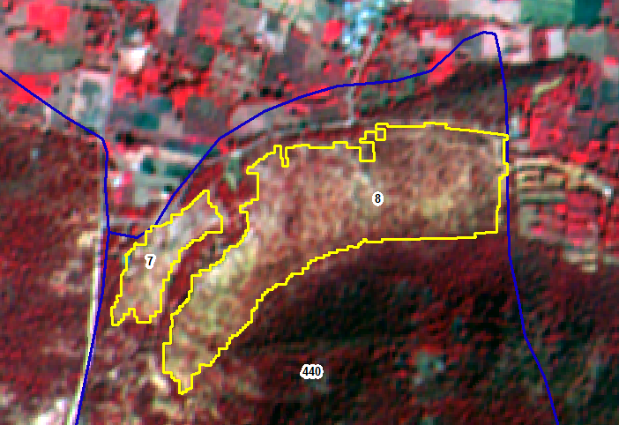
IRS_R2_LISS4_ 101-64-b-6-mar-18
IRS_R2_LISS4_101-64-a-24-jan-2019
SNO | Division | Range | Section | Beat | Block | Comp | Class | Change | Area_Ha | Longitude | Latitude | VSS | Sanctuary
7 | CHITTOOR EAST | CHITTOOR EAST | PENUMUR | PATHAGUNTA | Panapakam Extn | 440 | SF TO OF | POSITIVE | 2.01 | 79.23362 | 13.43385
8 | CHITTOOR EAST | CHITTOOR EAST | PENUMUR | PATHAGUNTA | Panapakam Extn | 440 | SF TO OF | POSITIVE | 12.74 | 79.23666 | 13.43451

Slide 8
IRS_R2_LISS4_ 101-64-b-6-mar-18
IRS_R2_LISS4_101-64-a-24-jan-2019
SNO | Division | Range | Section | Beat | Block | Comp | Class | Change | Area_Ha | Longitude | Latitude | VSS | Sanctuary
7 | CHITTOOR EAST | CHITTOOR EAST | PENUMUR | PATHAGUNTA | Panapakam Extn | 440 | SF TO OF | POSITIVE | 2.01 | 79.23362 | 13.43385
8 | CHITTOOR EAST | CHITTOOR EAST | PENUMUR | PATHAGUNTA | Panapakam Extn | 440 | SF TO OF | POSITIVE | 12.74 | 79.23666 | 13.43451

Slide 9
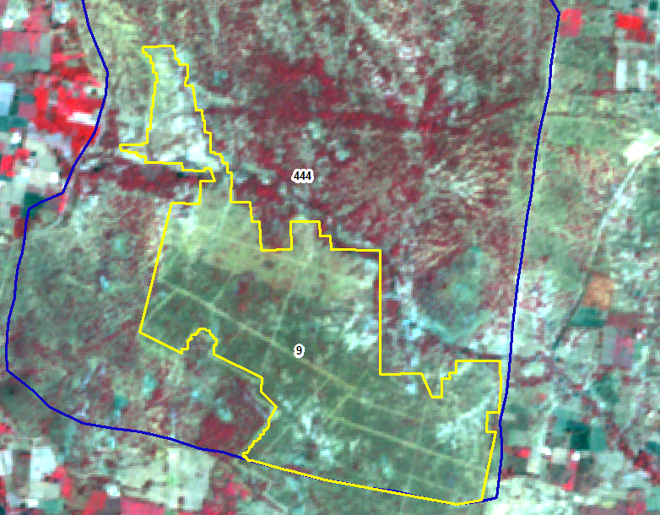
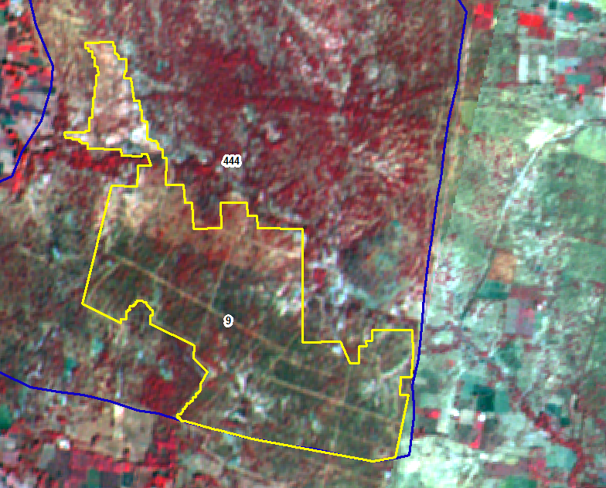
IRS_R2_LISS4_ 101-64-b-6-mar-18
IRS_R2_LISS4_101-64-a-24-jan-2019
SNO | Division | Range | Section | Beat | Block | Comp | Class | Change | Area_Ha | Longitude | Latitude | VSS | Sanctuary
9 | CHITTOOR EAST | CHITTOOR EAST | PENUMUR | PENUMUR | Penumur | 444 | SF TO OF | POSITIVE | 39.35 | 79.24568 | 13.37967

Slide 10
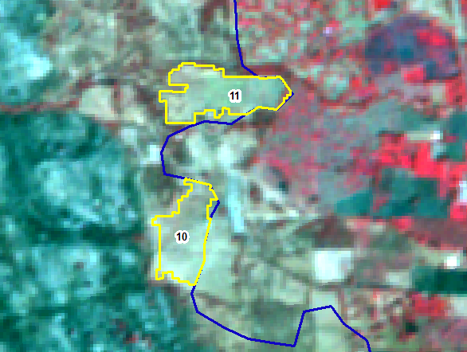
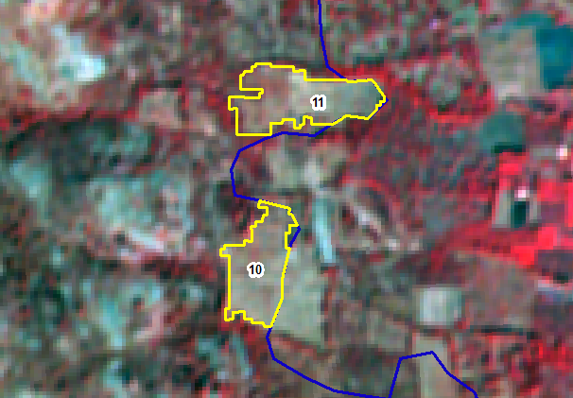
IRS_R2_LISS4_ 101-64-b-6-mar-18
IRS_R2_LISS4_101-64-a-24-jan-2019
SNO | Division | Range | Section | Beat | Block | Comp | Class | Change | Area_Ha | Longitude | Latitude | VSS | Sanctuary
10 | CHITTOOR EAST | CHITTOOR EAST | PENUMUR | PUTHALAPATTU | Puthalapattu | 446 | NF TO SF | POSITIVE | 0.96 | 79.14007 | 13.33554
11 | CHITTOOR EAST | CHITTOOR EAST | PENUMUR | PUTHALAPATTU | Puthalapattu | 446 | NF TO SF | POSITIVE | 1.2 | 79.14055 | 13.33757

Slide 11
IRS_R2_LISS4_ 101-64-b-6-mar-18
IRS_R2_LISS4_101-64-a-24-jan-2019
SNO | Division | Range | Section | Beat | Block | Comp | Class | Change | Area_Ha | Longitude | Latitude | VSS | Sanctuary
10 | CHITTOOR EAST | CHITTOOR EAST | PENUMUR | PUTHALAPATTU | Puthalapattu | 446 | NF TO SF | POSITIVE | 0.96 | 79.14007 | 13.33554
11 | CHITTOOR EAST | CHITTOOR EAST | PENUMUR | PUTHALAPATTU | Puthalapattu | 446 | NF TO SF | POSITIVE | 1.2 | 79.14055 | 13.33757

Slide 12
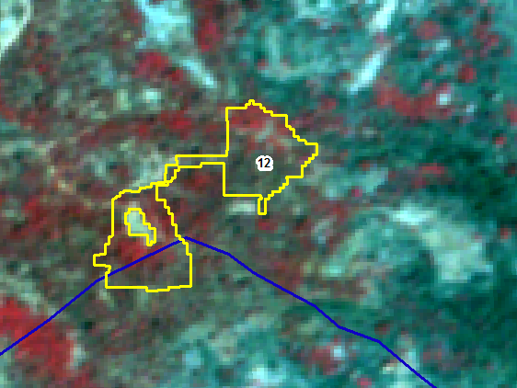
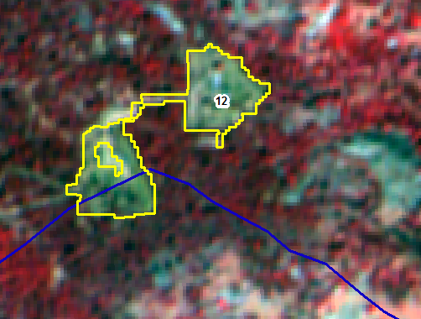
IRS_R2_LISS4_ 101-64-b-6-mar-18
IRS_R2_LISS4_101-64-a-24-jan-2019
SNO | Division | Range | Section | Beat | Block | Comp | Class | Change | Area_Ha | Longitude | Latitude | VSS | Sanctuary
12 | CHITTOOR EAST | CHITTOOR EAST | PENUMUR | PUTHALAPATTU | Puthalapattu | 446 | OF TO NF | NEGATIVE | 2.44 | 79.12755 | 13.33632

Slide 13
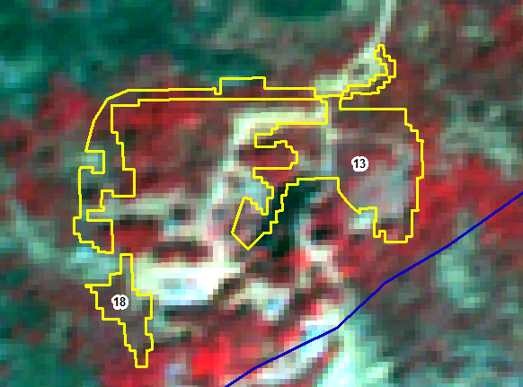
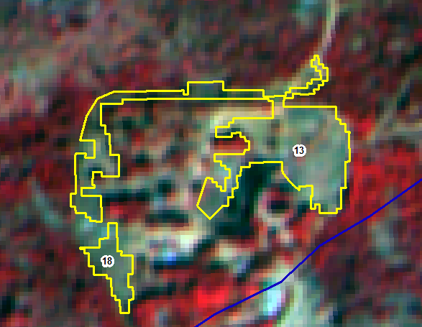
IRS_R2_LISS4_ 101-64-b-6-mar-18
IRS_R2_LISS4_101-64-a-24-jan-2019
SNO | Division | Range | Section | Beat | Block | Comp | Class | Change | Area_Ha | Longitude | Latitude | VSS | Sanctuary
13 | CHITTOOR EAST | CHITTOOR EAST | PENUMUR | PUTHALAPATTU | Puthalapattu | 446 | OF TO NF | NEGATIVE | 1.91 | 79.12359 | 13.33506
18 | CHITTOOR EAST | CHITTOOR EAST | PENUMUR | PUTHALAPATTU | Puthalapattu | 446 | OF TO NF | NEGATIVE | 0.27 | 79.12224 | 13.33378

Slide 14
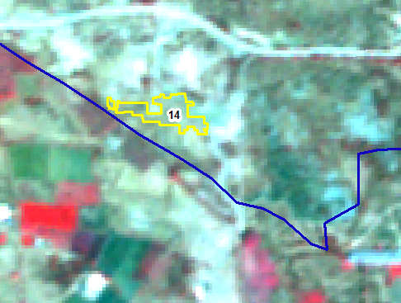
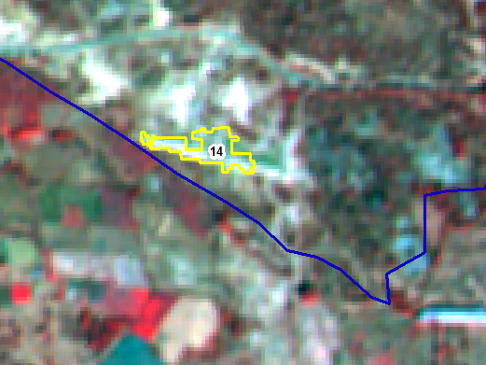
IRS_R2_LISS4_ 101-64-b-6-mar-18
IRS_R2_LISS4_101-64-a-24-jan-2019
SNO | Division | Range | Section | Beat | Block | Comp | Class | Change | Area_Ha | Longitude | Latitude | VSS | Sanctuary
14 | CHITTOOR EAST | CHITTOOR EAST | PENUMUR | PUTHALAPATTU | Puthalapattu | 446 | SF TO NF | NEGATIVE | 0.39 | 79.13839 | 13.32929

Slide 15
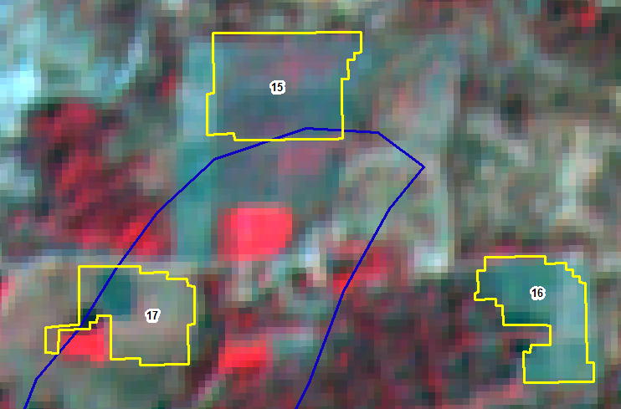
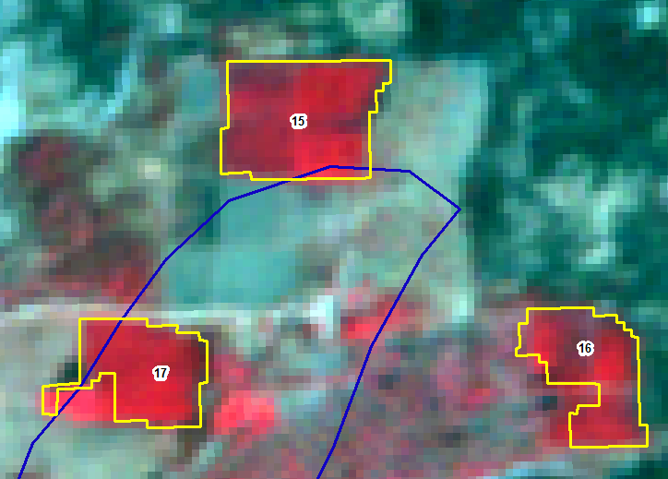
IRS_R2_LISS4_ 101-64-b-6-mar-18
IRS_R2_LISS4_101-64-a-24-jan-2019
SNO | Division | Range | Section | Beat | Block | Comp | Class | Change | Area_Ha | Longitude | Latitude | VSS | Sanctuary
15 | CHITTOOR EAST | CHITTOOR EAST | PENUMUR | PUTHALAPATTU | Puthalapattu | 447 | SF TO NF | NEGATIVE | 0.81 | 79.15824 | 13.34353
16 | CHITTOOR EAST | CHITTOOR EAST | PENUMUR | PUTHALAPATTU | Puthalapattu | 447 | OF TO NF | NEGATIVE | 0.52 | 79.16004 | 13.34196
17 | CHITTOOR EAST | CHITTOOR EAST | PENUMUR | PUTHALAPATTU | Puthalapattu | 447 | SF TO NF | NEGATIVE | 0.53 | 79.15726 | 13.34197

Slide 16
IRS_R2_LISS4_ 101-64-b-6-mar-18
IRS_R2_LISS4_101-64-a-24-jan-2019
SNO | Division | Range | Section | Beat | Block | Comp | Class | Change | Area_Ha | Longitude | Latitude | VSS | Sanctuary
15 | CHITTOOR EAST | CHITTOOR EAST | PENUMUR | PUTHALAPATTU | Puthalapattu | 447 | SF TO NF | NEGATIVE | 0.81 | 79.15824 | 13.34353
16 | CHITTOOR EAST | CHITTOOR EAST | PENUMUR | PUTHALAPATTU | Puthalapattu | 447 | OF TO NF | NEGATIVE | 0.52 | 79.16004 | 13.34196
17 | CHITTOOR EAST | CHITTOOR EAST | PENUMUR | PUTHALAPATTU | Puthalapattu | 447 | SF TO NF | NEGATIVE | 0.53 | 79.15726 | 13.34197

Slide 17
IRS_R2_LISS4_ 101-64-b-6-mar-18
IRS_R2_LISS4_101-64-a-24-jan-2019
SNO | Division | Range | Section | Beat | Block | Comp | Class | Change | Area_Ha | Longitude | Latitude | VSS | Sanctuary
15 | CHITTOOR EAST | CHITTOOR EAST | PENUMUR | PUTHALAPATTU | Puthalapattu | 447 | SF TO NF | NEGATIVE | 0.81 | 79.15824 | 13.34353
16 | CHITTOOR EAST | CHITTOOR EAST | PENUMUR | PUTHALAPATTU | Puthalapattu | 447 | OF TO NF | NEGATIVE | 0.52 | 79.16004 | 13.34196
17 | CHITTOOR EAST | CHITTOOR EAST | PENUMUR | PUTHALAPATTU | Puthalapattu | 447 | SF TO NF | NEGATIVE | 0.53 | 79.15726 | 13.34197

Slide 18
IRS_R2_LISS4_ 101-64-b-6-mar-18
IRS_R2_LISS4_101-64-a-24-jan-2019
SNO | Division | Range | Section | Beat | Block | Comp | Class | Change | Area_Ha | Longitude | Latitude | VSS | Sanctuary
13 | CHITTOOR EAST | CHITTOOR EAST | PENUMUR | PUTHALAPATTU | Puthalapattu | 446 | OF TO NF | NEGATIVE | 1.91 | 79.12359 | 13.33506
18 | CHITTOOR EAST | CHITTOOR EAST | PENUMUR | PUTHALAPATTU | Puthalapattu | 446 | OF TO NF | NEGATIVE | 0.27 | 79.12224 | 13.33378

Slide 19
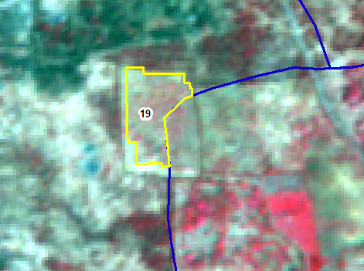
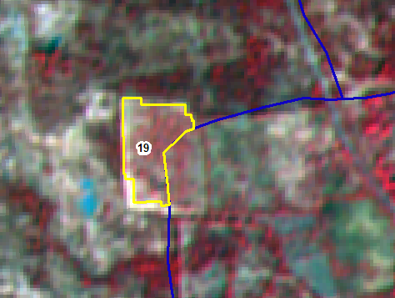
IRS_R2_LISS4_101-64-a-22-02-2018
IRS_R2_LISS4_101-64-a-24-jan-2019
SNO | Division | Range | Section | Beat | Block | Comp | Class | Change | Area_Ha | Longitude | Latitude | VSS | Sanctuary
19 | CHITTOOR EAST | CHITTOOR EAST | PENUMUR | PUTHALAPATTU | Puthalapattu | 446 | SF TO OF | POSITIVE | 1.1 | 79.14039 | 13.34138

Slide 20
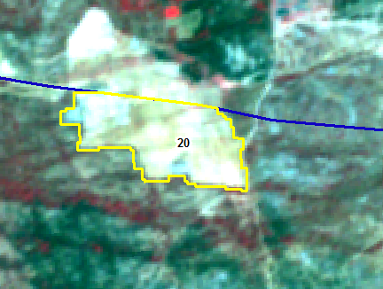
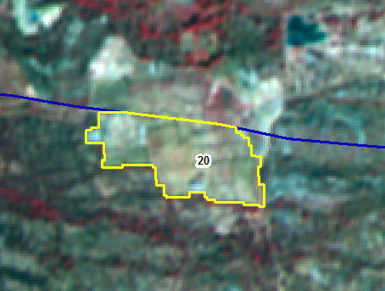
IRS_R2_LISS4_101-64-a-22-02-2018
IRS_R2_LISS4_101-64-a-24-jan-2019
SNO | Division | Range | Section | Beat | Block | Comp | Class | Change | Area_Ha | Longitude | Latitude | VSS | Sanctuary
20 | CHITTOOR EAST | PILER | MANGALAMPET | DAMALCHERUVU | Pulicherla | 74 | NF TO SF | POSITIVE | 4.11 | 79.03141 | 13.56269

Slide 21
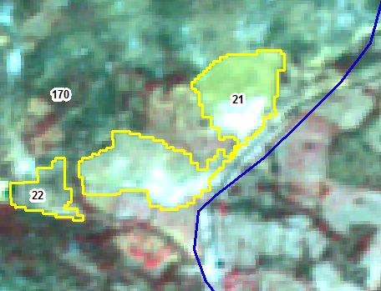
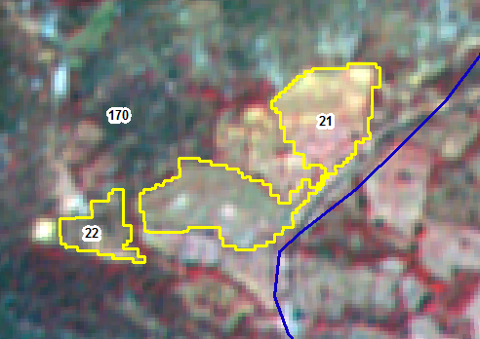
IRS_R2_LISS4_101-64-a-22-02-2018
IRS_R2_LISS4_101-64-a-24-jan-2019
SNO | Division | Range | Section | Beat | Block | Comp | Class | Change | Area_Ha | Longitude | Latitude | VSS | Sanctuary
21 | CHITTOOR EAST | PILER | MANGALAMPET | DAMALCHERUVU | Vallicedu | 170 | NF TO SF | POSITIVE | 2.84 | 79.05788 | 13.53195
22 | CHITTOOR EAST | PILER | MANGALAMPET | DAMALCHERUVU | Vallicedu | 170 | NF TO SF | POSITIVE | 0.52 | 79.05591 | 13.53116

Slide 22
IRS_R2_LISS4_101-64-a-22-02-2018
IRS_R2_LISS4_101-64-a-24-jan-2019
SNO | Division | Range | Section | Beat | Block | Comp | Class | Change | Area_Ha | Longitude | Latitude | VSS | Sanctuary
21 | CHITTOOR EAST | PILER | MANGALAMPET | DAMALCHERUVU | Vallicedu | 170 | NF TO SF | POSITIVE | 2.84 | 79.05788 | 13.53195
22 | CHITTOOR EAST | PILER | MANGALAMPET | DAMALCHERUVU | Vallicedu | 170 | NF TO SF | POSITIVE | 0.52 | 79.05591 | 13.53116

Slide 23
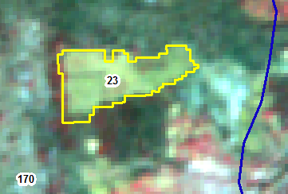
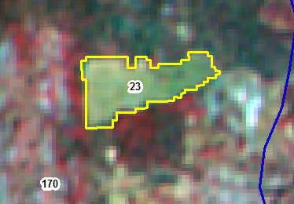
IRS_R2_LISS4_101-64-a-22-02-2018
IRS_R2_LISS4_101-64-a-24-jan-2019
SNO | Division | Range | Section | Beat | Block | Comp | Class | Change | Area_Ha | Longitude | Latitude | VSS | Sanctuary
23 | CHITTOOR EAST | PILER | MANGALAMPET | DAMALCHERUVU | Vallicedu | 170 | NF TO SF | POSITIVE | 1.07 | 79.05544 | 13.53765

Slide 24
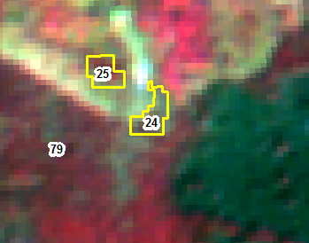
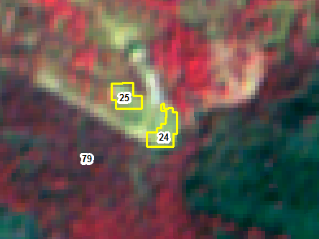
IRS_R2_LISS4_101-64-a-22-02-2018
IRS_R2_LISS4_101-64-a-24-jan-2019
SNO | Division | Range | Section | Beat | Block | Comp | Class | Change | Area_Ha | Longitude | Latitude | VSS | Sanctuary
24 | CHITTOOR EAST | PILER | MANGALAMPET | GANUGAPENTA | Mungiliputtu | 79 | SF TO NF | NEGATIVE | 0.1 | 79.12221 | 13.53049 | Mallireddygaripalli Stc
25 | CHITTOOR EAST | PILER | MANGALAMPET | GANUGAPENTA | Mungiliputtu | 79 | SF TO NF | NEGATIVE | 0.08 | 79.1218 | 13.53085

Slide 25
IRS_R2_LISS4_101-64-a-22-02-2018
IRS_R2_LISS4_101-64-a-24-jan-2019
SNO | Division | Range | Section | Beat | Block | Comp | Class | Change | Area_Ha | Longitude | Latitude | VSS | Sanctuary
24 | CHITTOOR EAST | PILER | MANGALAMPET | GANUGAPENTA | Mungiliputtu | 79 | SF TO NF | NEGATIVE | 0.1 | 79.12221 | 13.53049 | Mallireddygaripalli Stc
25 | CHITTOOR EAST | PILER | MANGALAMPET | GANUGAPENTA | Mungiliputtu | 79 | SF TO NF | NEGATIVE | 0.08 | 79.1218 | 13.53085

Slide 26
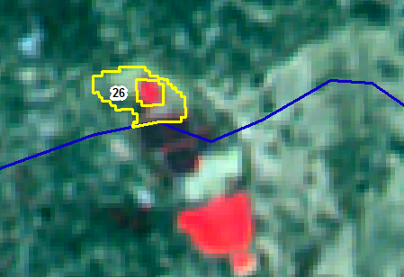
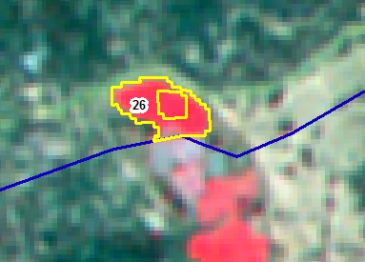
IRS_R2_LISS4_101-64-a-22-02-2018
IRS_R2_LISS4_101-64-a-24-jan-2019
SNO | Division | Range | Section | Beat | Block | Comp | Class | Change | Area_Ha | Longitude | Latitude | VSS | Sanctuary
26 | CHITTOOR EAST | PILER | PILER | TALAPULA | Marella | 6 | NF TO SF | POSITIVE | 0.4 | 78.95844 | 13.74264

Slide 27
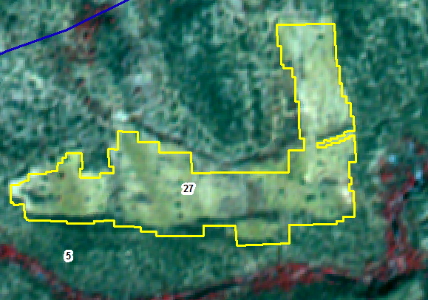
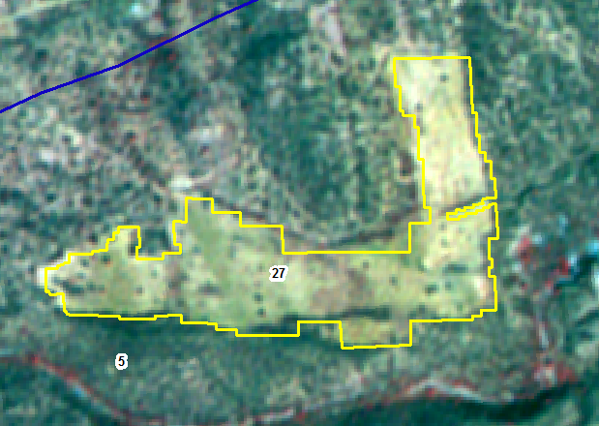
IRS_R2_LISS4_101-64-a-22-02-2018
IRS_R2_LISS4_101-64-a-24-jan-2019
SNO | Division | Range | Section | Beat | Block | Comp | Class | Change | Area_Ha | Longitude | Latitude | VSS | Sanctuary
27 | CHITTOOR EAST | PILER | PILER | TALAPULA | Marella | 5 | NF TO SF | POSITIVE | 14.83 | 78.95673 | 13.72739 | Chinthalabailu

Slide 28
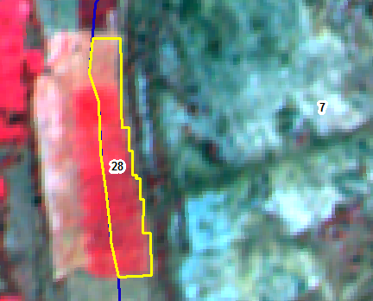
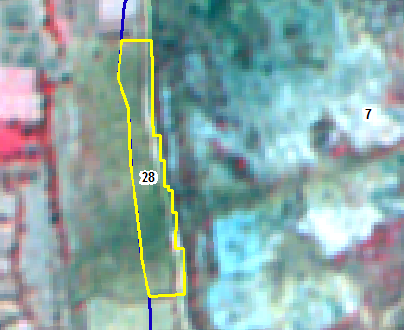
IRS_R2_LISS4_101-64-a-22-02-2018
IRS_R2_LISS4_101-64-a-24-jan-2019
SNO | Division | Range | Section | Beat | Block | Comp | Class | Change | Area_Ha | Longitude | Latitude | VSS | Sanctuary
28 | CHITTOOR EAST | PILER | PILER | VAGALLA | Marella | 7 | OF TO SF | NEGATIVE | 1.61 | 78.91787 | 13.74563

Slide 29
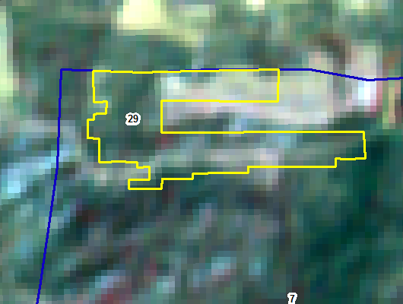
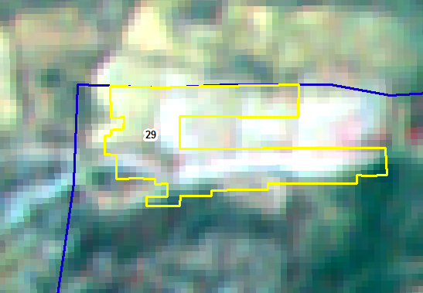
IRS_R2_LISS3_101-63-22-feb-2018
IRS_R2_LISS3_101-63-13-nov-2018
SNO | Division | Range | Section | Beat | Block | Comp | Class | Change | Area_Ha | Longitude | Latitude | VSS | Sanctuary
29 | CHITTOOR EAST | PILER | PILER | VAGALLA | Marella | 7 | SF TO NF | NEGATIVE | 1.19 | 78.93878 | 13.77124 | Gantavaripalli

Slide 30
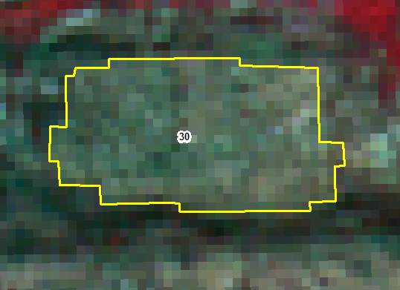
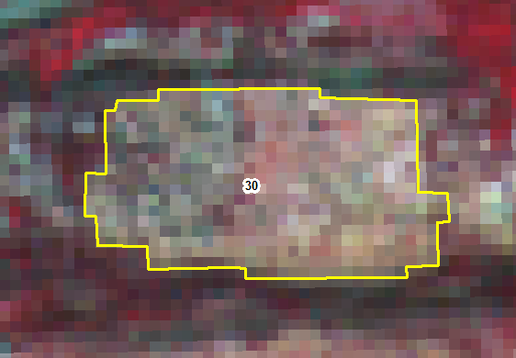
IRS_R2_LISS3_101-63-22-feb-2018
IRS_R2_LISS3_101-63-13-nov-2018
SNO | Division | Range | Section | Beat | Block | Comp | Class | Change | Area_Ha | Longitude | Latitude | VSS | Sanctuary
30 | CHITTOOR EAST | PILER | ROMPICHERLA | ROMPICHERLA | Peddamallela | 72 | NF TO SF | POSITIVE | 29.71 | 79.01806 | 13.72674 | Pathapalem

Slide 31
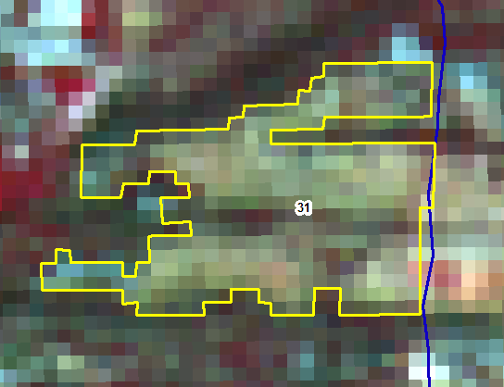
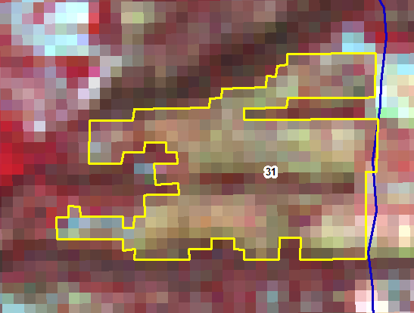
IRS_R2_LISS3_101-63-22-feb-2018
IRS_R2_LISS3_101-63-13-nov-2018
SNO | Division | Range | Section | Beat | Block | Comp | Class | Change | Area_Ha | Longitude | Latitude | VSS | Sanctuary
31 | CHITTOOR EAST | PILER | ROMPICHERLA | ROMPICHERLA | Peddamallela | 71 | NF TO SF | POSITIVE | 19.67 | 79.05606 | 13.73124

Slide 32
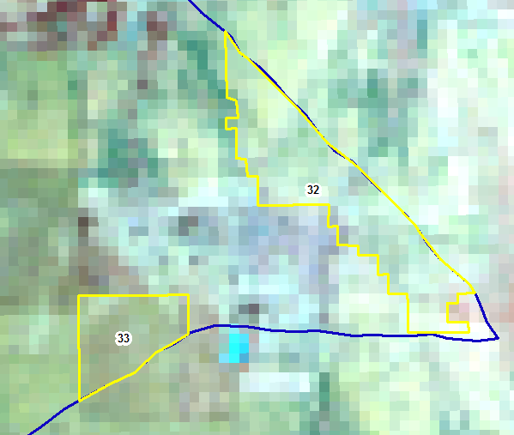
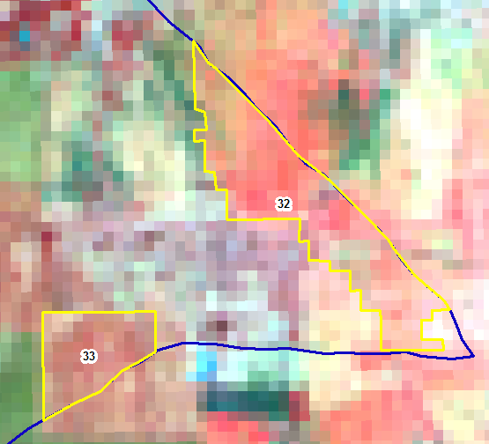
IRS_R2_LISS3_101-63-22-feb-2018
IRS_R2_LISS3_101-63-13-nov-2018
SNO | Division | Range | Section | Beat | Block | Comp | Class | Change | Area_Ha | Longitude | Latitude | VSS | Sanctuary
32 | CHITTOOR EAST | SRIKALAHASTI | CHINTHALAPALEM | CHINTALAPALEM | Pallam | 194 | NF TO SF | POSITIVE | 12.42 | 79.61674 | 13.79422 | Chinthalapalem
33 | CHITTOOR EAST | SRIKALAHASTI | CHINTHALAPALEM | CHINTALAPALEM | Pallam | 194 | NF TO SF | POSITIVE | 4.75 | 79.61205 | 13.79111 | Chinthalapalem

Slide 33
IRS_R2_LISS3_101-63-22-feb-2018
IRS_R2_LISS3_101-63-13-nov-2018
SNO | Division | Range | Section | Beat | Block | Comp | Class | Change | Area_Ha | Longitude | Latitude | VSS | Sanctuary
32 | CHITTOOR EAST | SRIKALAHASTI | CHINTHALAPALEM | CHINTALAPALEM | Pallam | 194 | NF TO SF | POSITIVE | 12.42 | 79.61674 | 13.79422 | Chinthalapalem
33 | CHITTOOR EAST | SRIKALAHASTI | CHINTHALAPALEM | CHINTALAPALEM | Pallam | 194 | NF TO SF | POSITIVE | 4.75 | 79.61205 | 13.79111 | Chinthalapalem

Slide 34
IRS_R2_LISS3_101-63-22-feb-2018
IRS_R2_LISS3_101-63-13-nov-2018
SNO | Division | Range | Section | Beat | Block | Comp | Class | Change | Area_Ha | Longitude | Latitude | VSS | Sanctuary
34 | CHITTOOR EAST | SRIKALAHASTI | CHINTHALAPALEM | CHINTALAPALEM | Pallam | 194 | SF TO NF | NEGATIVE | 2.97 | 79.59309 | 13.80836 | Chinthalapalem

Slide 35
IRS_R2_LISS3_101-63-22-feb-2018
IRS_R2_LISS3_101-63-13-nov-2018
SNO | Division | Range | Section | Beat | Block | Comp | Class | Change | Area_Ha | Longitude | Latitude | VSS | Sanctuary
35 | CHITTOOR EAST | SRIKALAHASTI | CHINTHALAPALEM | CHINTALAPALEM | Pallam | 194 | SF TO NF | NEGATIVE | 1.37 | 79.60621 | 13.80229 | Chinthalapalem
36 | CHITTOOR EAST | SRIKALAHASTI | CHINTHALAPALEM | CHINTALAPALEM | Pallam | 194 | SF TO NF | NEGATIVE | 0.89 | 79.60909 | 13.80186 | Chinthalapalem
37 | CHITTOOR EAST | SRIKALAHASTI | CHINTHALAPALEM | CHINTALAPALEM | Pallam | 194 | SF TO NF | NEGATIVE | 1.12 | 79.61146 | 13.80006 | Chinthalapalem
38 | CHITTOOR EAST | SRIKALAHASTI | CHINTHALAPALEM | CHINTALAPALEM | Pallam | 194 | SF TO NF | NEGATIVE | 0.56 | 79.61046 | 13.80092 | Chinthalapalem

Slide 36
IRS_R2_LISS3_101-63-22-feb-2018
IRS_R2_LISS3_101-63-13-nov-2018
SNO | Division | Range | Section | Beat | Block | Comp | Class | Change | Area_Ha | Longitude | Latitude | VSS | Sanctuary
35 | CHITTOOR EAST | SRIKALAHASTI | CHINTHALAPALEM | CHINTALAPALEM | Pallam | 194 | SF TO NF | NEGATIVE | 1.37 | 79.60621 | 13.80229 | Chinthalapalem
36 | CHITTOOR EAST | SRIKALAHASTI | CHINTHALAPALEM | CHINTALAPALEM | Pallam | 194 | SF TO NF | NEGATIVE | 0.89 | 79.60909 | 13.80186 | Chinthalapalem
37 | CHITTOOR EAST | SRIKALAHASTI | CHINTHALAPALEM | CHINTALAPALEM | Pallam | 194 | SF TO NF | NEGATIVE | 1.12 | 79.61146 | 13.80006 | Chinthalapalem
38 | CHITTOOR EAST | SRIKALAHASTI | CHINTHALAPALEM | CHINTALAPALEM | Pallam | 194 | SF TO NF | NEGATIVE | 0.56 | 79.61046 | 13.80092 | Chinthalapalem

Slide 37
IRS_R2_LISS3_101-63-22-feb-2018
IRS_R2_LISS3_101-63-13-nov-2018
SNO | Division | Range | Section | Beat | Block | Comp | Class | Change | Area_Ha | Longitude | Latitude | VSS | Sanctuary
35 | CHITTOOR EAST | SRIKALAHASTI | CHINTHALAPALEM | CHINTALAPALEM | Pallam | 194 | SF TO NF | NEGATIVE | 1.37 | 79.60621 | 13.80229 | Chinthalapalem
36 | CHITTOOR EAST | SRIKALAHASTI | CHINTHALAPALEM | CHINTALAPALEM | Pallam | 194 | SF TO NF | NEGATIVE | 0.89 | 79.60909 | 13.80186 | Chinthalapalem
37 | CHITTOOR EAST | SRIKALAHASTI | CHINTHALAPALEM | CHINTALAPALEM | Pallam | 194 | SF TO NF | NEGATIVE | 1.12 | 79.61146 | 13.80006 | Chinthalapalem
38 | CHITTOOR EAST | SRIKALAHASTI | CHINTHALAPALEM | CHINTALAPALEM | Pallam | 194 | SF TO NF | NEGATIVE | 0.56 | 79.61046 | 13.80092 | Chinthalapalem

Slide 38
IRS_R2_LISS3_101-63-22-feb-2018
IRS_R2_LISS3_101-63-13-nov-2018
SNO | Division | Range | Section | Beat | Block | Comp | Class | Change | Area_Ha | Longitude | Latitude | VSS | Sanctuary
35 | CHITTOOR EAST | SRIKALAHASTI | CHINTHALAPALEM | CHINTALAPALEM | Pallam | 194 | SF TO NF | NEGATIVE | 1.37 | 79.60621 | 13.80229 | Chinthalapalem
36 | CHITTOOR EAST | SRIKALAHASTI | CHINTHALAPALEM | CHINTALAPALEM | Pallam | 194 | SF TO NF | NEGATIVE | 0.89 | 79.60909 | 13.80186 | Chinthalapalem
37 | CHITTOOR EAST | SRIKALAHASTI | CHINTHALAPALEM | CHINTALAPALEM | Pallam | 194 | SF TO NF | NEGATIVE | 1.12 | 79.61146 | 13.80006 | Chinthalapalem
38 | CHITTOOR EAST | SRIKALAHASTI | CHINTHALAPALEM | CHINTALAPALEM | Pallam | 194 | SF TO NF | NEGATIVE | 0.56 | 79.61046 | 13.80092 | Chinthalapalem

Slide 39
IRS_R2_LISS3_101-63-22-feb-2018
IRS_R2_LISS3_101-63-13-nov-2018
SNO | Division | Range | Section | Beat | Block | Comp | Class | Change | Area_Ha | Longitude | Latitude | VSS | Sanctuary
39 | CHITTOOR EAST | SRIKALAHASTI | CHINTHALAPALEM | KUNTIPUDI | Gollapalli | 186 | OF TO NF | NEGATIVE | 2.08 | 79.53039 | 13.80578
40 | CHITTOOR EAST | SRIKALAHASTI | CHINTHALAPALEM | KUNTIPUDI | Gollapalli | 186 | NF TO SF | POSITIVE | 3.69 | 79.5277 | 13.80581

Slide 40
IRS_R2_LISS3_101-63-22-feb-2018
IRS_R2_LISS3_101-63-13-nov-2018
SNO | Division | Range | Section | Beat | Block | Comp | Class | Change | Area_Ha | Longitude | Latitude | VSS | Sanctuary
39 | CHITTOOR EAST | SRIKALAHASTI | CHINTHALAPALEM | KUNTIPUDI | Gollapalli | 186 | OF TO NF | NEGATIVE | 2.08 | 79.53039 | 13.80578
40 | CHITTOOR EAST | SRIKALAHASTI | CHINTHALAPALEM | KUNTIPUDI | Gollapalli | 186 | NF TO SF | POSITIVE | 3.69 | 79.5277 | 13.80581

Slide 41
IRS_R2_LISS3_101-63-22-feb-2018
IRS_R2_LISS3_101-63-13-nov-2018
SNO | Division | Range | Section | Beat | Block | Comp | Class | Change | Area_Ha | Longitude | Latitude | VSS | Sanctuary
41 | CHITTOOR EAST | SRIKALAHASTI | CHINTHALAPALEM | KUNTIPUDI | Gollapalli | 186 | OF TO NF | NEGATIVE | 2.24 | 79.52247 | 13.81476 | Kothur
42 | CHITTOOR EAST | SRIKALAHASTI | CHINTHALAPALEM | KUNTIPUDI | Gollapalli | 186 | SF TO NF | NEGATIVE | 0.8 | 79.52287 | 13.81714

Slide 42
IRS_R2_LISS3_101-63-22-feb-2018
IRS_R2_LISS3_101-63-13-nov-2018
SNO | Division | Range | Section | Beat | Block | Comp | Class | Change | Area_Ha | Longitude | Latitude | VSS | Sanctuary
41 | CHITTOOR EAST | SRIKALAHASTI | CHINTHALAPALEM | KUNTIPUDI | Gollapalli | 186 | OF TO NF | NEGATIVE | 2.24 | 79.52247 | 13.81476 | Kothur
42 | CHITTOOR EAST | SRIKALAHASTI | CHINTHALAPALEM | KUNTIPUDI | Gollapalli | 186 | SF TO NF | NEGATIVE | 0.8 | 79.52287 | 13.81714

Slide 43
IRS_R2_LISS3_101-63-22-feb-2018
IRS_R2_LISS3_101-63-13-nov-2018
SNO | Division | Range | Section | Beat | Block | Comp | Class | Change | Area_Ha | Longitude | Latitude | VSS | Sanctuary
43 | CHITTOOR EAST | SRIKALAHASTI | PALLAM | MANNAVARAM | Venkatagiri | 172 | SF TO NF | NEGATIVE | 0.86 | 79.52561 | 13.90319 | Mannamvaram

Slide 44
IRS_R2_LISS3_101-63-22-feb-2018
IRS_R2_LISS3_101-63-13-nov-2018
SNO | Division | Range | Section | Beat | Block | Comp | Class | Change | Area_Ha | Longitude | Latitude | VSS | Sanctuary
44 | CHITTOOR EAST | SRIKALAHASTI | PALLAM | MANNAVARAM | Venkatagiri | 172 | NF TO SF | POSITIVE | 3.46 | 79.53316 | 13.9161

Slide 45
IRS_R2_LISS3_101-63-22-feb-2018
IRS_R2_LISS3_101-63-13-nov-2018
SNO | Division | Range | Section | Beat | Block | Comp | Class | Change | Area_Ha | Longitude | Latitude | VSS | Sanctuary
45 | CHITTOOR EAST | SRIKALAHASTI | PALLAM | MANNAVARAM | Venkatagiri | 172 | NF TO SF | POSITIVE | 0.45 | 79.52746 | 13.9145
46 | CHITTOOR EAST | SRIKALAHASTI | PALLAM | MANNAVARAM | Venkatagiri | 172 | NF TO SF | POSITIVE | 0.23 | 79.52813 | 13.9145

Slide 46
IRS_R2_LISS3_101-63-22-feb-2018
IRS_R2_LISS3_101-63-13-nov-2018
SNO | Division | Range | Section | Beat | Block | Comp | Class | Change | Area_Ha | Longitude | Latitude | VSS | Sanctuary
45 | CHITTOOR EAST | SRIKALAHASTI | PALLAM | MANNAVARAM | Venkatagiri | 172 | NF TO SF | POSITIVE | 0.45 | 79.52746 | 13.9145
46 | CHITTOOR EAST | SRIKALAHASTI | PALLAM | MANNAVARAM | Venkatagiri | 172 | NF TO SF | POSITIVE | 0.23 | 79.52813 | 13.9145

Slide 47
IRS_R2_LISS3_101-63-22-feb-2018
IRS_R2_LISS3_101-63-13-nov-2018
SNO | Division | Range | Section | Beat | Block | Comp | Class | Change | Area_Ha | Longitude | Latitude | VSS | Sanctuary
47 | CHITTOOR EAST | SRIKALAHASTI | PALLAM | MELACHUR | Gollapalli | 182 | SF TO OF | POSITIVE | 8.22 | 79.50317 | 13.85465 | Melachuru
48 | CHITTOOR EAST | SRIKALAHASTI | PALLAM | MELACHUR | Gollapalli | 182 | SF TO OF | POSITIVE | 1.15 | 79.50036 | 13.85227 | Melachuru

Slide 48
IRS_R2_LISS3_101-63-22-feb-2018
IRS_R2_LISS3_101-63-13-nov-2018
SNO | Division | Range | Section | Beat | Block | Comp | Class | Change | Area_Ha | Longitude | Latitude | VSS | Sanctuary
47 | CHITTOOR EAST | SRIKALAHASTI | PALLAM | MELACHUR | Gollapalli | 182 | SF TO OF | POSITIVE | 8.22 | 79.50317 | 13.85465 | Melachuru
48 | CHITTOOR EAST | SRIKALAHASTI | PALLAM | MELACHUR | Gollapalli | 182 | SF TO OF | POSITIVE | 1.15 | 79.50036 | 13.85227 | Melachuru

Slide 49
IRS_R2_LISS4_101-64-a-22-02-2018
IRS_R2_LISS4_101-64-a-24-jan-2019
SNO | Division | Range | Section | Beat | Block | Comp | Class | Change | Area_Ha | Longitude | Latitude | VSS | Sanctuary
49 | CHITTOOR EAST | TIRUPATI | CHANDRAGIRI | DORNAKAMBALA | Panapakam | 429 | NF TO SF | POSITIVE | 0.59 | 79.24772 | 13.49004 | Panapakam Sc Colony
53 | CHITTOOR EAST | TIRUPATI | CHANDRAGIRI | DORNAKAMBALA | Bopparajupalli | 381 | OF TO NF | NEGATIVE | 0.35 | 79.24833 | 13.48873
55 | CHITTOOR EAST | TIRUPATI | CHANDRAGIRI | DORNAKAMBALA | Bopparajupalli | 381 | NF TO SF | POSITIVE | 0.05 | 79.24863 | 13.48969

Slide 50
IRS_R2_LISS4_ 101-64-b-6-mar-18
IRS_R2_LISS4_101-64-a-24-jan-2019
SNO | Division | Range | Section | Beat | Block | Comp | Class | Change | Area_Ha | Longitude | Latitude | VSS | Sanctuary
50 | CHITTOOR EAST | TIRUPATI | CHANDRAGIRI | DORNAKAMBALA | Bopparajupalli | 381 | NF TO SF | POSITIVE | 3.55 | 79.27184 | 13.5058

Slide 51
IRS_R2_LISS4_ 101-64-b-6-mar-18
IRS_R2_LISS4_101-64-a-24-jan-2019
SNO | Division | Range | Section | Beat | Block | Comp | Class | Change | Area_Ha | Longitude | Latitude | VSS | Sanctuary
51 | CHITTOOR EAST | TIRUPATI | CHANDRAGIRI | DORNAKAMBALA | Bopparajupalli | 381 | SF TO NF | NEGATIVE | 0.76 | 79.27694 | 13.50637
52 | CHITTOOR EAST | TIRUPATI | CHANDRAGIRI | DORNAKAMBALA | Bopparajupalli | 381 | OF TO NF | NEGATIVE | 0.53 | 79.27879 | 13.50619
54 | CHITTOOR EAST | TIRUPATI | CHANDRAGIRI | DORNAKAMBALA | Bopparajupalli | 381 | OF TO NF | NEGATIVE | 0.08 | 79.27921 | 13.5065

Slide 52
IRS_R2_LISS4_ 101-64-b-6-mar-18
IRS_R2_LISS4_101-64-a-24-jan-2019
SNO | Division | Range | Section | Beat | Block | Comp | Class | Change | Area_Ha | Longitude | Latitude | VSS | Sanctuary
51 | CHITTOOR EAST | TIRUPATI | CHANDRAGIRI | DORNAKAMBALA | Bopparajupalli | 381 | SF TO NF | NEGATIVE | 0.76 | 79.27694 | 13.50637
52 | CHITTOOR EAST | TIRUPATI | CHANDRAGIRI | DORNAKAMBALA | Bopparajupalli | 381 | OF TO NF | NEGATIVE | 0.53 | 79.27879 | 13.50619
54 | CHITTOOR EAST | TIRUPATI | CHANDRAGIRI | DORNAKAMBALA | Bopparajupalli | 381 | OF TO NF | NEGATIVE | 0.08 | 79.27921 | 13.5065

Slide 53
IRS_R2_LISS4_101-64-a-22-02-2018
IRS_R2_LISS4_101-64-a-24-jan-2019
SNO | Division | Range | Section | Beat | Block | Comp | Class | Change | Area_Ha | Longitude | Latitude | VSS | Sanctuary
49 | CHITTOOR EAST | TIRUPATI | CHANDRAGIRI | DORNAKAMBALA | Panapakam | 429 | NF TO SF | POSITIVE | 0.59 | 79.24772 | 13.49004 | Panapakam Sc Colony
53 | CHITTOOR EAST | TIRUPATI | CHANDRAGIRI | DORNAKAMBALA | Bopparajupalli | 381 | OF TO NF | NEGATIVE | 0.35 | 79.24833 | 13.48873
55 | CHITTOOR EAST | TIRUPATI | CHANDRAGIRI | DORNAKAMBALA | Bopparajupalli | 381 | NF TO SF | POSITIVE | 0.05 | 79.24863 | 13.48969

Slide 54
IRS_R2_LISS4_ 101-64-b-6-mar-18
IRS_R2_LISS4_101-64-a-24-jan-2019
SNO | Division | Range | Section | Beat | Block | Comp | Class | Change | Area_Ha | Longitude | Latitude | VSS | Sanctuary
51 | CHITTOOR EAST | TIRUPATI | CHANDRAGIRI | DORNAKAMBALA | Bopparajupalli | 381 | SF TO NF | NEGATIVE | 0.76 | 79.27694 | 13.50637
52 | CHITTOOR EAST | TIRUPATI | CHANDRAGIRI | DORNAKAMBALA | Bopparajupalli | 381 | OF TO NF | NEGATIVE | 0.53 | 79.27879 | 13.50619
54 | CHITTOOR EAST | TIRUPATI | CHANDRAGIRI | DORNAKAMBALA | Bopparajupalli | 381 | OF TO NF | NEGATIVE | 0.08 | 79.27921 | 13.5065

Slide 55
IRS_R2_LISS4_101-64-a-22-02-2018
IRS_R2_LISS4_101-64-a-24-jan-2019
SNO | Division | Range | Section | Beat | Block | Comp | Class | Change | Area_Ha | Longitude | Latitude | VSS | Sanctuary
49 | CHITTOOR EAST | TIRUPATI | CHANDRAGIRI | DORNAKAMBALA | Panapakam | 429 | NF TO SF | POSITIVE | 0.59 | 79.24772 | 13.49004 | Panapakam Sc Colony
53 | CHITTOOR EAST | TIRUPATI | CHANDRAGIRI | DORNAKAMBALA | Bopparajupalli | 381 | OF TO NF | NEGATIVE | 0.35 | 79.24833 | 13.48873
55 | CHITTOOR EAST | TIRUPATI | CHANDRAGIRI | DORNAKAMBALA | Bopparajupalli | 381 | NF TO SF | POSITIVE | 0.05 | 79.24863 | 13.48969

Slide 56
IRS_R2_LISS4_101-64-a-22-02-2018
IRS_R2_LISS4_101-64-a-24-jan-2019
SNO | Division | Range | Section | Beat | Block | Comp | Class | Change | Area_Ha | Longitude | Latitude | VSS | Sanctuary
56 | CHITTOOR EAST | TIRUPATI | PANAPAKAM | MUNGILIPATTU | Mungiliputtu | 96 | NF TO SF | POSITIVE | 10.05 | 79.1714 | 13.50825 | Ganugapenta
57 | CHITTOOR EAST | TIRUPATI | PANAPAKAM | MUNGILIPATTU | Mungiliputtu | 96 | NF TO SF | POSITIVE | 7.77 | 79.16971 | 13.50941 | Ganugapenta
63 | CHITTOOR EAST | TIRUPATI | PANAPAKAM | NENDRAGUNTA | Mungiliputtu | 95 | NF TO SF | POSITIVE | 1.14 | 79.17295 | 13.50715 | Chinnapapaiahgari Palli

Slide 57
IRS_R2_LISS4_101-64-a-22-02-2018
IRS_R2_LISS4_101-64-a-24-jan-2019
SNO | Division | Range | Section | Beat | Block | Comp | Class | Change | Area_Ha | Longitude | Latitude | VSS | Sanctuary
56 | CHITTOOR EAST | TIRUPATI | PANAPAKAM | MUNGILIPATTU | Mungiliputtu | 96 | NF TO SF | POSITIVE | 10.05 | 79.1714 | 13.50825 | Ganugapenta
57 | CHITTOOR EAST | TIRUPATI | PANAPAKAM | MUNGILIPATTU | Mungiliputtu | 96 | NF TO SF | POSITIVE | 7.77 | 79.16971 | 13.50941 | Ganugapenta
63 | CHITTOOR EAST | TIRUPATI | PANAPAKAM | NENDRAGUNTA | Mungiliputtu | 95 | NF TO SF | POSITIVE | 1.14 | 79.17295 | 13.50715 | Chinnapapaiahgari Palli

Slide 58
IRS_R2_LISS4_101-64-a-22-02-2018
IRS_R2_LISS4_101-64-a-24-jan-2019
SNO | Division | Range | Section | Beat | Block | Comp | Class | Change | Area_Ha | Longitude | Latitude | VSS | Sanctuary
58 | CHITTOOR EAST | TIRUPATI | PANAPAKAM | NENDRAGUNTA | Mungiliputtu | 95 | SF TO OF | POSITIVE | 15.17 | 79.19794 | 13.49411
64 | CHITTOOR EAST | TIRUPATI | PANAPAKAM | NENDRAGUNTA | Mungiliputtu | 97 | SF TO OF | POSITIVE | 7.83 | 79.19665 | 13.49021

Slide 59
IRS_R2_LISS4_101-64-a-22-02-2018
IRS_R2_LISS4_101-64-a-24-jan-2019
SNO | Division | Range | Section | Beat | Block | Comp | Class | Change | Area_Ha | Longitude | Latitude | VSS | Sanctuary
59 | CHITTOOR EAST | TIRUPATI | PANAPAKAM | NENDRAGUNTA | Mungiliputtu | 97 | SF TO OF | POSITIVE | 1.27 | 79.17987 | 13.47775

Slide 60
IRS_R2_LISS4_101-64-a-22-02-2018
IRS_R2_LISS4_101-64-a-24-jan-2019
SNO | Division | Range | Section | Beat | Block | Comp | Class | Change | Area_Ha | Longitude | Latitude | VSS | Sanctuary
60 | CHITTOOR EAST | TIRUPATI | PANAPAKAM | NENDRAGUNTA | Pakala B | 102 | OF TO NF | NEGATIVE | 0.29 | 79.15603 | 13.46604
61 | CHITTOOR EAST | TIRUPATI | PANAPAKAM | NENDRAGUNTA | Pakala B | 102 | SF TO NF | NEGATIVE | 0.25 | 79.15721 | 13.46502

Slide 61
IRS_R2_LISS4_101-64-a-22-02-2018
IRS_R2_LISS4_101-64-a-24-jan-2019
SNO | Division | Range | Section | Beat | Block | Comp | Class | Change | Area_Ha | Longitude | Latitude | VSS | Sanctuary
60 | CHITTOOR EAST | TIRUPATI | PANAPAKAM | NENDRAGUNTA | Pakala B | 102 | OF TO NF | NEGATIVE | 0.29 | 79.15603 | 13.46604
61 | CHITTOOR EAST | TIRUPATI | PANAPAKAM | NENDRAGUNTA | Pakala B | 102 | SF TO NF | NEGATIVE | 0.25 | 79.15721 | 13.46502

Slide 62
IRS_R2_LISS4_101-64-a-22-02-2018
IRS_R2_LISS4_101-64-a-24-jan-2019
SNO | Division | Range | Section | Beat | Block | Comp | Class | Change | Area_Ha | Longitude | Latitude | VSS | Sanctuary
62 | CHITTOOR EAST | TIRUPATI | PANAPAKAM | NENDRAGUNTA | Mungiliputtu | 95 | NF TO SF | POSITIVE | 21.45 | 79.16286 | 13.50398 | Ganugapenta

Slide 63
IRS_R2_LISS4_101-64-a-22-02-2018
IRS_R2_LISS4_101-64-a-24-jan-2019
SNO | Division | Range | Section | Beat | Block | Comp | Class | Change | Area_Ha | Longitude | Latitude | VSS | Sanctuary
56 | CHITTOOR EAST | TIRUPATI | PANAPAKAM | MUNGILIPATTU | Mungiliputtu | 96 | NF TO SF | POSITIVE | 10.05 | 79.1714 | 13.50825 | Ganugapenta
57 | CHITTOOR EAST | TIRUPATI | PANAPAKAM | MUNGILIPATTU | Mungiliputtu | 96 | NF TO SF | POSITIVE | 7.77 | 79.16971 | 13.50941 | Ganugapenta
63 | CHITTOOR EAST | TIRUPATI | PANAPAKAM | NENDRAGUNTA | Mungiliputtu | 95 | NF TO SF | POSITIVE | 1.14 | 79.17295 | 13.50715 | Chinnapapaiahgari Palli

Slide 64
IRS_R2_LISS4_101-64-a-22-02-2018
IRS_R2_LISS4_101-64-a-24-jan-2019
SNO | Division | Range | Section | Beat | Block | Comp | Class | Change | Area_Ha | Longitude | Latitude | VSS | Sanctuary
58 | CHITTOOR EAST | TIRUPATI | PANAPAKAM | NENDRAGUNTA | Mungiliputtu | 95 | SF TO OF | POSITIVE | 15.17 | 79.19794 | 13.49411
64 | CHITTOOR EAST | TIRUPATI | PANAPAKAM | NENDRAGUNTA | Mungiliputtu | 97 | SF TO OF | POSITIVE | 7.83 | 79.19665 | 13.49021

Slide 65
IRS_R2_LISS4_101-64-a-22-02-2018
IRS_R2_LISS4_101-64-a-24-jan-2019
SNO | Division | Range | Section | Beat | Block | Comp | Class | Change | Area_Ha | Longitude | Latitude | VSS | Sanctuary
65 | CHITTOOR EAST | TIRUPATI | PANAPAKAM | PANAPAKAM | Panapakam | 430 | SF TO NF | NEGATIVE | 0.32 | 79.22277 | 13.49289 | Panapakam Sc Colony
66 | CHITTOOR EAST | TIRUPATI | PANAPAKAM | PANAPAKAM | Panapakam | 430 | OF TO NF | NEGATIVE | 0.16 | 79.22186 | 13.49256 | Panapakam Sc Colony

Slide 66
IRS_R2_LISS4_101-64-a-22-02-2018
IRS_R2_LISS4_101-64-a-24-jan-2019
SNO | Division | Range | Section | Beat | Block | Comp | Class | Change | Area_Ha | Longitude | Latitude | VSS | Sanctuary
65 | CHITTOOR EAST | TIRUPATI | PANAPAKAM | PANAPAKAM | Panapakam | 430 | SF TO NF | NEGATIVE | 0.32 | 79.22277 | 13.49289 | Panapakam Sc Colony
66 | CHITTOOR EAST | TIRUPATI | PANAPAKAM | PANAPAKAM | Panapakam | 430 | OF TO NF | NEGATIVE | 0.16 | 79.22186 | 13.49256 | Panapakam Sc Colony

Slide 67
IRS_R2_LISS4_101-64-a-22-02-2018
IRS_R2_LISS4_101-64-a-24-jan-2019
SNO | Division | Range | Section | Beat | Block | Comp | Class | Change | Area_Ha | Longitude | Latitude | VSS | Sanctuary
67 | CHITTOOR EAST | TIRUPATI | PANAPAKAM | PANAPAKAM | Panapakam | 430 | SF TO NF | NEGATIVE | 0.23 | 79.22361 | 13.4962 | Panapakam Sc Colony

Slide 68
IRS_R2_LISS4_101-64-a-22-02-2018
IRS_R2_LISS4_101-64-a-24-jan-2019
SNO | Division | Range | Section | Beat | Block | Comp | Class | Change | Area_Ha | Longitude | Latitude | VSS | Sanctuary
68 | CHITTOOR EAST | TIRUPATI | PANAPAKAM | PANAPAKAM | Panapakam | 433 | SF TO OF | POSITIVE | 2.63 | 79.18826 | 13.47054 | Gadhanki

Slide 69
IRS_R2_LISS4_101-64-a-22-02-2018
IRS_R2_LISS4_101-64-a-24-jan-2019
SNO | Division | Range | Section | Beat | Block | Comp | Class | Change | Area_Ha | Longitude | Latitude | VSS | Sanctuary
69 | CHITTOOR EAST | TIRUPATI | PANAPAKAM | PANAPAKAM | Panapakam | 433 | NF TO SF | POSITIVE | 0.66 | 79.18579 | 13.47514 | Gadhanki

Slide 70
IRS_R2_LISS4_101-64-a-22-02-2018
IRS_R2_LISS4_101-64-a-24-jan-2019
SNO | Division | Range | Section | Beat | Block | Comp | Class | Change | Area_Ha | Longitude | Latitude | VSS | Sanctuary
70 | CHITTOOR EAST | TIRUPATI | PANAPAKAM | PANAPAKAM | Panapakam | 430 | NF TO SF | POSITIVE | 0.09 | 79.22144 | 13.49046 | Arigelavaripalli
71 | CHITTOOR EAST | TIRUPATI | PANAPAKAM | PANAPAKAM | Panapakam | 430 | NF TO SF | POSITIVE | 0.08 | 79.22083 | 13.49058 | Arigelavaripalli
72 | CHITTOOR EAST | TIRUPATI | PANAPAKAM | PANAPAKAM | Panapakam | 430 | NF TO SF | POSITIVE | 0.12 | 79.22144 | 13.49098 | Arigelavaripalli

Slide 71
IRS_R2_LISS4_101-64-a-22-02-2018
IRS_R2_LISS4_101-64-a-24-jan-2019
SNO | Division | Range | Section | Beat | Block | Comp | Class | Change | Area_Ha | Longitude | Latitude | VSS | Sanctuary
70 | CHITTOOR EAST | TIRUPATI | PANAPAKAM | PANAPAKAM | Panapakam | 430 | NF TO SF | POSITIVE | 0.09 | 79.22144 | 13.49046 | Arigelavaripalli
71 | CHITTOOR EAST | TIRUPATI | PANAPAKAM | PANAPAKAM | Panapakam | 430 | NF TO SF | POSITIVE | 0.08 | 79.22083 | 13.49058 | Arigelavaripalli
72 | CHITTOOR EAST | TIRUPATI | PANAPAKAM | PANAPAKAM | Panapakam | 430 | NF TO SF | POSITIVE | 0.12 | 79.22144 | 13.49098 | Arigelavaripalli

Slide 72
IRS_R2_LISS4_101-64-a-22-02-2018
IRS_R2_LISS4_101-64-a-24-jan-2019
SNO | Division | Range | Section | Beat | Block | Comp | Class | Change | Area_Ha | Longitude | Latitude | VSS | Sanctuary
70 | CHITTOOR EAST | TIRUPATI | PANAPAKAM | PANAPAKAM | Panapakam | 430 | NF TO SF | POSITIVE | 0.09 | 79.22144 | 13.49046 | Arigelavaripalli
71 | CHITTOOR EAST | TIRUPATI | PANAPAKAM | PANAPAKAM | Panapakam | 430 | NF TO SF | POSITIVE | 0.08 | 79.22083 | 13.49058 | Arigelavaripalli
72 | CHITTOOR EAST | TIRUPATI | PANAPAKAM | PANAPAKAM | Panapakam | 430 | NF TO SF | POSITIVE | 0.12 | 79.22144 | 13.49098 | Arigelavaripalli

Slide 73
IRS_R2_LISS3_101-63-22-feb-2018
IRS_R2_LISS3_101-63-13-nov-2018
SNO | Division | Range | Section | Beat | Block | Comp | Class | Change | Area_Ha | Longitude | Latitude | VSS | Sanctuary
73 | CHITTOOR EAST | TIRUPATI | PAPANAIDUPETA | P.GOLLAPALLI | Narayanavanam | 363 | NF TO SF | POSITIVE | 6.97 | 79.55877 | 13.55069 | Ramasamudram
74 | CHITTOOR EAST | TIRUPATI | PAPANAIDUPETA | P.GOLLAPALLI | Narayanavanam | 363 | NF TO SF | POSITIVE | 2.89 | 79.56255 | 13.55172 | L.M Kandriga

Slide 74
IRS_R2_LISS3_101-63-22-feb-2018
IRS_R2_LISS3_101-63-13-nov-2018
SNO | Division | Range | Section | Beat | Block | Comp | Class | Change | Area_Ha | Longitude | Latitude | VSS | Sanctuary
73 | CHITTOOR EAST | TIRUPATI | PAPANAIDUPETA | P.GOLLAPALLI | Narayanavanam | 363 | NF TO SF | POSITIVE | 6.97 | 79.55877 | 13.55069 | Ramasamudram
74 | CHITTOOR EAST | TIRUPATI | PAPANAIDUPETA | P.GOLLAPALLI | Narayanavanam | 363 | NF TO SF | POSITIVE | 2.89 | 79.56255 | 13.55172 | L.M Kandriga

Slide 75
IRS_R2_LISS3_101-63-22-feb-2018
IRS_R2_LISS3_101-63-13-nov-2018
SNO | Division | Range | Section | Beat | Block | Comp | Class | Change | Area_Ha | Longitude | Latitude | VSS | Sanctuary
75 | CHITTOOR EAST | TIRUPATI | PAPANAIDUPETA | P.GOLLAPALLI | Narayanavanam | 230 | NF TO SF | POSITIVE | 17.55 | 79.56502 | 13.5622 | L.M Kandriga
76 | CHITTOOR EAST | TIRUPATI | PAPANAIDUPETA | P.GOLLAPALLI | Narayanavanam | 230 | NF TO SF | POSITIVE | 17.33 | 79.56829 | 13.56623 | L.M Kandriga

Slide 76
IRS_R2_LISS3_101-63-22-feb-2018
IRS_R2_LISS3_101-63-13-nov-2018
SNO | Division | Range | Section | Beat | Block | Comp | Class | Change | Area_Ha | Longitude | Latitude | VSS | Sanctuary
75 | CHITTOOR EAST | TIRUPATI | PAPANAIDUPETA | P.GOLLAPALLI | Narayanavanam | 230 | NF TO SF | POSITIVE | 17.55 | 79.56502 | 13.5622 | L.M Kandriga
76 | CHITTOOR EAST | TIRUPATI | PAPANAIDUPETA | P.GOLLAPALLI | Narayanavanam | 230 | NF TO SF | POSITIVE | 17.33 | 79.56829 | 13.56623 | L.M Kandriga

Slide 77
IRS_R2_LISS3_101-63-22-feb-2018
IRS_R2_LISS3_101-63-13-nov-2018
SNO | Division | Range | Section | Beat | Block | Comp | Class | Change | Area_Ha | Longitude | Latitude | VSS | Sanctuary
77 | CHITTOOR EAST | TIRUPATI | PAPANAIDUPETA | YERPEDU | Yerpedu | 190 | NF TO SF | POSITIVE | 20 | 79.58248 | 13.74646 | Krishnampalli

Slide 78
IRS_R2_LISS3_101-63-22-feb-2018
IRS_R2_LISS3_101-63-13-nov-2018
SNO | Division | Range | Section | Beat | Block | Comp | Class | Change | Area_Ha | Longitude | Latitude | VSS | Sanctuary
78 | CHITTOOR EAST | TIRUPATI | PAPANAIDUPETA | YERPEDU | Yerpedu | 191 | NF TO SF | POSITIVE | 21.3 | 79.57791 | 13.73713

Slide 79
IRS_R2_LISS3_101-63-22-feb-2018
IRS_R2_LISS3_101-63-13-nov-2018
SNO | Division | Range | Section | Beat | Block | Comp | Class | Change | Area_Ha | Longitude | Latitude | VSS | Sanctuary
79 | CHITTOOR EAST | TIRUPATI | PAPANAIDUPETA | YERPEDU | Yerpedu | 192 | NF TO SF | POSITIVE | 23.55 | 79.57953 | 13.69282 | Erpedu

Slide 80
IRS_R2_LISS3_101-63-22-feb-2018
IRS_R2_LISS3_101-63-13-nov-2018
SNO | Division | Range | Section | Beat | Block | Comp | Class | Change | Area_Ha | Longitude | Latitude | VSS | Sanctuary
80 | CHITTOOR EAST | TIRUPATI | PAPANAIDUPETA | YERPEDU | Yerpedu | 193 | NF TO SF | POSITIVE | 20.07 | 79.56799 | 13.69306 | Pothumanukunta

Slide 81
IRS_R2_LISS3_101-63-22-feb-2018
IRS_R2_LISS3_101-63-13-nov-2018
SNO | Division | Range | Section | Beat | Block | Comp | Class | Change | Area_Ha | Longitude | Latitude | VSS | Sanctuary
81 | CHITTOOR EAST | TIRUPATI | PAPANAIDUPETA | YERPEDU | Yerpedu | 191 | OF TO NF | NEGATIVE | 2.38 | 79.5792 | 13.72129

