Slide 1
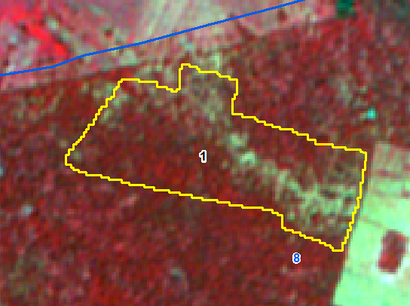
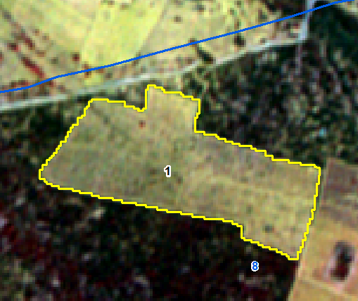
IRS R2 LISS IV Imagery 20-Oct-2017
IRS R2 LISS IV Imagery 12-feb-2019
Sno | Division | Range | Section | Beat | Block | Comp | Class | Change | Area_Ha | Longitude | Latitude | VSS | Sanctuary
1 | CHITTOOR WEST | MADANAPALLE | TAMBALAPALLE | VEPURIKOTA | Bathalapuram | 8 | DF TO NF | NEGATIVE | 10.97 | 78.284639 | 13.737340

Slide 2
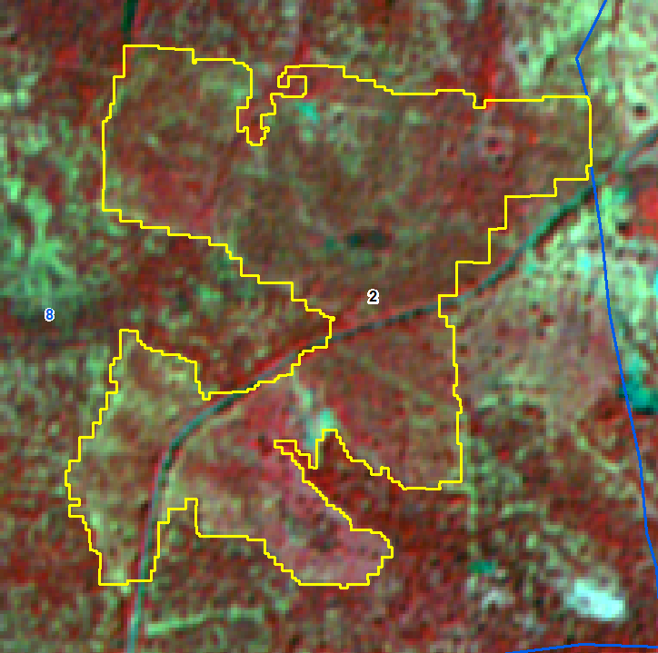
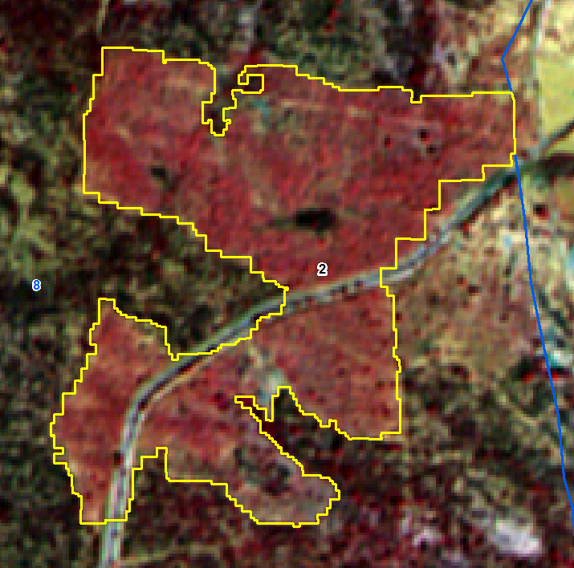
IRS R2 LISS IV Imagery 20-Oct-2017
IRS R2 LISS IV Imagery 12-feb-2019
Sno | Division | Range | Section | Beat | Block | Comp | Class | Change | Area_Ha | Longitude | Latitude | VSS | Sanctuary
2 | CHITTOOR WEST | MADANAPALLE | TAMBALAPALLE | VEPURIKOTA | Bathalapuram | 8 | SF TO OF | POSITIVE | 32.31 | 78.290211 | 13.725494 | Dharmavandlapalli

Slide 3
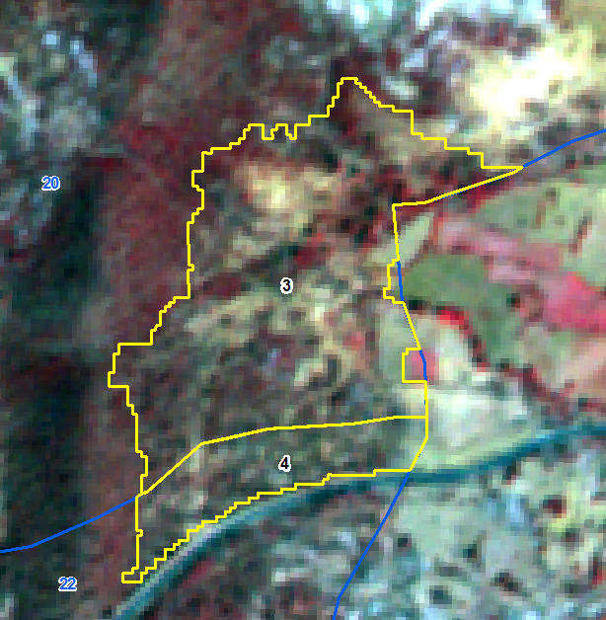
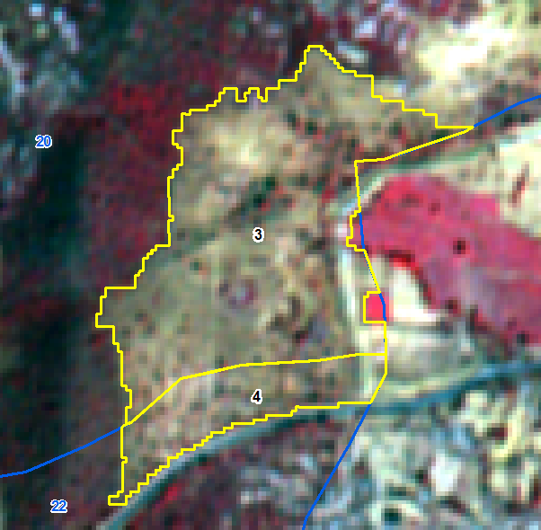
IRS R2 LISS IV Imagery- 1-mar-2018
IRS R2 LISS IV Imagery- 12-feb-2019
Sno | Division | Range | Section | Beat | Block | Comp | Class | Change | Area Ha | Longitude | Latitude | VSS | Sanctuary
3 | CHITTOOR WEST | MADANAPALLE | MADANAPALLE | CHEEKALABYLU | Horsley Konda | 20 | OF TO NF | NEGATIVE | 9.13 | 78.401294 | 13.544683 | Cheekalabailu
4 | CHITTOOR WEST | MADANAPALLE | MADANAPALLE | CHEEKALABYLU | Horsley Konda | 20 | OF TO NF | NEGATIVE | 2.13 | 78.401043 | 13.542839 | Cheekalabailu

Slide 4
IRS R2 LISS IV Imagery- 1-mar-2018
IRS R2 LISS IV Imagery- 12-feb-2019
Sno | Division | Range | Section | Beat | Block | Comp | Class | Change | Area Ha | Longitude | Latitude | VSS | Sanctuary
3 | CHITTOOR WEST | MADANAPALLE | MADANAPALLE | CHEEKALABYLU | Horsley Konda | 20 | OF TO NF | NEGATIVE | 9.13 | 78.401294 | 13.544683 | Cheekalabailu
4 | CHITTOOR WEST | MADANAPALLE | MADANAPALLE | CHEEKALABYLU | Horsley Konda | 20 | OF TO NF | NEGATIVE | 2.13 | 78.401043 | 13.542839 | Cheekalabailu

Slide 5
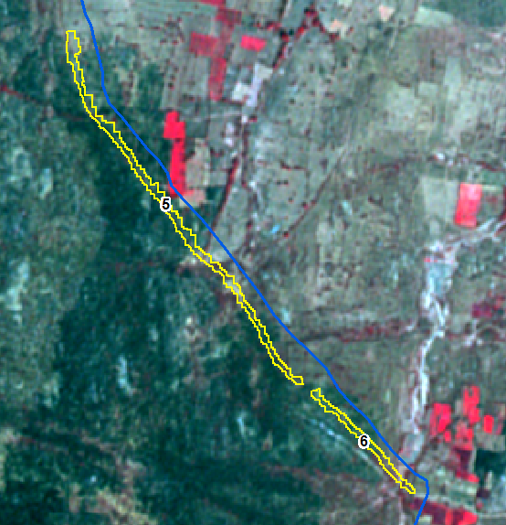
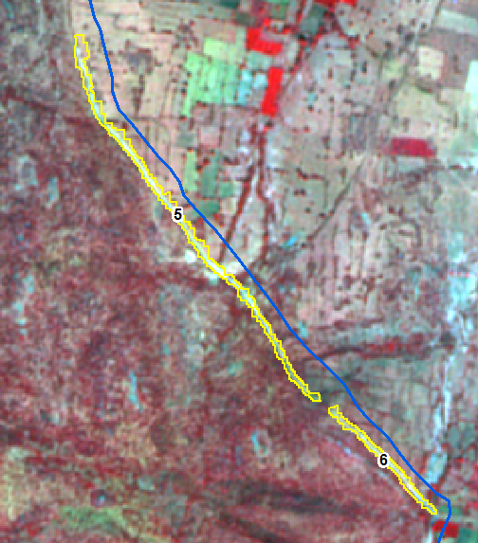
IRS R2 LISS IV Imagery- 22-Feb-2018
IRS R2 LISS IV Imagery- 25-oct-2018
Sno | Division | Range | Section | Beat | Block | Comp | Class | Change | Area Ha | Longitude | Latitude | VSS | Sanctuary
5 | CHITTOOR WEST | MADANAPALLE | TAMBALAPALLE | NERDIKONDA | Neredikonda | 3 | SF TO NF | NEGATIVE | 2.44 | 78.386523 | 13.881223
6 | CHITTOOR WEST | MADANAPALLE | TAMBALAPALLE | NERDIKONDA | Neredikonda | 3 | SF TO NF | NEGATIVE | 0.73 | 78.391850 | 13.875058 | Kudikabandathanda

Slide 6
IRS R2 LISS IV Imagery- 22-Feb-2018
IRS R2 LISS IV Imagery- 25-oct-2018
Sno | Division | Range | Section | Beat | Block | Comp | Class | Change | Area Ha | Longitude | Latitude | VSS | Sanctuary
5 | CHITTOOR WEST | MADANAPALLE | TAMBALAPALLE | NERDIKONDA | Neredikonda | 3 | SF TO NF | NEGATIVE | 2.44 | 78.386523 | 13.881223
6 | CHITTOOR WEST | MADANAPALLE | TAMBALAPALLE | NERDIKONDA | Neredikonda | 3 | SF TO NF | NEGATIVE | 0.73 | 78.391850 | 13.875058 | Kudikabandathanda

Slide 7
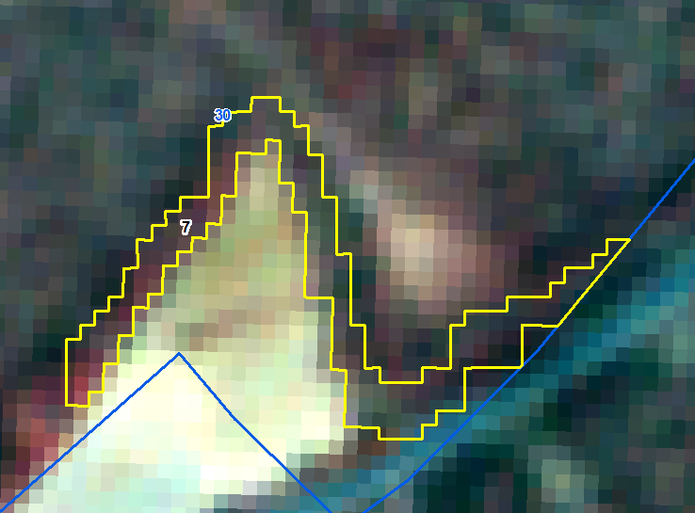
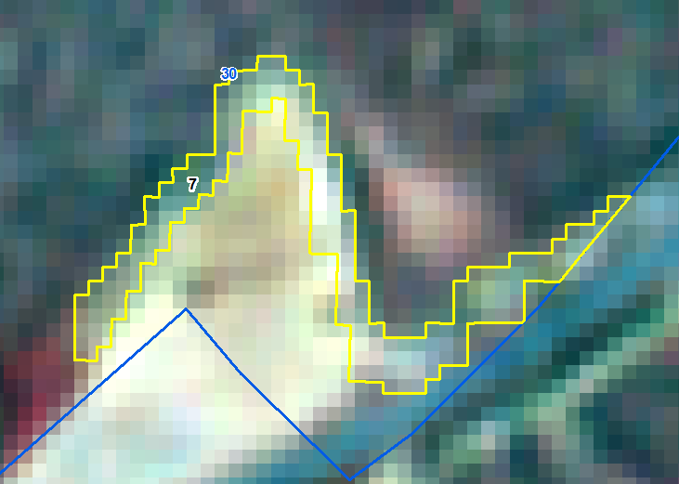
IRS R2 LISS IV Imagery- 1-Mar-2018
IRS R2 LISS IV Imagery- 12-Feb-2019
Sno | Division | Range | Section | Beat | Block | Comp | Class | Change | Area_Ha | Longitude | Latitude | VSS | Sanctuary
7 | CHITTOOR WEST | MADANAPALLE | TAMBALAPALLE | RAMAGANIPALLE | Mudivedu 1 & 2 | 30 | OF TO NF | NEGATIVE | 0.43 | 78.501829 | 13.685596

Slide 8
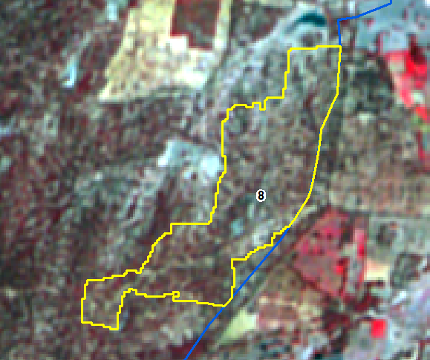
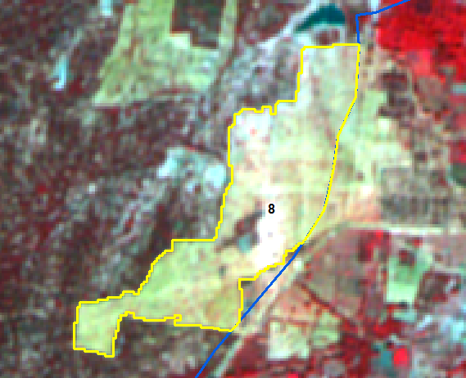
IRS R2 LISS IV Imagery- 22-Feb-2018
IRS R2 LISS IV Imagery- 25-oct-2018
Sno | Division | Range | Section | Beat | Block | Comp | Class | Change | Area Ha | Longitude | Latitude | VSS | Sanctuary
8 | CHITTOOR WEST | MADANAPALLE | TAMBALAPALLE | RAMAGANIPALLE | Kukkarajypalle | 34 | OF TO NF | NEGATIVE | 10.93 | 78.557359 | 13.730053 | Reddykota

Slide 9
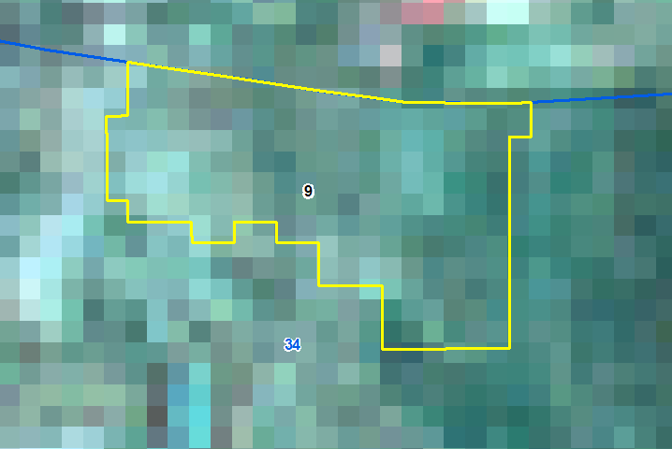
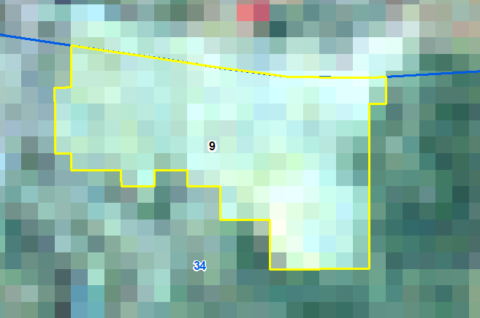
IRS R2 LISS IV Imagery- 22-Feb-2018
IRS R2 LISS IV Imagery- 13-Mar-2019
Sno | Division | Range | Section | Beat | Block | Comp | Class | Change | Area_Ha | Longitude | Latitude | VSS | Sanctuary
9 | CHITTOOR WEST | MADANAPALLE | TAMBALAPALLE | RAMAGANIPALLE | Kukkarajypalle | 34 | OF TO NF | NEGATIVE | 9.67 | 78.558170 | 13.721681

Slide 10
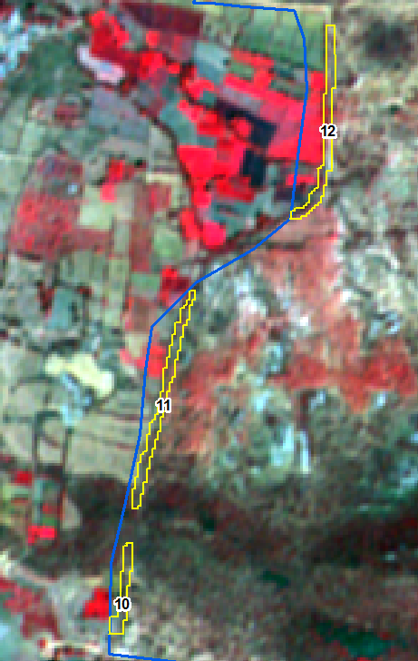
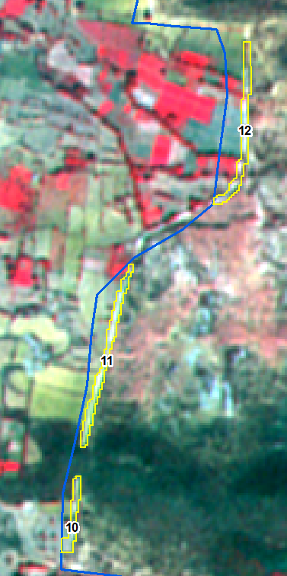
IRS R2 LISS IV Imagery-22-Feb-2018
IRS R2 LISS IV Imagery- 24-jan-2019
Sno | Division | Range | Section | Beat | Block | Comp | Class | Change | Area Ha | Longitude | Latitude | VSS | Sanctuary
10 | CHITTOOR WEST | MADANAPALLE | VALMIKIPURAM | KALIKIRI | Guttapalem | 48 | SF TO NF | NEGATIVE | 0.26 | 78.734545 | 13.593903
11 | CHITTOOR WEST | MADANAPALLE | VALMIKIPURAM | KALIKIRI | Guttapalem | 48 | SF TO NF | NEGATIVE | 0.57 | 78.735139 | 13.596912
12 | CHITTOOR WEST | MADANAPALLE | VALMIKIPURAM | KALIKIRI | Guttapalem | 48 | OF TO NF | NEGATIVE | 0.55 | 78.737728 | 13.601265 | Mekalavandlapalle

Slide 11
IRS R2 LISS IV Imagery-22-Feb-2018
IRS R2 LISS IV Imagery- 24-jan-2019
Sno | Division | Range | Section | Beat | Block | Comp | Class | Change | Area Ha | Longitude | Latitude | VSS | Sanctuary
10 | CHITTOOR WEST | MADANAPALLE | VALMIKIPURAM | KALIKIRI | Guttapalem | 48 | SF TO NF | NEGATIVE | 0.26 | 78.734545 | 13.593903
11 | CHITTOOR WEST | MADANAPALLE | VALMIKIPURAM | KALIKIRI | Guttapalem | 48 | SF TO NF | NEGATIVE | 0.57 | 78.735139 | 13.596912
12 | CHITTOOR WEST | MADANAPALLE | VALMIKIPURAM | KALIKIRI | Guttapalem | 48 | OF TO NF | NEGATIVE | 0.55 | 78.737728 | 13.601265 | Mekalavandlapalle

Slide 12
IRS R2 LISS IV Imagery-22-Feb-2018
IRS R2 LISS IV Imagery- 24-jan-2019
Sno | Division | Range | Section | Beat | Block | Comp | Class | Change | Area Ha | Longitude | Latitude | VSS | Sanctuary
10 | CHITTOOR WEST | MADANAPALLE | VALMIKIPURAM | KALIKIRI | Guttapalem | 48 | SF TO NF | NEGATIVE | 0.26 | 78.734545 | 13.593903
11 | CHITTOOR WEST | MADANAPALLE | VALMIKIPURAM | KALIKIRI | Guttapalem | 48 | SF TO NF | NEGATIVE | 0.57 | 78.735139 | 13.596912
12 | CHITTOOR WEST | MADANAPALLE | VALMIKIPURAM | KALIKIRI | Guttapalem | 48 | OF TO NF | NEGATIVE | 0.55 | 78.737728 | 13.601265 | Mekalavandlapalle

Slide 13
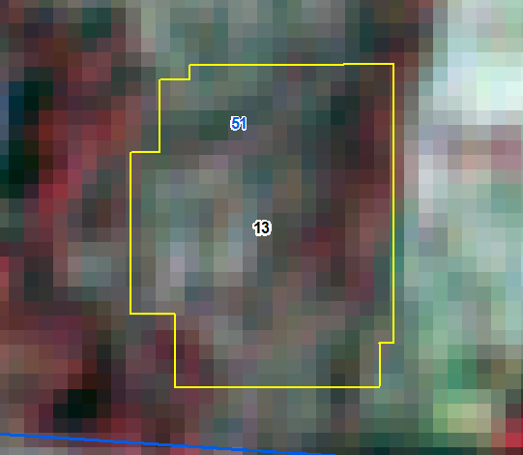
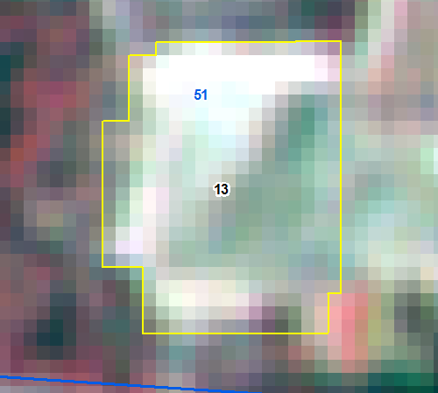
IRS R2 LISS IV Imagery-22-Feb-2018
IRS R2 LISS IV Imagery- 24-jan-2019
Sno | Division | Range | Section | Beat | Block | Comp | Class | Change | Area Ha | Longitude | Latitude | VSS | Sanctuary
13 | CHITTOOR WEST | MADANAPALLE | VALMIKIPURAM | KALIKIRI | Ankalammakonda | 51 | DF TO NF | NEGATIVE | 0.91 | 78.849672 | 13.657089 | Ankalammakonda

Slide 14
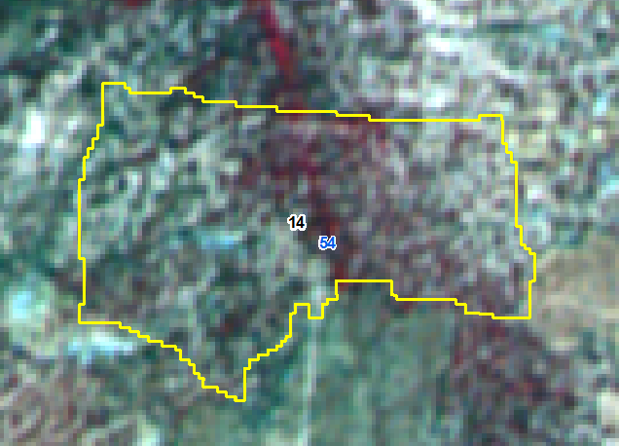
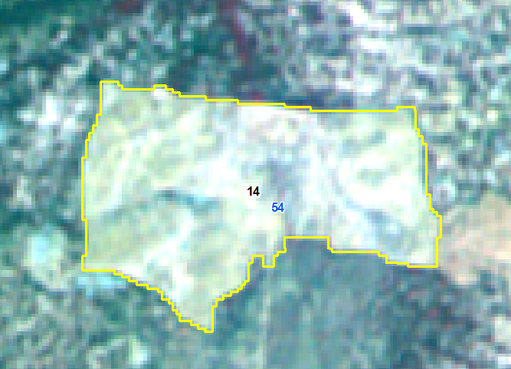
IRS R2 LISS IV Imagery-22-Feb-2018
IRS R2 LISS IV Imagery- 24-jan-2019
Sno | Division | Range | Section | Beat | Block | Comp | Class | Change | Area Ha | Longitude | Latitude | VSS | Sanctuary
14 | CHITTOOR WEST | MADANAPALLE | VALMIKIPURAM | MARRIPADU | Gundluru | 54 | OF TO NF | NEGATIVE | 11.18 | 78.760143 | 13.756010

Slide 15
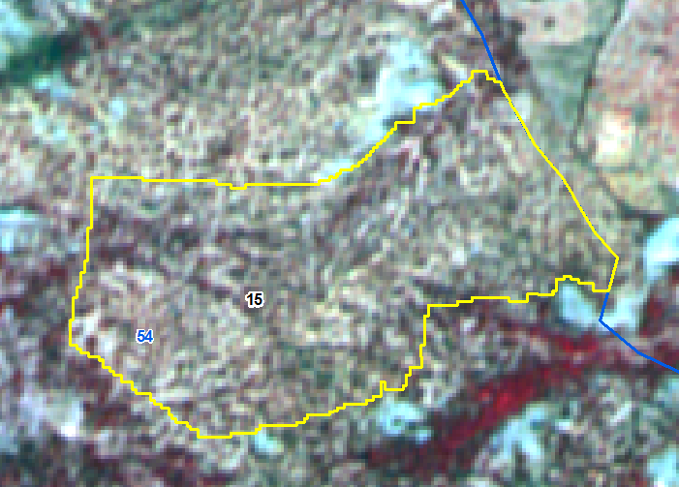
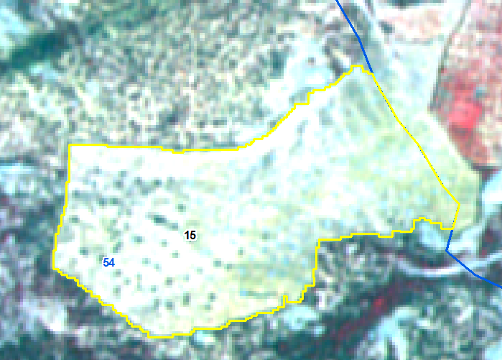
IRS R2 LISS IV Imagery-22-Feb-2018
IRS R2 LISS IV Imagery- 24-jan-2019
Sno | Division | Range | Section | Beat | Block | Comp | Class | Change | Area Ha | Longitude | Latitude | VSS | Sanctuary
15 | CHITTOOR WEST | MADANAPALLE | VALMIKIPURAM | MARRIPADU | Gundluru | 54 | OF TO NF | NEGATIVE | 20.48 | 78.749114 | 13.766084

Slide 16
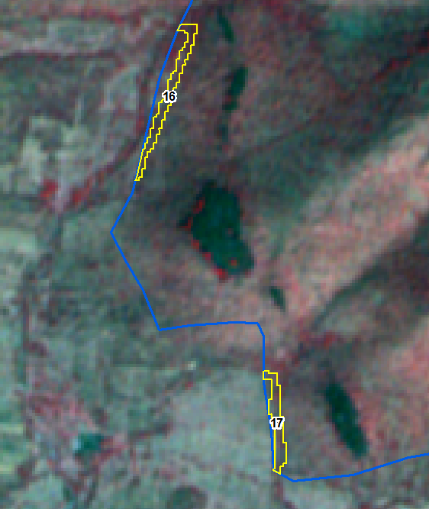
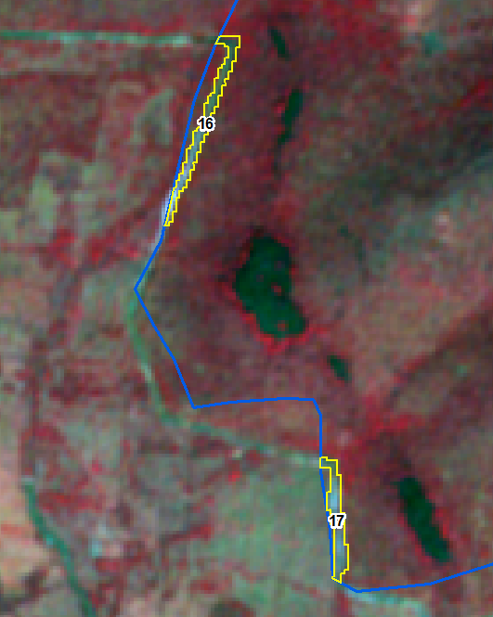
IRS R2 LISS IV Imagery-22-Feb-2018
IRS R2 LISS IV Imagery- 25-oct-2018
Sno | Division | Range | Section | Beat | Block | Comp | Class | Change | Area Ha | Longitude | Latitude | VSS | Sanctuary
16 | CHITTOOR WEST | MADANAPALLE | TAMBALAPALLE | THAMBALPALLE | T Sadukonda | 65 | SF TO NF | NEGATIVE | 0.37 | 78.451148 | 13.843978
17 | CHITTOOR WEST | MADANAPALLE | TAMBALAPALLE | THAMBALPALLE | T Sadukonda | 65 | SF TO NF | NEGATIVE | 0.30 | 78.452948 | 13.838884

Slide 17
IRS R2 LISS IV Imagery-22-Feb-2018
IRS R2 LISS IV Imagery- 25-oct-2018
Sno | Division | Range | Section | Beat | Block | Comp | Class | Change | Area Ha | Longitude | Latitude | VSS | Sanctuary
16 | CHITTOOR WEST | MADANAPALLE | TAMBALAPALLE | THAMBALPALLE | T Sadukonda | 65 | SF TO NF | NEGATIVE | 0.37 | 78.451148 | 13.843978
17 | CHITTOOR WEST | MADANAPALLE | TAMBALAPALLE | THAMBALPALLE | T Sadukonda | 65 | SF TO NF | NEGATIVE | 0.30 | 78.452948 | 13.838884

Slide 18
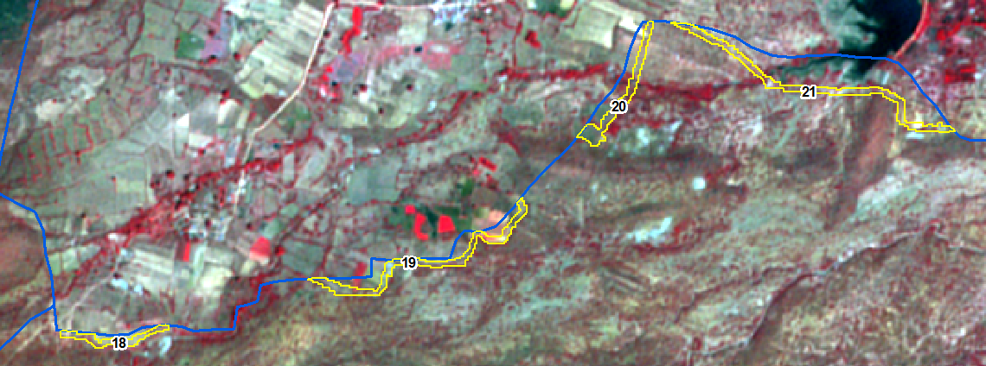
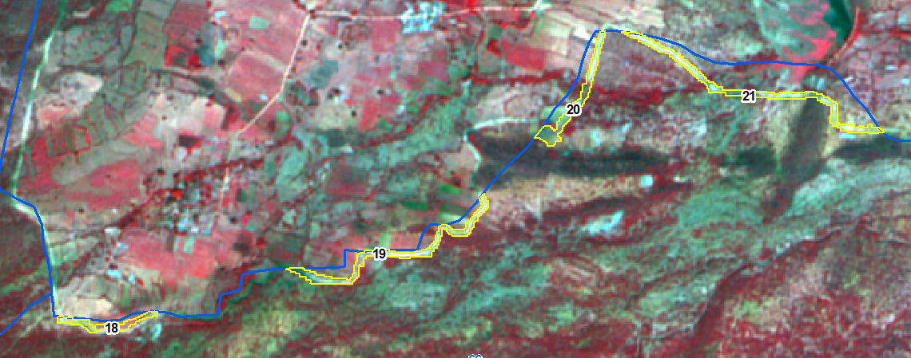
IRS R2 LISS IV Imagery-22-Feb-2018
IRS R2 LISS IV Imagery-25-oct-2018
Sno | Division | Range | Section | Beat | Block | Comp | Class | Change | Area Ha | Longitude | Latitude | VSS | Sanctuary
18 | CHITTOOR WEST | MADANAPALLE | TAMBALAPALLE | KOTTALA | T Sadukonda | 66 | OF TO NF | NEGATIVE | 0.65 | 78.464441 | 13.868768
19 | CHITTOOR WEST | MADANAPALLE | TAMBALAPALLE | KOTTALA | T Sadukonda | 66 | OF TO NF | NEGATIVE | 1.70 | 78.473199 | 13.870976
20 | CHITTOOR WEST | MADANAPALLE | TAMBALAPALLE | KOTTALA | T Sadukonda | 66 | SF TO NF | NEGATIVE | 1.13 | 78.478685 | 13.875604
21 | CHITTOOR WEST | MADANAPALLE | TAMBALAPALLE | KOTTALA | T Sadukonda | 66 | OF TO NF | NEGATIVE | 1.89 | 78.484266 | 13.876002

Slide 19
IRS R2 LISS IV Imagery-22-Feb-2018
IRS R2 LISS IV Imagery-25-oct-2018
Sno | Division | Range | Section | Beat | Block | Comp | Class | Change | Area Ha | Longitude | Latitude | VSS | Sanctuary
18 | CHITTOOR WEST | MADANAPALLE | TAMBALAPALLE | KOTTALA | T Sadukonda | 66 | OF TO NF | NEGATIVE | 0.65 | 78.464441 | 13.868768
19 | CHITTOOR WEST | MADANAPALLE | TAMBALAPALLE | KOTTALA | T Sadukonda | 66 | OF TO NF | NEGATIVE | 1.70 | 78.473199 | 13.870976
20 | CHITTOOR WEST | MADANAPALLE | TAMBALAPALLE | KOTTALA | T Sadukonda | 66 | SF TO NF | NEGATIVE | 1.13 | 78.478685 | 13.875604
21 | CHITTOOR WEST | MADANAPALLE | TAMBALAPALLE | KOTTALA | T Sadukonda | 66 | OF TO NF | NEGATIVE | 1.89 | 78.484266 | 13.876002

Slide 20
IRS R2 LISS IV Imagery-22-Feb-2018
IRS R2 LISS IV Imagery-25-oct-2018
Sno | Division | Range | Section | Beat | Block | Comp | Class | Change | Area Ha | Longitude | Latitude | VSS | Sanctuary
18 | CHITTOOR WEST | MADANAPALLE | TAMBALAPALLE | KOTTALA | T Sadukonda | 66 | OF TO NF | NEGATIVE | 0.65 | 78.464441 | 13.868768
19 | CHITTOOR WEST | MADANAPALLE | TAMBALAPALLE | KOTTALA | T Sadukonda | 66 | OF TO NF | NEGATIVE | 1.70 | 78.473199 | 13.870976
20 | CHITTOOR WEST | MADANAPALLE | TAMBALAPALLE | KOTTALA | T Sadukonda | 66 | SF TO NF | NEGATIVE | 1.13 | 78.478685 | 13.875604
21 | CHITTOOR WEST | MADANAPALLE | TAMBALAPALLE | KOTTALA | T Sadukonda | 66 | OF TO NF | NEGATIVE | 1.89 | 78.484266 | 13.876002

Slide 21
IRS R2 LISS IV Imagery-22-Feb-2018
IRS R2 LISS IV Imagery-25-oct-2018
Sno | Division | Range | Section | Beat | Block | Comp | Class | Change | Area Ha | Longitude | Latitude | VSS | Sanctuary
18 | CHITTOOR WEST | MADANAPALLE | TAMBALAPALLE | KOTTALA | T Sadukonda | 66 | OF TO NF | NEGATIVE | 0.65 | 78.464441 | 13.868768
19 | CHITTOOR WEST | MADANAPALLE | TAMBALAPALLE | KOTTALA | T Sadukonda | 66 | OF TO NF | NEGATIVE | 1.70 | 78.473199 | 13.870976
20 | CHITTOOR WEST | MADANAPALLE | TAMBALAPALLE | KOTTALA | T Sadukonda | 66 | SF TO NF | NEGATIVE | 1.13 | 78.478685 | 13.875604
21 | CHITTOOR WEST | MADANAPALLE | TAMBALAPALLE | KOTTALA | T Sadukonda | 66 | OF TO NF | NEGATIVE | 1.89 | 78.484266 | 13.876002

Slide 22
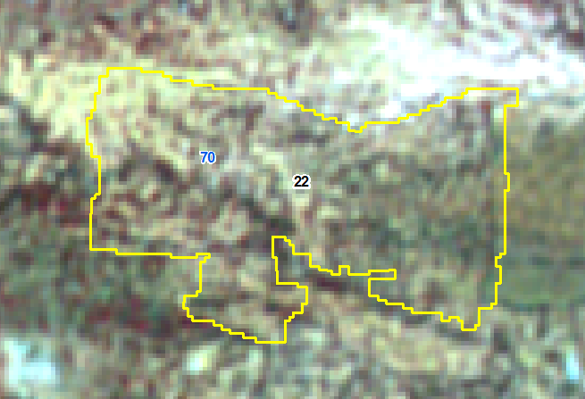
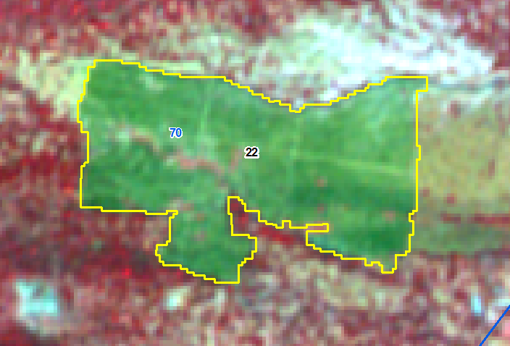
IRS R2 LISS IV Imagery-22-Feb-2018
IRS R2 LISS IV Imagery- 25-Oct-2018
Sno | Division | Range | Section | Beat | Block | Comp | Class | Change | Area Ha | Longitude | Latitude | VSS | Sanctuary
22 | CHITTOOR WEST | MADANAPALLE | GURRAMKONDA | NADIMICHERLA | Urakonda | 70 | OF TO NF | NEGATIVE | 11.29 | 78.722021 | 13.857315

Slide 23
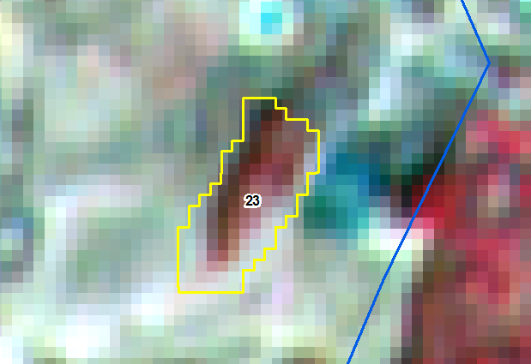
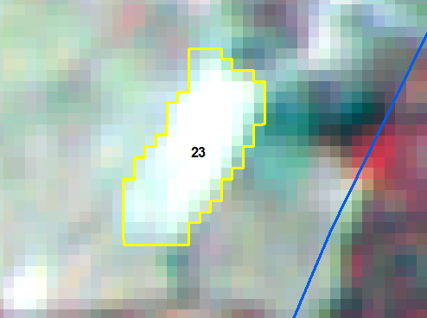
IRS R2 LISS IV Imagery-22-Feb-2018
IRS R2 LISS IV Imagery- 24-Jan-2019
Sno | Division | Range | Section | Beat | Block | Comp | Class | Change | Area Ha | Longitude | Latitude | VSS | Sanctuary
23 | CHITTOOR WEST | PUNGANUR | SOMALA | VALLIGATLA | Valligatla | 85 | OF TO NF | NEGATIVE | 0.34 | 78.848185 | 13.596235

Slide 24
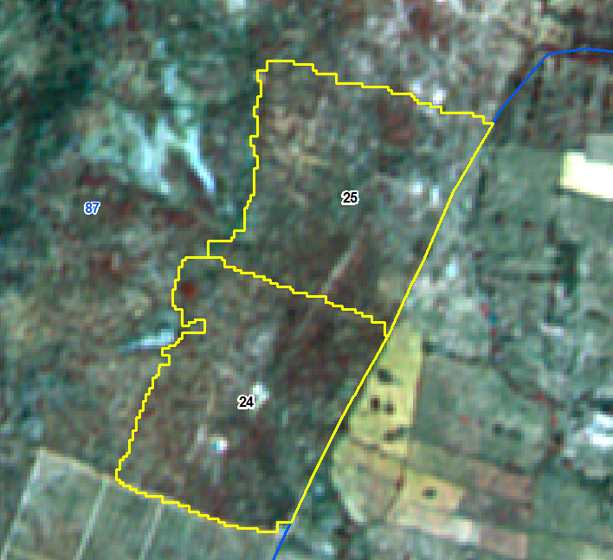
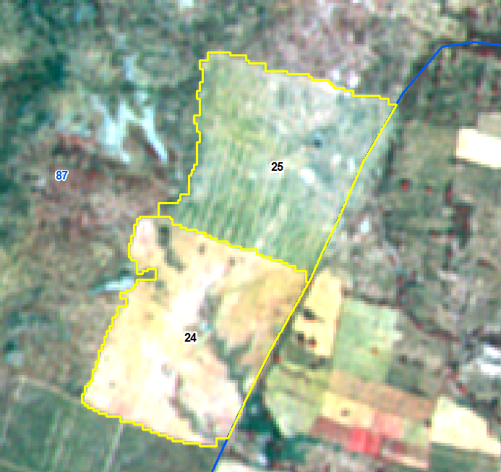
IRS R2 LISS IV Imagery-22-Feb-2018
IRS R2 LISS IV Imagery- 24-Jan-2019
Sno | Division | Range | Section | Beat | Block | Comp | Class | Change | Area Ha | Longitude | Latitude | VSS | Sanctuary
24 | CHITTOOR WEST | PUNGANUR | SOMALA | VALLIGATLA | Poolakonda | 87 | OF TO NF | NEGATIVE | 10.64 | 78.744212 | 13.564265
25 | CHITTOOR WEST | PUNGANUR | SOMALA | VALLIGATLA | Poolakonda | 87 | OF TO NF | NEGATIVE | 10.27 | 78.745596 | 13.567155

Slide 25
IRS R2 LISS IV Imagery-22-Feb-2018
IRS R2 LISS IV Imagery- 24-Jan-2019
Sno | Division | Range | Section | Beat | Block | Comp | Class | Change | Area Ha | Longitude | Latitude | VSS | Sanctuary
24 | CHITTOOR WEST | PUNGANUR | SOMALA | VALLIGATLA | Poolakonda | 87 | OF TO NF | NEGATIVE | 10.64 | 78.744212 | 13.564265
25 | CHITTOOR WEST | PUNGANUR | SOMALA | VALLIGATLA | Poolakonda | 87 | OF TO NF | NEGATIVE | 10.27 | 78.745596 | 13.567155

Slide 26
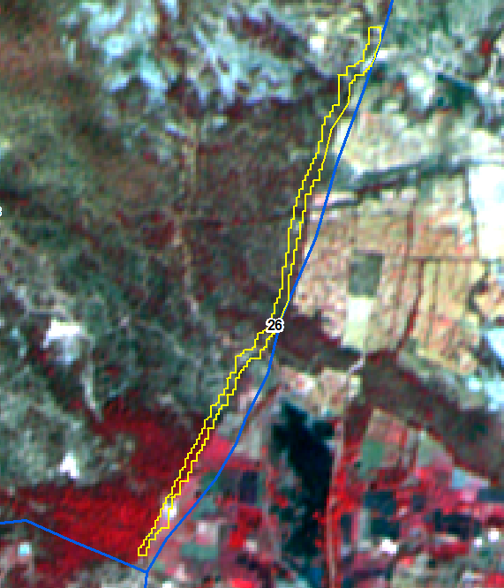
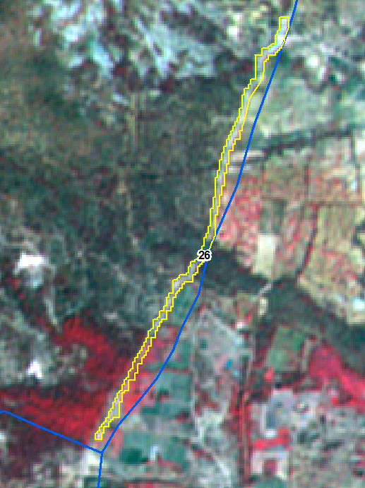
IRS R2 LISS IV Imagery-22-Feb-2018
IRS R2 LISS IV Imagery- 24-Jan-2019
Sno | Division | Range | Section | Beat | Block | Comp | Class | Change | Area Ha | Longitude | Latitude | VSS | Sanctuary
26 | CHITTOOR WEST | PUNGANUR | SOMALA | SOMALA | Nellimanda | 88 | DF TO NF | NEGATIVE | 1.66 | 78.859974 | 13.530755

Slide 27
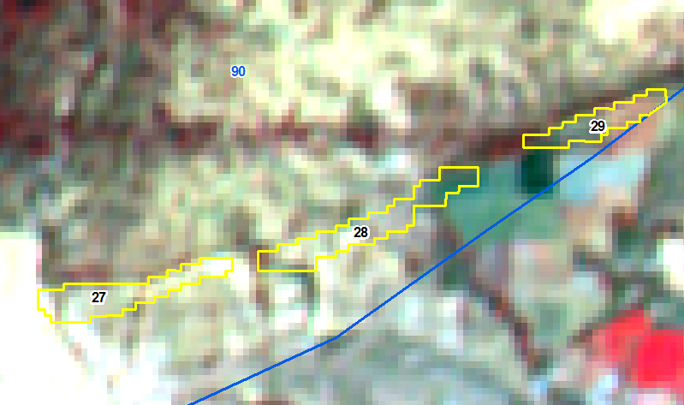
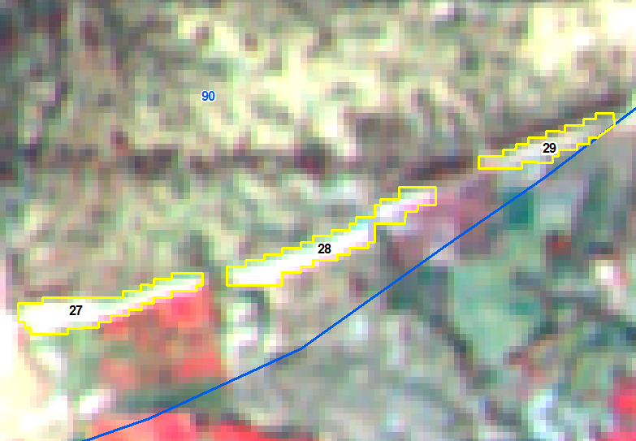
IRS R2 LISS IV Imagery-22-Feb-2018
IRS R2 LISS IV Imagery- 24-Jan-2019
Sno | Division | Range | Section | Beat | Block | Comp | Class | Change | Area_Ha | Longitude | Latitude | VSS | Sanctuary
27 | CHITTOOR WEST | PUNGANUR | SOMALA | SOMALA | Nellimanda | 90 | SF TO NF | NEGATIVE | 0.30 | 78.849193 | 13.513243 | Karakamanda
28 | CHITTOOR WEST | PUNGANUR | SOMALA | SOMALA | Nellimanda | 90 | SF TO NF | NEGATIVE | 0.34 | 78.850939 | 13.513734 | Karakamanda
29 | CHITTOOR WEST | PUNGANUR | SOMALA | SOMALA | Nellimanda | 90 | OF TO NF | NEGATIVE | 0.18 | 78.852579 | 13.514463 | Karakamanda

Slide 28
IRS R2 LISS IV Imagery-22-Feb-2018
IRS R2 LISS IV Imagery- 24-Jan-2019
Sno | Division | Range | Section | Beat | Block | Comp | Class | Change | Area_Ha | Longitude | Latitude | VSS | Sanctuary
27 | CHITTOOR WEST | PUNGANUR | SOMALA | SOMALA | Nellimanda | 90 | SF TO NF | NEGATIVE | 0.30 | 78.849193 | 13.513243 | Karakamanda
28 | CHITTOOR WEST | PUNGANUR | SOMALA | SOMALA | Nellimanda | 90 | SF TO NF | NEGATIVE | 0.34 | 78.850939 | 13.513734 | Karakamanda
29 | CHITTOOR WEST | PUNGANUR | SOMALA | SOMALA | Nellimanda | 90 | OF TO NF | NEGATIVE | 0.18 | 78.852579 | 13.514463 | Karakamanda

Slide 29
IRS R2 LISS IV Imagery-22-Feb-2018
IRS R2 LISS IV Imagery- 24-Jan-2019
Sno | Division | Range | Section | Beat | Block | Comp | Class | Change | Area_Ha | Longitude | Latitude | VSS | Sanctuary
27 | CHITTOOR WEST | PUNGANUR | SOMALA | SOMALA | Nellimanda | 90 | SF TO NF | NEGATIVE | 0.30 | 78.849193 | 13.513243 | Karakamanda
28 | CHITTOOR WEST | PUNGANUR | SOMALA | SOMALA | Nellimanda | 90 | SF TO NF | NEGATIVE | 0.34 | 78.850939 | 13.513734 | Karakamanda
29 | CHITTOOR WEST | PUNGANUR | SOMALA | SOMALA | Nellimanda | 90 | OF TO NF | NEGATIVE | 0.18 | 78.852579 | 13.514463 | Karakamanda

Slide 30
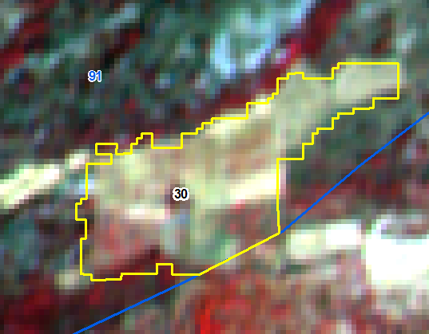
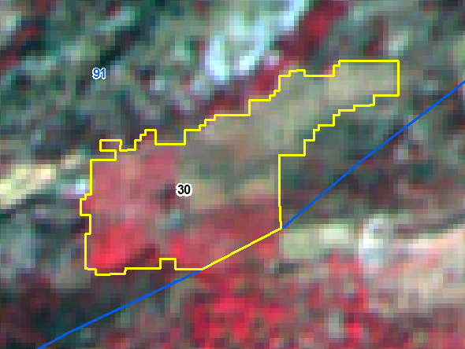
IRS R2 LISS IV Imagery-22-Feb-2018
IRS R2 LISS IV Imagery- 24-Jan-2019
Sno | Division | Range | Section | Beat | Block | Comp | Class | Change | Area_Ha | Longitude | Latitude | VSS | Sanctuary
30 | CHITTOOR WEST | PUNGANUR | SOMALA | SOMALA | Nellimanda | 91 | NF TO SF | POSITIVE | 3.22 | 78.825464 | 13.502100 | Kanchamvaripalli

Slide 31
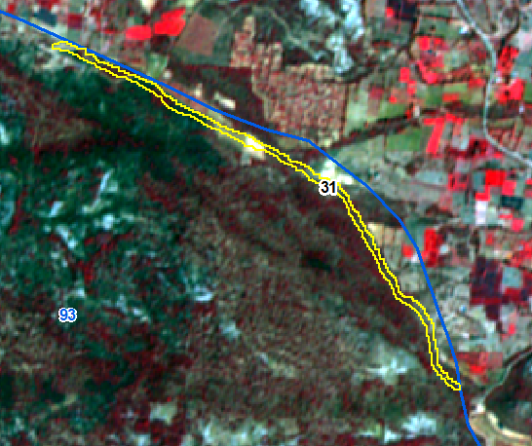
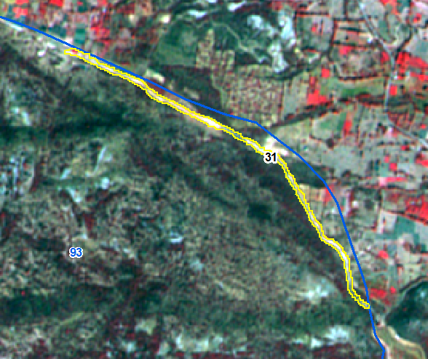
IRS R2 LISS IV Imagery-22-Feb-2018
IRS R2 LISS IV Imagery- 24-Jan-2019
Sno | Division | Range | Section | Beat | Block | Comp | Class | Change | Area_Ha | Longitude | Latitude | VSS | Sanctuary
31 | CHITTOOR WEST | PUNGANUR | SOMALA | KANDURU | Kandurukanuma East | 93 | DF TO NF | NEGATIVE | 2.64 | 78.795637 | 13.499378

Slide 32
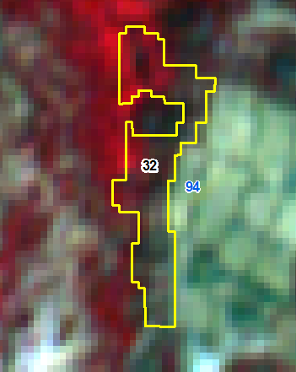
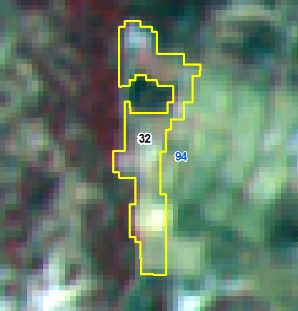
IRS R2 LISS IV Imagery-22-Feb-2018
IRS R2 LISS IV Imagery- 24-Jan-2019
Sno | Division | Range | Section | Beat | Block | Comp | Class | Change | Area_Ha | Longitude | Latitude | VSS | Sanctuary
32 | CHITTOOR WEST | PUNGANUR | SOMALA | KANDURU | Kandurukanuma West | 94 | OF TO NF | NEGATIVE | 0.83 | 78.752165 | 13.473305

Slide 33
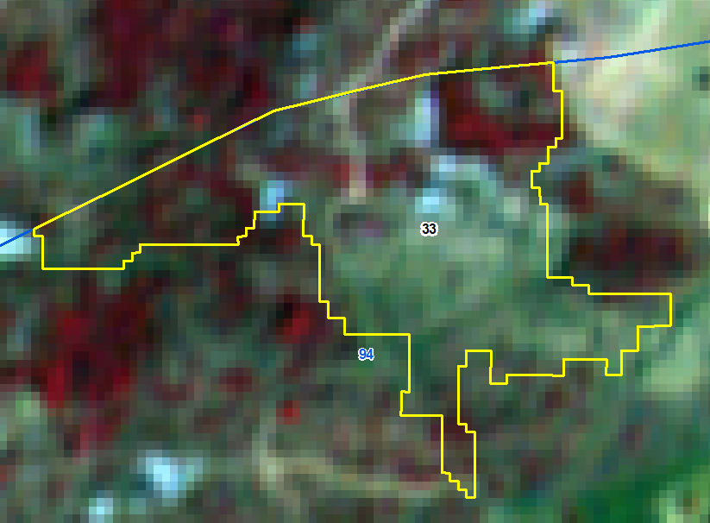
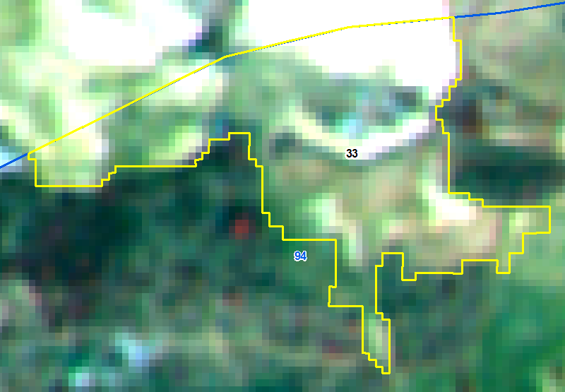
IRS R2 LISS IV Imagery-22-Feb-2018
IRS R2 LISS IV Imagery- 24-Jan-2019
Sno | Division | Range | Section | Beat | Block | Comp | Class | Change | Area_Ha | Longitude | Latitude | VSS | Sanctuary
33 | CHITTOOR WEST | PUNGANUR | SOMALA | KANDURU | Kandurukanuma West | 94 | DF TO NF | NEGATIVE | 3.77 | 78.754052 | 13.486722

Slide 34
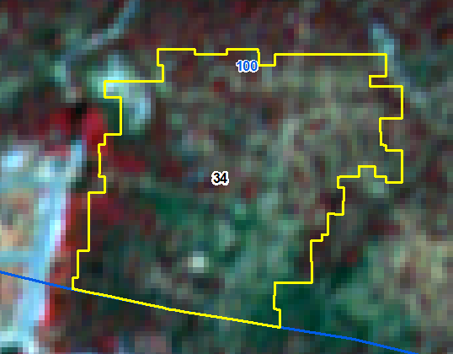
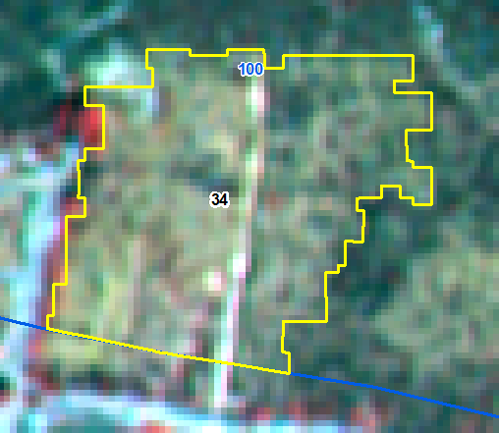
IRS R2 LISS IV Imagery-22-Feb-2018
IRS R2 LISS IV Imagery- 24-Jan-2019
Sno | Division | Range | Section | Beat | Block | Comp | Class | Change | Area_Ha | Longitude | Latitude | VSS | Sanctuary
34 | CHITTOOR WEST | PUNGANUR | PUNGANUR | GURUJULAVARIPALLE | Boyakonda | 100 | DF TO NF | NEGATIVE | 5.66 | 78.629863 | 13.489639 | Boyakondagangamma

Slide 35
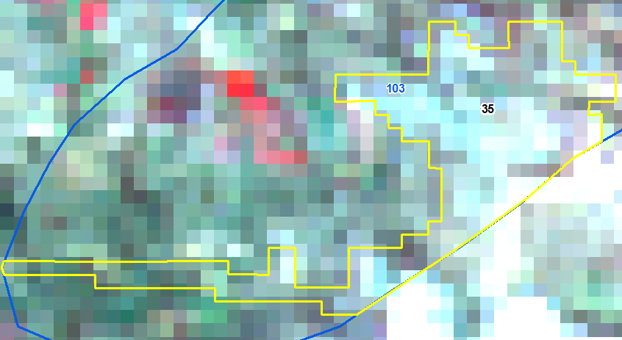
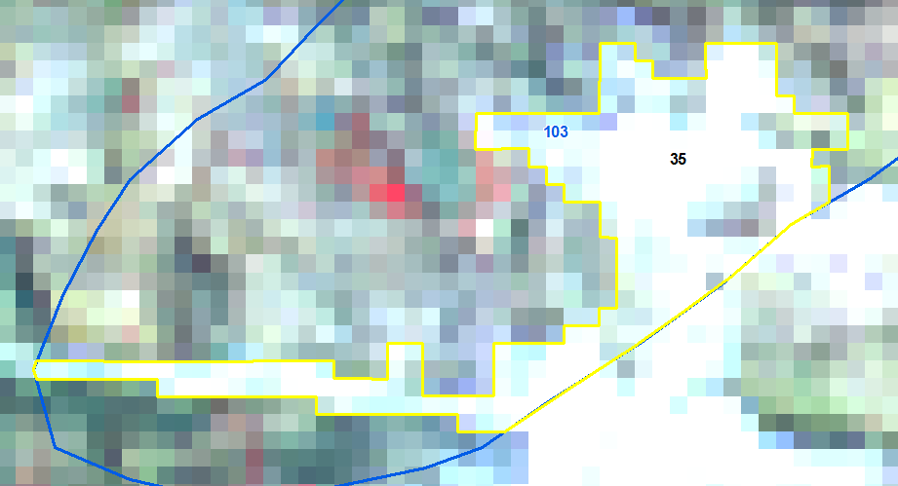
IRS R2 LISS III Imagery-22-Feb-2018
IRS R2 LISS III Imagery- 13-mar-2019
Sno | Division | Range | Section | Beat | Block | Comp | Class | Change | Area_Ha | Longitude | Latitude | VSS | Sanctuary
35 | CHITTOOR WEST | PUNGANUR | PUNGANUR | CHANDRAMAKULAPALLE | Boyakonda | 103 | OF TO NF | NEGATIVE | 14.51 | 78.552026 | 13.452909 | Thimmapuram

Slide 36
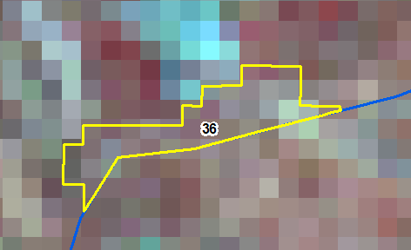
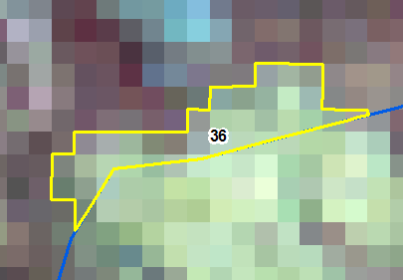
IRS R2 LISS III Imagery-22-Feb-2018
IRS R2 LISS III Imagery- 13-mar-2019
Sno | Division | Range | Section | Beat | Block | Comp | Class | Change | Area_Ha | Longitude | Latitude | VSS | Sanctuary
36 | CHITTOOR WEST | PUNGANUR | PUNGANUR | CHANDRAMAKULAPALLE | Boyakonda | 103 | DF TO NF | NEGATIVE | 1.74 | 78.581417 | 13.459646

Slide 37
IRS R2 LISS III Imagery-22-Feb-2018
IRS R2 LISS III Imagery- 13-mar-2019
Sno | Division | Range | Section | Beat | Block | Comp | Class | Change | Area_Ha | Longitude | Latitude | VSS | Sanctuary
37 | CHITTOOR WEST | PUNGANUR | PUNGANUR | CHANDRAMAKULAPALLE | Boyakonda | 103 | DF TO NF | NEGATIVE | 1.15 | 78.588626 | 13.466380

Slide 38
IRS R2 LISS IV Imagery-22-Feb-2018
IRS R2 LISS IV Imagery- 24-Jan-2019
Sno | Division | Range | Section | Beat | Block | Comp | Class | Change | Area_Ha | Longitude | Latitude | VSS | Sanctuary
38 | CHITTOOR WEST | PUNGANUR | PUNGANUR | MUTHUKUR | Muthukur East | 114 | OF TO NF | NEGATIVE | 11.03 | 78.655458 | 13.266644

Slide 39
IRS R2 LISS IV Imagery-22-Feb-2018
IRS R2 LISS IV Imagery- 24-Jan-2019
Sno | Division | Range | Section | Beat | Block | Comp | Class | Change | Area_Ha | Longitude | Latitude | VSS | Sanctuary
39 | CHITTOOR WEST | PUNGANUR | PUNGANUR | MUTHUKUR | Muthukur East | 115 | OF TO NF | NEGATIVE | 0.30 | 78.682872 | 13.261400
40 | CHITTOOR WEST | PUNGANUR | PUNGANUR | MUTHUKUR | Muthukur East | 115 | SF TO NF | NEGATIVE | 4.58 | 78.677901 | 13.253224
41 | CHITTOOR WEST | PUNGANUR | PUNGANUR | MUTHUKUR | Muthukur East | 115 | SF TO NF | NEGATIVE | 0.83 | 78.687088 | 13.264488

Slide 40
IRS R2 LISS IV Imagery-22-Feb-2018
IRS R2 LISS IV Imagery- 24-Jan-2019
Sno | Division | Range | Section | Beat | Block | Comp | Class | Change | Area_Ha | Longitude | Latitude | VSS | Sanctuary
39 | CHITTOOR WEST | PUNGANUR | PUNGANUR | MUTHUKUR | Muthukur East | 115 | OF TO NF | NEGATIVE | 0.30 | 78.682872 | 13.261400
40 | CHITTOOR WEST | PUNGANUR | PUNGANUR | MUTHUKUR | Muthukur East | 115 | SF TO NF | NEGATIVE | 4.58 | 78.677901 | 13.253224
41 | CHITTOOR WEST | PUNGANUR | PUNGANUR | MUTHUKUR | Muthukur East | 115 | SF TO NF | NEGATIVE | 0.83 | 78.687088 | 13.264488

Slide 41
IRS R2 LISS IV Imagery-22-Feb-2018
IRS R2 LISS IV Imagery- 24-Jan-2019
Sno | Division | Range | Section | Beat | Block | Comp | Class | Change | Area_Ha | Longitude | Latitude | VSS | Sanctuary
39 | CHITTOOR WEST | PUNGANUR | PUNGANUR | MUTHUKUR | Muthukur East | 115 | OF TO NF | NEGATIVE | 0.30 | 78.682872 | 13.261400
40 | CHITTOOR WEST | PUNGANUR | PUNGANUR | MUTHUKUR | Muthukur East | 115 | SF TO NF | NEGATIVE | 4.58 | 78.677901 | 13.253224
41 | CHITTOOR WEST | PUNGANUR | PUNGANUR | MUTHUKUR | Muthukur East | 115 | SF TO NF | NEGATIVE | 0.83 | 78.687088 | 13.264488

Slide 42
IRS R2 LISS IV Imagery-22-Feb-2018
IRS R2 LISS IV Imagery- 24-Jan-2019
Sno | Division | Range | Section | Beat | Block | Comp | Class | Change | Area_Ha | Longitude | Latitude | VSS | Sanctuary
42 | CHITTOOR WEST | PUNGANUR | CHARALA | RAYOLPETA | Annemagaripalle | 118 | DF TO NF | NEGATIVE | 1.83 | 78.791081 | 13.355841

Slide 43
IRS R2 LISS IV Imagery-22-Feb-2018
IRS R2 LISS IV Imagery- 24-Jan-2019
Sno | Division | Range | Section | Beat | Block | Comp | Class | Change | Area_Ha | Longitude | Latitude | VSS | Sanctuary
43 | CHITTOOR WEST | PUNGANUR | CHARALA | CHARALA | Annemagaripalle | 119 | DF TO NF | NEGATIVE | 1.11 | 78.769480 | 13.389523

Slide 44
IRS R2 LISS IV Imagery-22-Feb-2018
IRS R2 LISS IV Imagery- 24-Jan-2019
Sno | Division | Range | Section | Beat | Block | Comp | Class | Change | Area_Ha | Longitude | Latitude | VSS | Sanctuary
44 | CHITTOOR WEST | PUNGANUR | P.U.PALLE | PETUR | Annemagaripalle | 122 | OF TO NF | NEGATIVE | 1.05 | 78.817376 | 13.349043 | Polikimakula Palle

Slide 45
IRS R2 LISS IV Imagery-22-Feb-2018
IRS R2 LISS IV Imagery- 24-Jan-2019
Sno | Division | Range | Section | Beat | Block | Comp | Class | Change | Area_Ha | Longitude | Latitude | VSS | Sanctuary
45 | CHITTOOR WEST | PUNGANUR | P.U.PALLE | PETUR | Avulapalle | 124 | OF TO NF | NEGATIVE | 1.31 | 78.851794 | 13.358232 | Bonamanda
46 | CHITTOOR WEST | PUNGANUR | P.U.PALLE | PETUR | Avulapalle | 124 | DF TO NF | NEGATIVE | 0.47 | 78.853184 | 13.357696 | Bonamanda

Slide 46
IRS R2 LISS IV Imagery-22-Feb-2018
IRS R2 LISS IV Imagery- 24-Jan-2019
Sno | Division | Range | Section | Beat | Block | Comp | Class | Change | Area_Ha | Longitude | Latitude | VSS | Sanctuary
45 | CHITTOOR WEST | PUNGANUR | P.U.PALLE | PETUR | Avulapalle | 124 | OF TO NF | NEGATIVE | 1.31 | 78.851794 | 13.358232 | Bonamanda
46 | CHITTOOR WEST | PUNGANUR | P.U.PALLE | PETUR | Avulapalle | 124 | DF TO NF | NEGATIVE | 0.47 | 78.853184 | 13.357696 | Bonamanda

Slide 47
IRS R2 LISS IV Imagery-22-Feb-2018
IRS R2 LISS IV Imagery- 24-Jan-2019
Sno | Division | Range | Section | Beat | Block | Comp | Class | Change | Area_Ha | Longitude | Latitude | VSS | Sanctuary
47 | CHITTOOR WEST | PUNGANUR | P.U.PALLE | UPPARAPALLE | Avulapalle | 126 | DF TO NF | NEGATIVE | 0.64 | 78.839129 | 13.374608

Slide 48
IRS R2 LISS IV Imagery-22-Feb-2018
IRS R2 LISS IV Imagery- 24-Jan-2019
Sno | Division | Range | Section | Beat | Block | Comp | Class | Change | Area_Ha | Longitude | Latitude | VSS | Sanctuary
48 | CHITTOOR WEST | PUNGANUR | AVULAPALLE | RAMPALLE | Avulapalle | 130 | DF TO NF | NEGATIVE | 2.40 | 78.891645 | 13.450236 | Gurikanivaripalle

Slide 49
IRS R2 LISS IV Imagery-22-Feb-2018
IRS R2 LISS IV Imagery- 24-Jan-2019
Sno | Division | Range | Section | Beat | Block | Comp | Class | Change | Area_Ha | Longitude | Latitude | VSS | Sanctuary
49 | CHITTOOR WEST | PUNGANUR | CHARALA | MADIRIMALAI WEST | Madiramalai | 133 | DF TO NF | NEGATIVE | 1.35 | 78.741381 | 13.411908 | Chukkavaripalle

Slide 50
IRS R2 LISS IV Imagery-22-Feb-2018
IRS R2 LISS IV Imagery- 24-Jan-2019
Sno | Division | Range | Section | Beat | Block | Comp | Class | Change | Area_Ha | Longitude | Latitude | VSS | Sanctuary
50 | CHITTOOR WEST | PUNGANUR | CHARALA | MADIRIMALAI EAST | Madiramalai | 136 | DF TO NF | NEGATIVE | 0.65 | 78.760970 | 13.457137

Slide 51
IRS R2 LISS IV Imagery-6-Mar-18
IRS R2 LISS IV Imagery-24-Jan-2019
Sno | Division | Range | Section | Beat | Block | Comp | Class | Change | Area_Ha | Longitude | Latitude | VSS | Sanctuary
51 | CHITTOOR WEST | CHITTOOR WEST | IRALA | NAMPALLE | Irala A | 155 | DF TO NF | NEGATIVE | 4.11 | 78.977421 | 13.437258

Slide 52
IRS R2 LISS IV Imagery-6-Mar-18
IRS R2 LISS IV Imagery-24-Jan-2019
Sno | Division | Range | Section | Beat | Block | Comp | Class | Change | Area_Ha | Longitude | Latitude | VSS | Sanctuary
52 | CHITTOOR WEST | CHITTOOR WEST | IRALA | IRALA | Irala B | 171 | DF TO NF | NEGATIVE | 0.65 | 78.962583 | 13.361892
53 | CHITTOOR WEST | CHITTOOR WEST | IRALA | IRALA | Irala B | 171 | DF TO NF | NEGATIVE | 1.85 | 78.954823 | 13.361024

Slide 53
IRS R2 LISS IV Imagery-6-Mar-18
IRS R2 LISS IV Imagery-24-Jan-2019
Sno | Division | Range | Section | Beat | Block | Comp | Class | Change | Area_Ha | Longitude | Latitude | VSS | Sanctuary
52 | CHITTOOR WEST | CHITTOOR WEST | IRALA | IRALA | Irala B | 171 | DF TO NF | NEGATIVE | 0.65 | 78.962583 | 13.361892
53 | CHITTOOR WEST | CHITTOOR WEST | IRALA | IRALA | Irala B | 171 | DF TO NF | NEGATIVE | 1.85 | 78.954823 | 13.361024

Slide 54
IRS R2 LISS IV Imagery-6-Mar-18
IRS R2 LISS IV Imagery-24-Jan-2019
Sno | Division | Range | Section | Beat | Block | Comp | Class | Change | Area Ha | Longitude | Latitude | VSS | Sanctuary
54 | CHITTOOR WEST | CHITTOOR WEST | GAJULAPALLE | SARAKALLU | Gajulapalle Bit I | 174 | DF TO NF | NEGATIVE | 0.99 | 78.938306 | 13.348918 | Yanadi Colony
55 | CHITTOOR WEST | CHITTOOR WEST | GAJULAPALLE | SARAKALLU | Gajulapalle Bit I | 174 | DF TO NF | NEGATIVE | 0.31 | 78.934052 | 13.350449

Slide 55
IRS R2 LISS IV Imagery-6-Mar-18
IRS R2 LISS IV Imagery-24-Jan-2019
Sno | Division | Range | Section | Beat | Block | Comp | Class | Change | Area Ha | Longitude | Latitude | VSS | Sanctuary
54 | CHITTOOR WEST | CHITTOOR WEST | GAJULAPALLE | SARAKALLU | Gajulapalle Bit I | 174 | DF TO NF | NEGATIVE | 0.99 | 78.938306 | 13.348918 | Yanadi Colony
55 | CHITTOOR WEST | CHITTOOR WEST | GAJULAPALLE | SARAKALLU | Gajulapalle Bit I | 174 | DF TO NF | NEGATIVE | 0.31 | 78.934052 | 13.350449

Slide 56
IRS R2 LISS IV Imagery-22-Feb-2018
IRS R2 LISS IV Imagery- 24-Jan-2019
Sno | Division | Range | Section | Beat | Block | Comp | Class | Change | Area Ha | Longitude | Latitude | VSS | Sanctuary
56 | CHITTOOR WEST | CHITTOOR WEST | GAJULAPALLE | MADHAVARAM | Annemagaripalle | 177 | DF TO NF | NEGATIVE | 0.28 | 78.880515 | 13.318249

Slide 57
IRS R2 LISS IV Imagery-22-Feb-2018
IRS R2 LISS IV Imagery- 24-Jan-2019
Sno | Division | Range | Section | Beat | Block | Comp | Class | Change | Area Ha | Longitude | Latitude | VSS | Sanctuary
57 | CHITTOOR WEST | CHITTOOR WEST | THUMBAKUPPAM | THUMBAKUPPAM | Tumba South | 192 | DF TO NF | NEGATIVE | 1.80 | 78.886207 | 13.240121 | Thumba Kuppam

Slide 58
IRS R2 LISS IV Imagery-6-Mar-2018
IRS R2 LISS IV Imagery- 24-Jan-2019
Sno | Division | Range | Section | Beat | Block | Comp | Class | Change | Area Ha | Longitude | Latitude | VSS | Sanctuary
58 | CHITTOOR WEST | CHITTOOR WEST | M.V.GIRI | M.V.GIRI | Peddakonda | 198 | DF TO NF | NEGATIVE | 1.53 | 78.915066 | 13.157357
60 | CHITTOOR WEST | CHITTOOR WEST | M.V.GIRI | M.V.GIRI | Peddakonda | 198 | NF TO SF | POSITIVE | 11.92 | 78.915797 | 13.158834

Slide 59
IRS R2 LISS IV Imagery-6-Mar-2018
IRS R2 LISS IV Imagery- 24-Jan-2019
Sno | Division | Range | Section | Beat | Block | Comp | Class | Change | Area Ha | Longitude | Latitude | VSS | Sanctuary
58 | CHITTOOR WEST | CHITTOOR WEST | M.V.GIRI | M.V.GIRI | Peddakonda | 198 | DF TO NF | NEGATIVE | 1.53 | 78.915066 | 13.157357
60 | CHITTOOR WEST | CHITTOOR WEST | M.V.GIRI | M.V.GIRI | Peddakonda | 198 | NF TO SF | POSITIVE | 11.92 | 78.915797 | 13.158834

Slide 60
IRS R2 LISS IV Imagery-6-Mar-2018
IRS R2 LISS IV Imagery- 24-Jan-2019
Sno | Division | Range | Section | Beat | Block | Comp | Class | Change | Area_Ha | Longitude | Latitude | VSS | Sanctuary
59 | CHITTOOR WEST | CHITTOOR WEST | M.V.GIRI | M.V.GIRI | Peddakonda | 198 | OF TO NF | NEGATIVE | 1.43 | 78.912504 | 13.163483

Slide 61
IRS R2 LISS IV Imagery-6-Mar-2018
IRS R2 LISS IV Imagery- 24-Jan-2019
Sno | Division | Range | Section | Beat | Block | Comp | Class | Change | Area Ha | Longitude | Latitude | VSS | Sanctuary
61 | CHITTOOR WEST | CHITTOOR WEST | M.V.GIRI | BODABANDA | Bodabanda | 200 | OF TO NF | NEGATIVE | 1.04 | 78.971103 | 13.160605

Slide 62
IRS R2 LISS IV Imagery-6-Mar-2018
IRS R2 LISS IV Imagery- 24-Jan-2019
Sno | Division | Range | Section | Beat | Block | Comp | Class | Change | Area Ha | Longitude | Latitude | VSS | Sanctuary
62 | CHITTOOR WEST | CHITTOOR WEST | M.V.GIRI | BODABANDA | Ragimanipenta | 203 | NF TO SF | POSITIVE | 12.25 | 78.985059 | 13.139816

Slide 63
IRS R2 LISS III Imagery-22-Feb-2018
IRS R2 LISS III Imagery- 13-mar-2019
Sno | Division | Range | Section | Beat | Block | Comp | Class | Change | Area Ha | Longitude | Latitude | VSS | Sanctuary
63 | CHITTOOR WEST | CHITTOOR WEST | CHITTOR | KAMMAPALLE | Paradarami | 213 | DF TO NF | NEGATIVE | 5.43 | 78.919346 | 13.083651

Slide 64
IRS R2 LISS III Imagery-22-Feb-2018
IRS R2 LISS III Imagery- 13-mar-2019
Sno | Division | Range | Section | Beat | Block | Comp | Class | Change | Area Ha | Longitude | Latitude | VSS | Sanctuary
64 | CHITTOOR WEST | CHITTOOR WEST | CHITTOR | RACHOOR | Paradarami | 216 | NF TO SF | POSITIVE | 14.56 | 78.986700 | 13.113693

Slide 65
IRS R2 LISS IV Imagery-6-Mar-2018
IRS R2 LISS IV Imagery- 24-Jan-2019
Sno | Division | Range | Section | Beat | Block | Comp | Class | Change | Area Ha | Longitude | Latitude | VSS | Sanctuary
65 | CHITTOOR WEST | CHITTOOR WEST | CHITTOR | SANTHAPETA | Santhapeta&Extn | 233 | DF TO NF | NEGATIVE | 0.56 | 79.079823 | 13.268238

Slide 66
IRS R2 LISS IV Imagery-6-Mar-2018
IRS R2 LISS IV Imagery- 24-Jan-2019
Sno | Division | Range | Section | Beat | Block | Comp | Class | Change | Area Ha | Longitude | Latitude | VSS | Sanctuary
66 | CHITTOOR WEST | CHITTOOR WEST | CHITTOR | SANTHAPETA | Santhapeta&Extn | 234 | SF TO NF | NEGATIVE | 1.37 | 79.094794 | 13.256856

Slide 67
IRS R2 LISS IV Imagery-6-Mar-2018
IRS R2 LISS IV Imagery- 24-Jan-2019
Sno | Division | Range | Section | Beat | Block | Comp | Class | Change | Area Ha | Longitude | Latitude | VSS | Sanctuary
67 | CHITTOOR WEST | CHITTOOR WEST | CHITTOR | SANTHAPETA | Vavilthota | 241 | SF TO NF | NEGATIVE | 2.46 | 79.083065 | 13.330129

Slide 68
IRS R2 LISS IV Imagery-22-02-2018
IRS R2 LISS IV Imagery- 24-Jan-2019
Sno | Division | Range | Section | Beat | Block | Comp | Class | Change | Area Ha | Longitude | Latitude | VSS | Sanctuary
68 | CHITTOOR WEST | PALAMANER | V.KOTA | THOTAKANUMA | Allapalle | 242 | OF TO NF | NEGATIVE | 21.65 | 78.559016 | 13.122867 | Ramapuram
69 | CHITTOOR WEST | PALAMANER | V.KOTA | THOTAKANUMA | Allapalle | 242 | OF TO NF | NEGATIVE | 5.08 | 78.556871 | 13.122916 | Ramapuram

Slide 69
IRS R2 LISS IV Imagery-22-02-2018
IRS R2 LISS IV Imagery- 24-Jan-2019
Sno | Division | Range | Section | Beat | Block | Comp | Class | Change | Area Ha | Longitude | Latitude | VSS | Sanctuary
68 | CHITTOOR WEST | PALAMANER | V.KOTA | THOTAKANUMA | Allapalle | 242 | OF TO NF | NEGATIVE | 21.65 | 78.559016 | 13.122867 | Ramapuram
69 | CHITTOOR WEST | PALAMANER | V.KOTA | THOTAKANUMA | Allapalle | 242 | OF TO NF | NEGATIVE | 5.08 | 78.556871 | 13.122916 | Ramapuram

Slide 70
IRS R2 LISS III Imagery-22-Feb-2018
IRS R2 LISS III Imagery- 13-mar-2019
Sno | Division | Range | Section | Beat | Block | Comp | Class | Change | Area Ha | Longitude | Latitude | VSS | Sanctuary
70 | CHITTOOR WEST | PALAMANER | V.KOTA | P.N.D SOUTH | Pedanaikdurg | 258 | DF TO NF | NEGATIVE | 6.30 | 78.627511 | 12.946901 | Lingapuram | KOUNDINYA

Slide 71
IRS R2 LISS IV Imagery-22-02-2018
IRS R2 LISS IV Imagery- 24-Jan-2019
Sno | Division | Range | Section | Beat | Block | Comp | Class | Change | Area Ha | Longitude | Latitude | VSS | Sanctuary
71 | CHITTOOR WEST | PALAMANER | KOLAMASINAPALLE | PATHIKONDA | Pattikonda | 273 | OF TO NF | NEGATIVE | 6.92 | 78.689998 | 13.188581

Slide 72
IRS R2 LISS IV Imagery-22-02-2018
IRS R2 LISS IV Imagery- 24-Jan-2019
Sno | Division | Range | Section | Beat | Block | Comp | Class | Change | Area Ha | Longitude | Latitude | VSS | Sanctuary
72 | CHITTOOR WEST | PALAMANER | KOLAMASINAPALLE | DODDIPALLE | Basivireddipalli A | 282 | OF TO NF | NEGATIVE | 15.17 | 78.694963 | 13.145373 | Palamakulapalli | Koundinya

Slide 73
IRS R2 LISS IV Imagery-22-02-2018
IRS R2 LISS IV Imagery- 24-Jan-2019
Sno | Division | Range | Section | Beat | Block | Comp | Class | Change | Area Ha | Longitude | Latitude | VSS | Sanctuary
73 | CHITTOOR WEST | PALAMANER | KOLAMASINAPALLE | DODDIPALLE | Basivireddipalli A | 282 | SF TO NF | NEGATIVE | 0.90 | 78.697649 | 13.151200 | Palamakulapalli | Koundinya

Slide 74
IRS R2 LISS IV Imagery-22-02-2018
IRS R2 LISS IV Imagery- 24-Jan-2019
Sno | Division | Range | Section | Beat | Block | Comp | Class | Change | Area Ha | Longitude | Latitude | VSS | Sanctuary
74 | CHITTOOR WEST | PALAMANER | KOLAMASINAPALLE | DODDIPALLE | Basivireddipalli A | 282 | OF TO NF | NEGATIVE | 2.26 | 78.706930 | 13.159728 | Palamakulapalli | Koundinya

Slide 75
IRS R2 LISS IV Imagery-22-02-2018
IRS R2 LISS IV Imagery- 24-Jan-2019
Sno | Division | Range | Section | Beat | Block | Comp | Class | Change | Area Ha | Longitude | Latitude | VSS | Sanctuary
75 | CHITTOOR WEST | PALAMANER | PALAMANER | KEELAPATLA | Keelapatla Extn | 320 | DF TO NF | NEGATIVE | 8.10 | 78.816712 | 13.290452

Slide 76
IRS R2 LISS IV Imagery-22-02-2018
IRS R2 LISS IV Imagery- 24-Jan-2019
Sno | Division | Range | Section | Beat | Block | Comp | Class | Change | Area Ha | Longitude | Latitude | VSS | Sanctuary
76 | CHITTOOR WEST | PALAMANER | PALAMANER | KEELAPATLA | Keelapatla | 321 | DF TO NF | NEGATIVE | 0.49 | 78.767781 | 13.314945

Slide 77
IRS R2 LISS IV Imagery-22-02-2018
IRS R2 LISS IV Imagery- 24-Jan-2019
Sno | Division | Range | Section | Beat | Block | Comp | Class | Change | Area Ha | Longitude | Latitude | VSS | Sanctuary
77 | CHITTOOR WEST | PALAMANER | PALAMANER | KEELAPATLA | Keelapatla | 321 | DF TO NF | NEGATIVE | 0.34 | 78.774807 | 13.317012

Slide 78
IRS R2 LISS IV Imagery-22-02-2018
IRS R2 LISS IV Imagery- 24-Jan-2019
Sno | Division | Range | Section | Beat | Block | Comp | Class | Change | Area Ha | Longitude | Latitude | VSS | Sanctuary
78 | CHITTOOR WEST | PALAMANER | KOLAMASINAPALLE | PATHIKONDA | Pattikonda | 271 | OF TO NF | NEGATIVE | 0.88 | 78.711733 | 13.200486
79 | CHITTOOR WEST | PALAMANER | KOLAMASINAPALLE | PATHIKONDA | Pattikonda | 271 | OF TO NF | NEGATIVE | 7.88 | 78.709980 | 13.200399

Slide 79
IRS R2 LISS IV Imagery-22-02-2018
IRS R2 LISS IV Imagery- 24-Jan-2019
Sno | Division | Range | Section | Beat | Block | Comp | Class | Change | Area Ha | Longitude | Latitude | VSS | Sanctuary
78 | CHITTOOR WEST | PALAMANER | KOLAMASINAPALLE | PATHIKONDA | Pattikonda | 271 | OF TO NF | NEGATIVE | 0.88 | 78.711733 | 13.200486
79 | CHITTOOR WEST | PALAMANER | KOLAMASINAPALLE | PATHIKONDA | Pattikonda | 271 | OF TO NF | NEGATIVE | 7.88 | 78.709980 | 13.200399

Slide 80
IRS R2 LISS III Imagery-22-Feb-2018
IRS R2 LISS III Imagery- 13-mar-2019
Sno | Division | Range | Section | Beat | Block | Comp | Class | Change | Area Ha | Longitude | Latitude | VSS | Sanctuary
80 | CHITTOOR WEST | KUPPAM | KUPPAM | KUPPUM | Kangundi | 345 | OF TO NF | NEGATIVE | 13.06 | 78.431378 | 12.751997 | Kangundi(Edc) | Koundinya
81 | CHITTOOR WEST | KUPPAM | KUPPAM | KUPPUM | Kangundi | 345 | OF TO NF | NEGATIVE | 14.19 | 78.431541 | 12.753526 | Kangundi(Edc) | Koundinya

Slide 81
IRS R2 LISS III Imagery-22-Feb-2018
IRS R2 LISS III Imagery- 13-mar-2019
Sno | Division | Range | Section | Beat | Block | Comp | Class | Change | Area Ha | Longitude | Latitude | VSS | Sanctuary
80 | CHITTOOR WEST | KUPPAM | KUPPAM | KUPPUM | Kangundi | 345 | OF TO NF | NEGATIVE | 13.06 | 78.431378 | 12.751997 | Kangundi(Edc) | Koundinya
81 | CHITTOOR WEST | KUPPAM | KUPPAM | KUPPUM | Kangundi | 345 | OF TO NF | NEGATIVE | 14.19 | 78.431541 | 12.753526 | Kangundi(Edc) | Koundinya

Slide 82
IRS R2 LISS III Imagery-22-Feb-2018
IRS R2 LISS III Imagery- 13-mar-2019
Sno | Division | Range | Section | Beat | Block | Comp | Class | Change | Area Ha | Longitude | Latitude | VSS | Sanctuary
82 | CHITTOOR WEST | KUPPAM | KUPPAM | KUPPUM | Kangundi | 346 | OF TO NF | NEGATIVE | 13.01 | 78.411221 | 12.772239 |  | Koundinya
83 | CHITTOOR WEST | KUPPAM | KUPPAM | KUPPUM | Kangundi | 346 | OF TO NF | NEGATIVE | 14.42 | 78.401266 | 12.766408 |  | Koundinya
84 | CHITTOOR WEST | KUPPAM | KUPPAM | KUPPUM | Kangundi | 345 | OF TO NF | NEGATIVE | 7.67 | 78.414346 | 12.764254 | Dasegownur | Koundinya
85 | CHITTOOR WEST | KUPPAM | KUPPAM | KUPPUM | Kangundi | 345 | OF TO NF | NEGATIVE | 2.26 | 78.403831 | 12.763963 | Dasegownur | Koundinya

Slide 83
IRS R2 LISS III Imagery-22-Feb-2018
IRS R2 LISS III Imagery- 13-mar-2019
Sno | Division | Range | Section | Beat | Block | Comp | Class | Change | Area Ha | Longitude | Latitude | VSS | Sanctuary
82 | CHITTOOR WEST | KUPPAM | KUPPAM | KUPPUM | Kangundi | 346 | OF TO NF | NEGATIVE | 13.01 | 78.411221 | 12.772239 |  | Koundinya
83 | CHITTOOR WEST | KUPPAM | KUPPAM | KUPPUM | Kangundi | 346 | OF TO NF | NEGATIVE | 14.42 | 78.401266 | 12.766408 |  | Koundinya
84 | CHITTOOR WEST | KUPPAM | KUPPAM | KUPPUM | Kangundi | 345 | OF TO NF | NEGATIVE | 7.67 | 78.414346 | 12.764254 | Dasegownur | Koundinya
85 | CHITTOOR WEST | KUPPAM | KUPPAM | KUPPUM | Kangundi | 345 | OF TO NF | NEGATIVE | 2.26 | 78.403831 | 12.763963 | Dasegownur | Koundinya

Slide 84
IRS R2 LISS III Imagery-22-Feb-2018
IRS R2 LISS III Imagery- 13-mar-2019
Sno | Division | Range | Section | Beat | Block | Comp | Class | Change | Area Ha | Longitude | Latitude | VSS | Sanctuary
82 | CHITTOOR WEST | KUPPAM | KUPPAM | KUPPUM | Kangundi | 346 | OF TO NF | NEGATIVE | 13.01 | 78.411221 | 12.772239 |  | Koundinya
83 | CHITTOOR WEST | KUPPAM | KUPPAM | KUPPUM | Kangundi | 346 | OF TO NF | NEGATIVE | 14.42 | 78.401266 | 12.766408 |  | Koundinya
84 | CHITTOOR WEST | KUPPAM | KUPPAM | KUPPUM | Kangundi | 345 | OF TO NF | NEGATIVE | 7.67 | 78.414346 | 12.764254 | Dasegownur | Koundinya
85 | CHITTOOR WEST | KUPPAM | KUPPAM | KUPPUM | Kangundi | 345 | OF TO NF | NEGATIVE | 2.26 | 78.403831 | 12.763963 | Dasegownur | Koundinya

Slide 85
IRS R2 LISS III Imagery-22-Feb-2018
IRS R2 LISS III Imagery- 13-mar-2019
Sno | Division | Range | Section | Beat | Block | Comp | Class | Change | Area Ha | Longitude | Latitude | VSS | Sanctuary
82 | CHITTOOR WEST | KUPPAM | KUPPAM | KUPPUM | Kangundi | 346 | OF TO NF | NEGATIVE | 13.01 | 78.411221 | 12.772239 |  | Koundinya
83 | CHITTOOR WEST | KUPPAM | KUPPAM | KUPPUM | Kangundi | 346 | OF TO NF | NEGATIVE | 14.42 | 78.401266 | 12.766408 |  | Koundinya
84 | CHITTOOR WEST | KUPPAM | KUPPAM | KUPPUM | Kangundi | 345 | OF TO NF | NEGATIVE | 7.67 | 78.414346 | 12.764254 | Dasegownur | Koundinya
85 | CHITTOOR WEST | KUPPAM | KUPPAM | KUPPUM | Kangundi | 345 | OF TO NF | NEGATIVE | 2.26 | 78.403831 | 12.763963 | Dasegownur | Koundinya

Slide 86
IRS R2 LISS III Imagery-22-Feb-2018
IRS R2 LISS III Imagery- 13-mar-2019
Sno | Division | Range | Section | Beat | Block | Comp | Class | Change | Area Ha | Longitude | Latitude | VSS | Sanctuary
86 | CHITTOOR WEST | KUPPAM | KANGUNDI | KANGUNDI | Kangundi | 352 | DF TO NF | NEGATIVE | 20.59 | 78.456537 | 12.785130 | Aniganur | Koundinya
87 | CHITTOOR WEST | KUPPAM | KANGUNDI | KANGUNDI | Kangundi | 352 | DF TO NF | NEGATIVE | 17.54 | 78.454192 | 12.791743 | Govindapalle | Koundinya

Slide 87
IRS R2 LISS III Imagery-22-Feb-2018
IRS R2 LISS III Imagery- 13-mar-2019
Sno | Division | Range | Section | Beat | Block | Comp | Class | Change | Area Ha | Longitude | Latitude | VSS | Sanctuary
86 | CHITTOOR WEST | KUPPAM | KANGUNDI | KANGUNDI | Kangundi | 352 | DF TO NF | NEGATIVE | 20.59 | 78.456537 | 12.785130 | Aniganur | Koundinya
87 | CHITTOOR WEST | KUPPAM | KANGUNDI | KANGUNDI | Kangundi | 352 | DF TO NF | NEGATIVE | 17.54 | 78.454192 | 12.791743 | Govindapalle | Koundinya

Slide 88
IRS R2 LISS IV Imagery- 6-mar-2018
IRS R2 LISS IV Imagery- 24-Jan-2019
Sno | Division | Range | Section | Beat | Block | Comp | Class | Change | Area Ha | Longitude | Latitude | VSS | Sanctuary
88 | CHITTOOR WEST | CHITTOOR WEST | GAJULAPALLE | SARAKALLU | Gajulapalle Bit I | 174 | DF TO NF | NEGATIVE | 0.91 | 78.937867 | 13.345731 | Yanadi Colony

