Slide 1
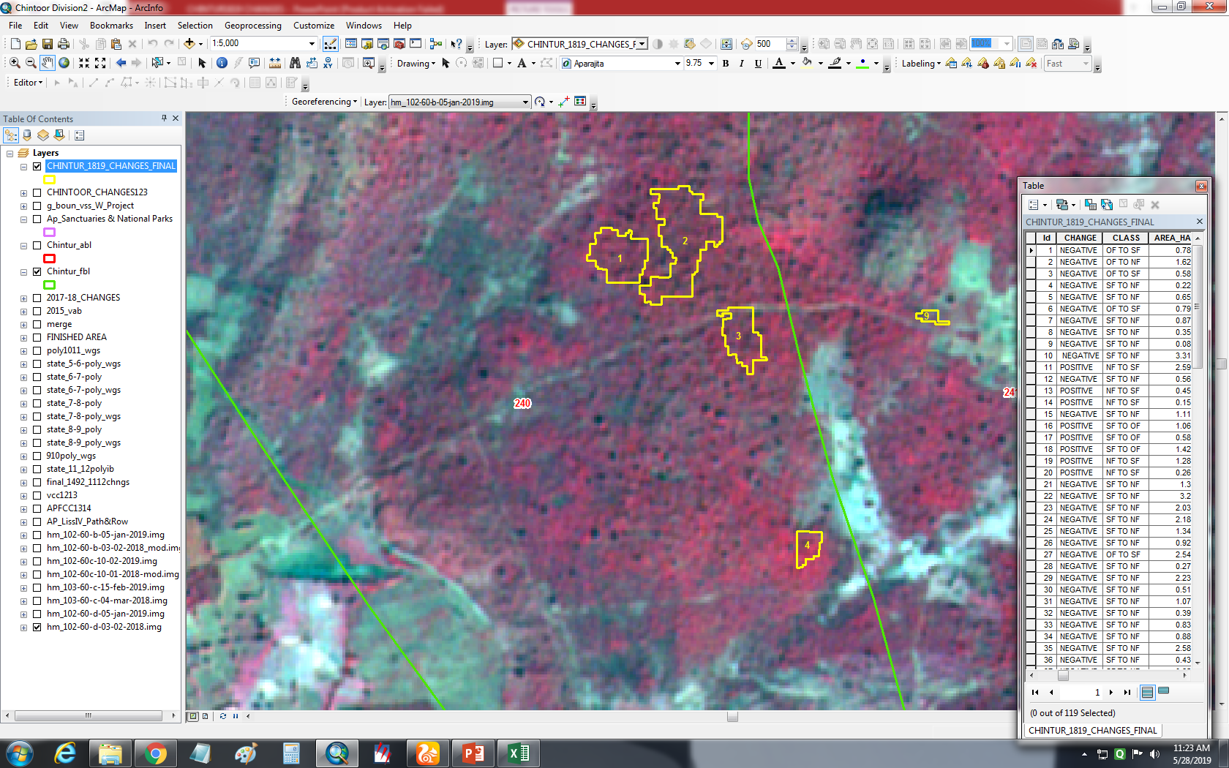
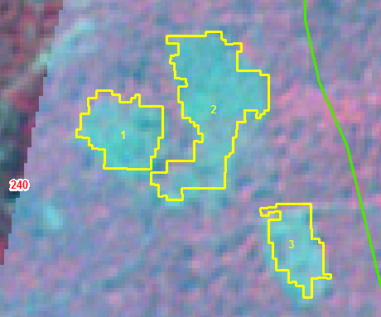
IRS R2 LISS IV Imagery 03 Feb 2018
IRS R2 LISS IV Imagery 05 Jan 2019

Slide 2
IRS R2 LISS IV Imagery 03 Feb 2018
IRS R2 LISS IV Imagery 05 Jan 2019

Slide 3
IRS R2 LISS IV Imagery 03 Feb 2018
IRS R2 LISS IV Imagery 05 Jan 2019

Slide 4
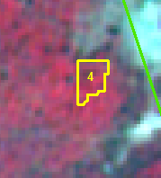
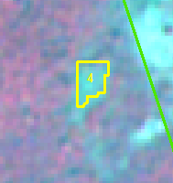
IRS R2 LISS IV Imagery 05 Jan 2019
IRS R2 LISS IV Imagery 03 Feb 2018

Slide 5
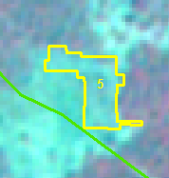
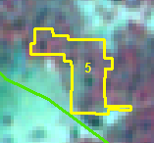
IRS R2 LISS IV Imagery 03 Feb 2018
IRS R2 LISS IV Imagery 05 Jan 2019

Slide 6
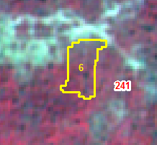
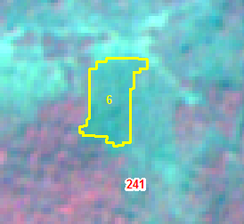
IRS R2 LISS IV Imagery 03 Feb 2018
IRS R2 LISS IV Imagery 05 Jan 2019

Slide 7
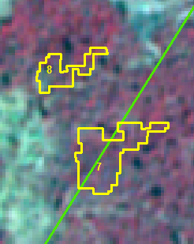
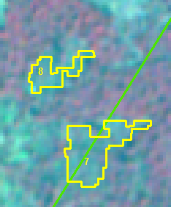
IRS R2 LISS IV Imagery 03 Feb 2018
IRS R2 LISS IV Imagery 05 Jan 2019

Slide 8
IRS R2 LISS IV Imagery 03 Feb 2018
IRS R2 LISS IV Imagery 05 Jan 2019

Slide 9
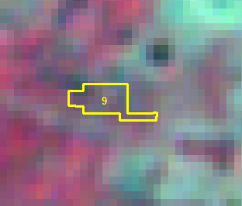
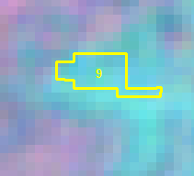
IRS R2 LISS IV Imagery 03 Feb 2018
IRS R2 LISS IV Imagery 05 Jan 2019

Slide 10
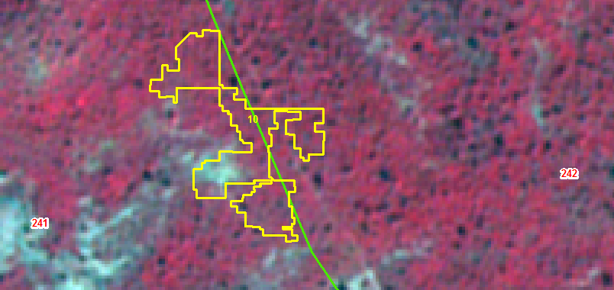
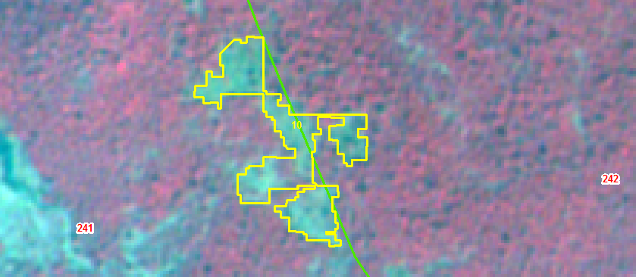
IRS R2 LISS IV Imagery 03 Feb 2018
IRS R2 LISS IV Imagery 05 Jan 2019

Slide 11
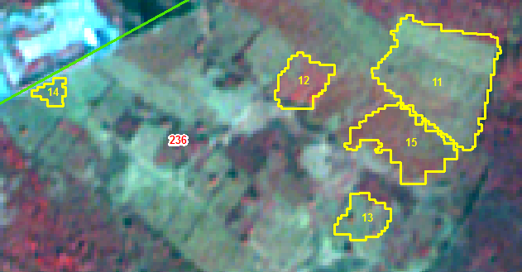
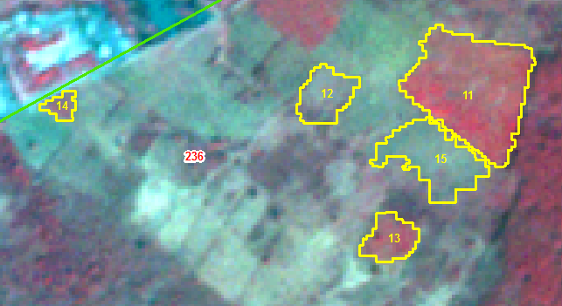
IRS R2 LISS IV Imagery 10 Jan 2018
IRS R2 LISS IV Imagery 11 Feb 2019

Slide 12
IRS R2 LISS IV Imagery 10 Jan 2018
IRS R2 LISS IV Imagery 11 Feb 2019

Slide 13
IRS R2 LISS IV Imagery 10 Jan 2018
IRS R2 LISS IV Imagery 11 Feb 2019

Slide 14
IRS R2 LISS IV Imagery 10 Jan 2018
IRS R2 LISS IV Imagery 11 Feb 2019

Slide 15
IRS R2 LISS IV Imagery 10 Jan 2018
IRS R2 LISS IV Imagery 11 Feb 2019

Slide 16
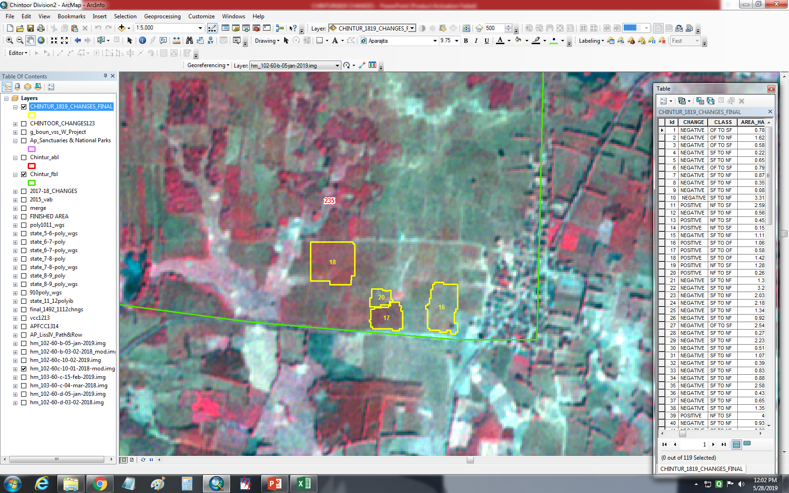
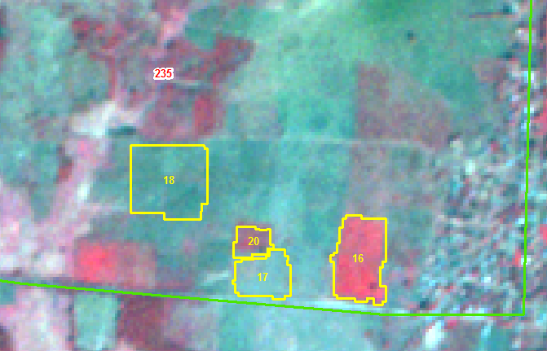
IRS R2 LISS IV Imagery 10 Jan 2018
IRS R2 LISS IV Imagery 11 Feb 2019

Slide 17
IRS R2 LISS IV Imagery 10 Jan 2018
IRS R2 LISS IV Imagery 11 Feb 2019

Slide 18
IRS R2 LISS IV Imagery 10 Jan 2018
IRS R2 LISS IV Imagery 11 Feb 2019

Slide 19
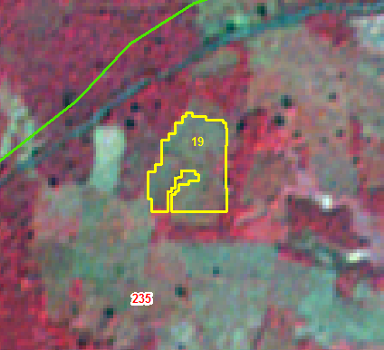
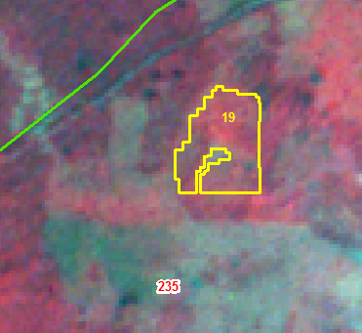
IRS R2 LISS IV Imagery 10 Jan 2018
IRS R2 LISS IV Imagery 11 Feb 2019

Slide 20
IRS R2 LISS IV Imagery 10 Jan 2018
IRS R2 LISS IV Imagery 11 Feb 2019

Slide 21
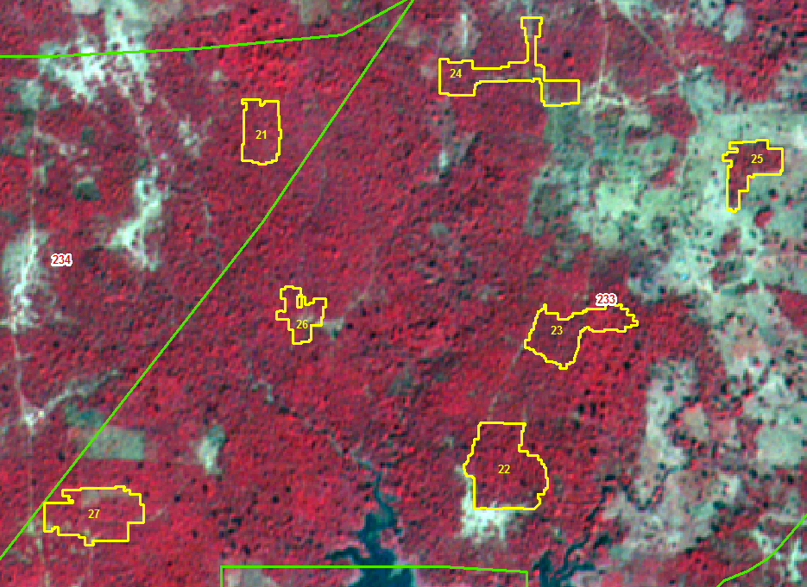
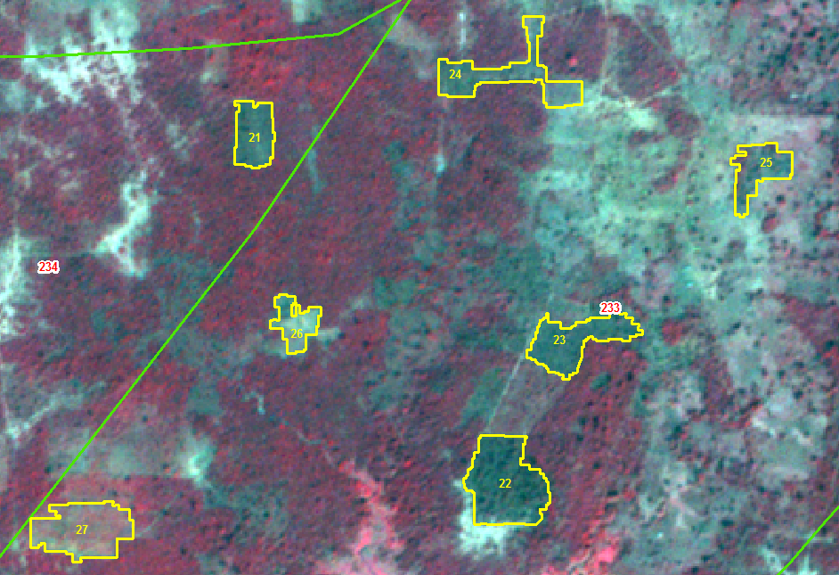
IRS R2 LISS IV Imagery 10 Jan 2018
IRS R2 LISS IV Imagery 11 Feb 2019

Slide 22
IRS R2 LISS IV Imagery 10 Jan 2018
IRS R2 LISS IV Imagery 11 Feb 2019

Slide 23
IRS R2 LISS IV Imagery 10 Jan 2018
IRS R2 LISS IV Imagery 11 Feb 2019

Slide 24
IRS R2 LISS IV Imagery 10 Jan 2018
IRS R2 LISS IV Imagery 11 Feb 2019

Slide 25
IRS R2 LISS IV Imagery 10 Jan 2018
IRS R2 LISS IV Imagery 11 Feb 2019

Slide 26
IRS R2 LISS IV Imagery 10 Jan 2018
IRS R2 LISS IV Imagery 11 Feb 2019

Slide 27
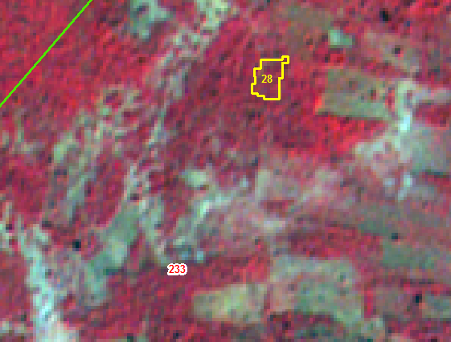
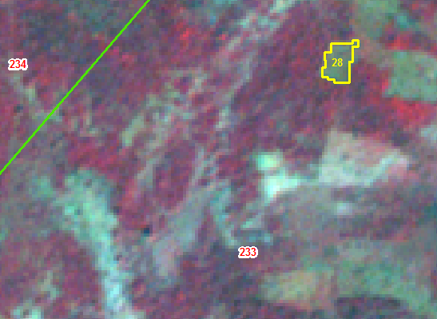
IRS R2 LISS IV Imagery 10 Jan 2018
IRS R2 LISS IV Imagery 11 Feb 2019

Slide 28
IRS R2 LISS IV Imagery 10 Jan 2018
IRS R2 LISS IV Imagery 11 Feb 2019

Slide 29
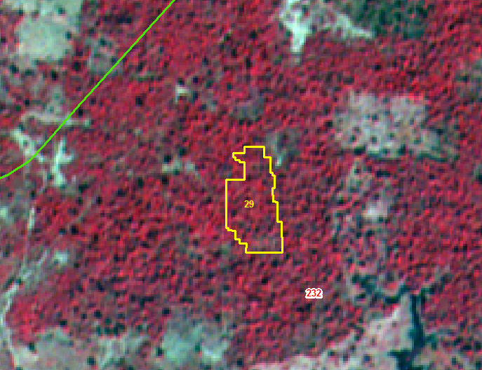
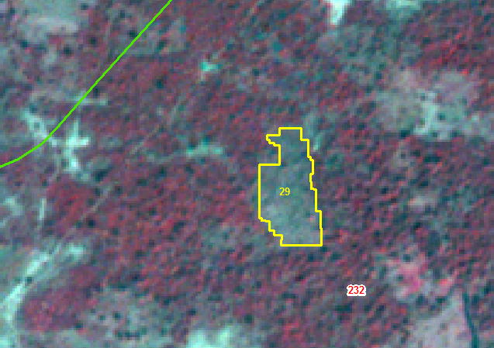
IRS R2 LISS IV Imagery 10 Jan 2018
IRS R2 LISS IV Imagery 11 Feb 2019

Slide 30
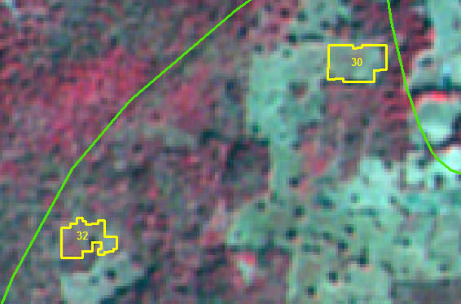
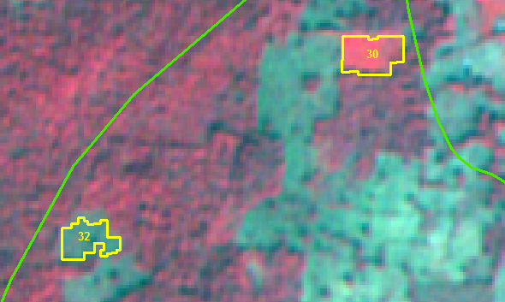
IRS R2 LISS IV Imagery 10 Jan 2018
IRS R2 LISS IV Imagery 11 Feb 2019

Slide 31
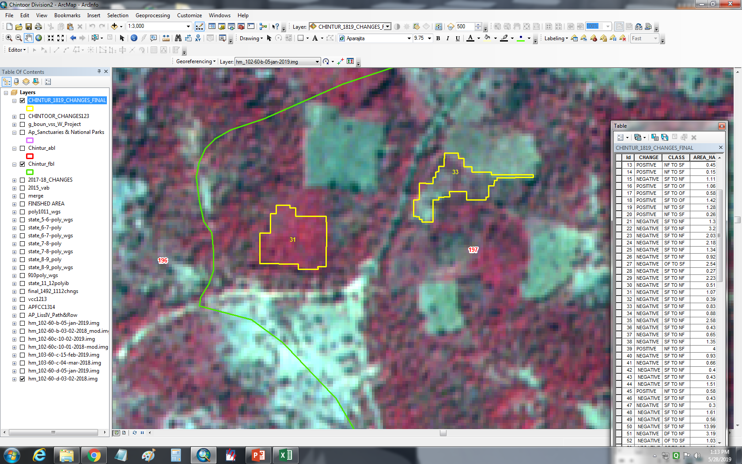
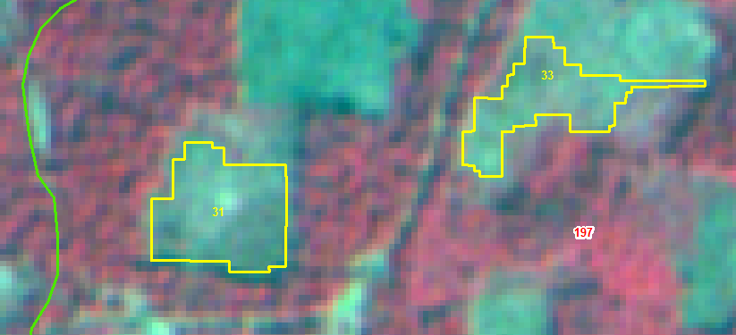
IRS R2 LISS IV Imagery 03 Feb 2018
IRS R2 LISS IV Imagery 05 Jan2019

Slide 32
IRS R2 LISS IV Imagery 10 Jan 2018
IRS R2 LISS IV Imagery 11 Feb 2019

Slide 33
IRS R2 LISS IV Imagery 03 Feb 2018
IRS R2 LISS IV Imagery 05 Jan2019

Slide 34
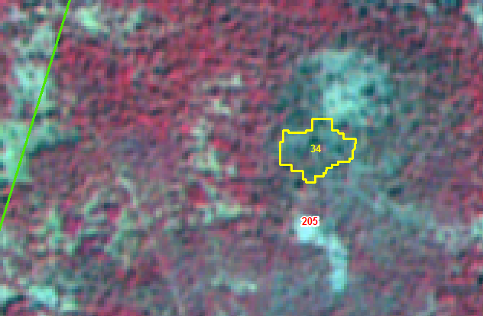
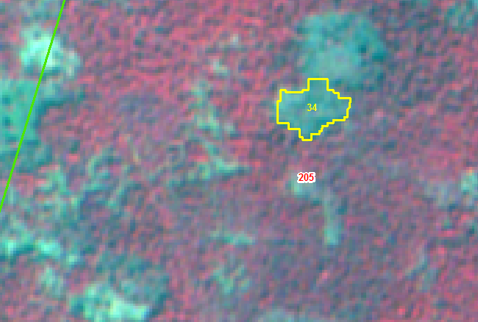
IRS R2 LISS IV Imagery 03 Feb 2018
IRS R2 LISS IV Imagery 05 Jan2019

Slide 35
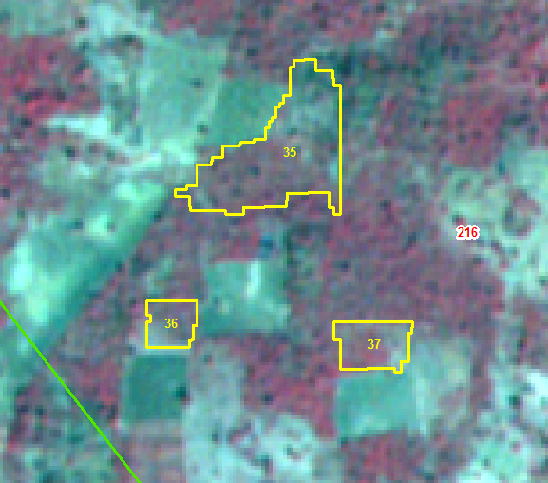
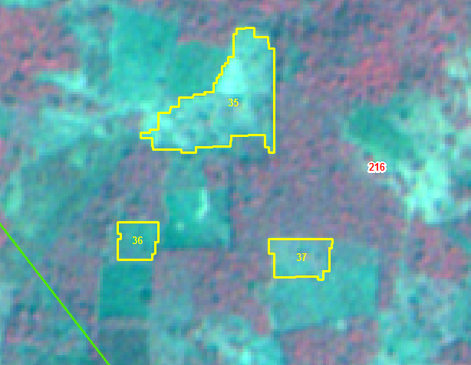
IRS R2 LISS IV Imagery 03 Feb 2018
IRS R2 LISS IV Imagery 05 Jan2019

Slide 36
IRS R2 LISS IV Imagery 03 Feb 2018
IRS R2 LISS IV Imagery 05 Jan2019

Slide 37
IRS R2 LISS IV Imagery 03 Feb 2018
IRS R2 LISS IV Imagery 05 Jan2019

Slide 38
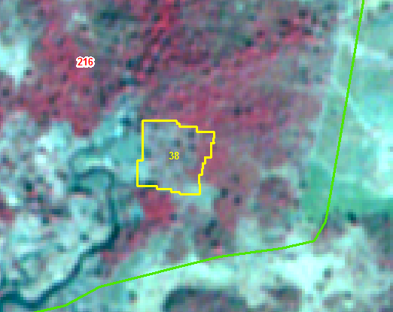
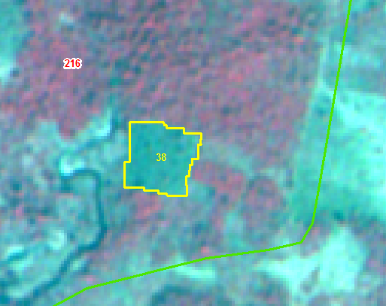
IRS R2 LISS IV Imagery 03 Feb 2018
IRS R2 LISS IV Imagery 05 Jan2019

Slide 39
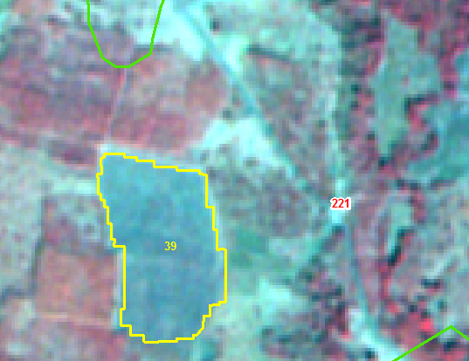
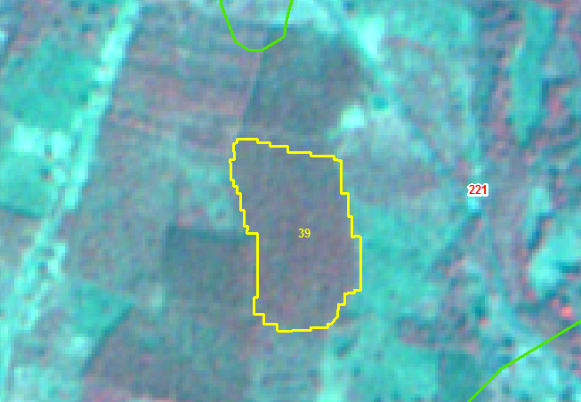
IRS R2 LISS IV Imagery 03 Feb 2018
IRS R2 LISS IV Imagery 05 Jan2019

Slide 40
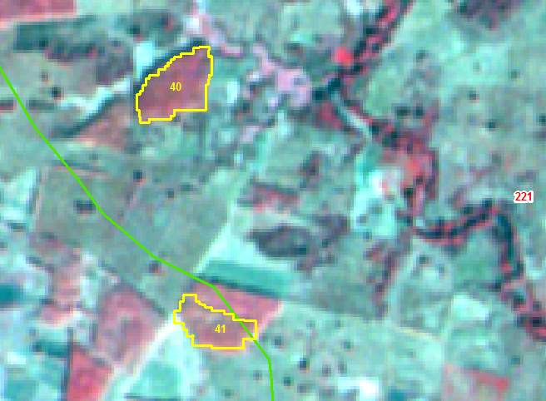
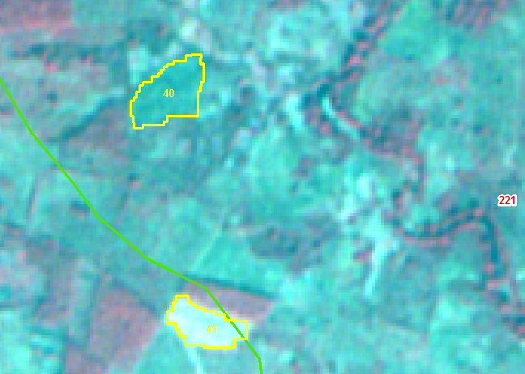
IRS R2 LISS IV Imagery 03 Feb 2018
IRS R2 LISS IV Imagery 05 Jan2019

Slide 41
IRS R2 LISS IV Imagery 03 Feb 2018
IRS R2 LISS IV Imagery 05 Jan2019

Slide 42
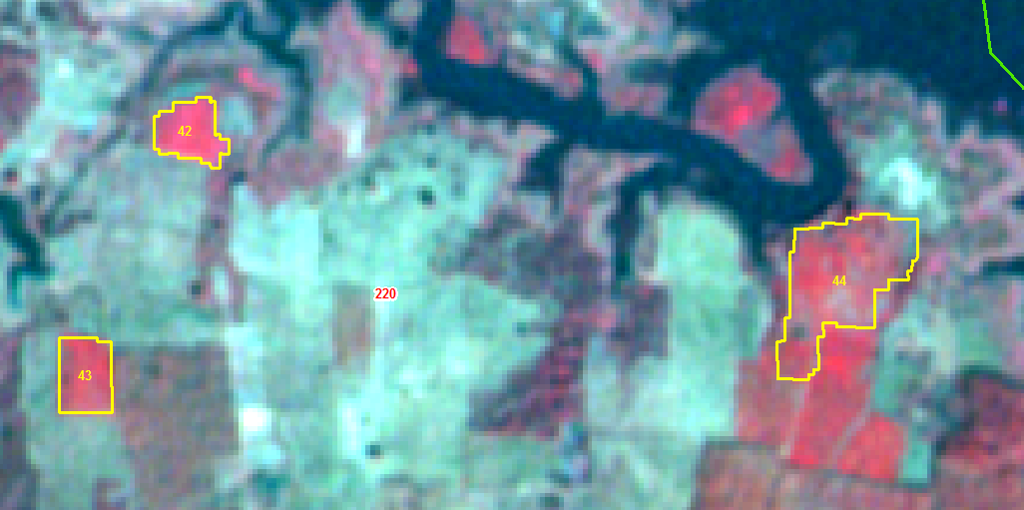
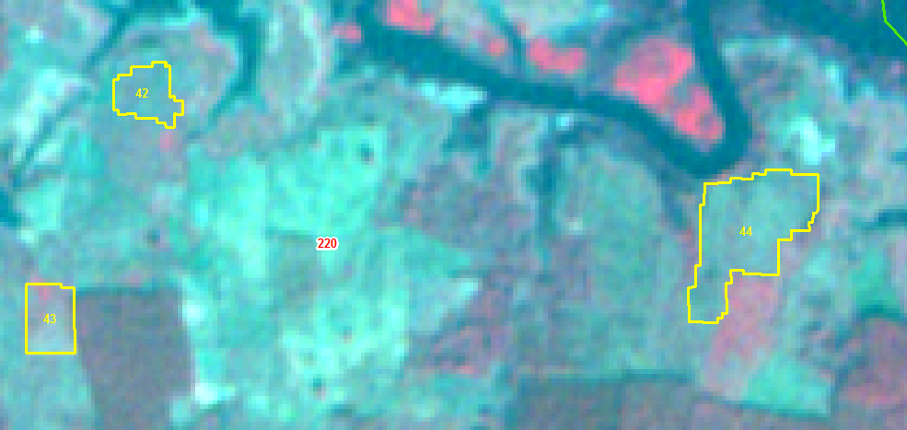
IRS R2 LISS IV Imagery 03 Feb 2018
IRS R2 LISS IV Imagery 05 Jan2019

Slide 43
IRS R2 LISS IV Imagery 03 Feb 2018
IRS R2 LISS IV Imagery 05 Jan2019

Slide 44
IRS R2 LISS IV Imagery 03 Feb 2018
IRS R2 LISS IV Imagery 05 Jan2019

Slide 45
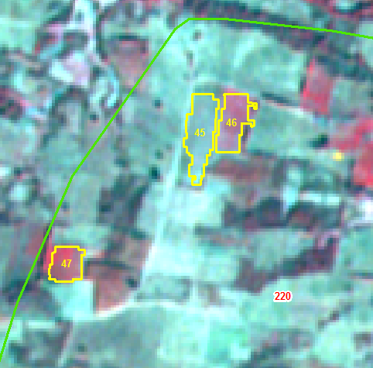
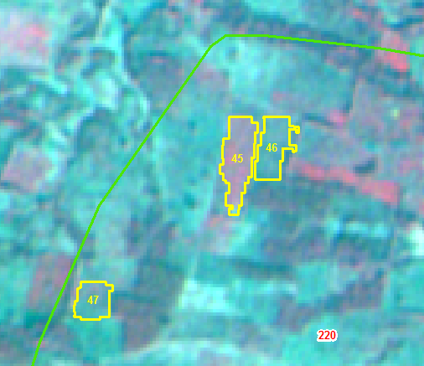
IRS R2 LISS IV Imagery 03 Feb 2018
IRS R2 LISS IV Imagery 05 Jan2019

Slide 46
IRS R2 LISS IV Imagery 03 Feb 2018
IRS R2 LISS IV Imagery 05 Jan2019

Slide 47
IRS R2 LISS IV Imagery 03 Feb 2018
IRS R2 LISS IV Imagery 05 Jan2019

Slide 48
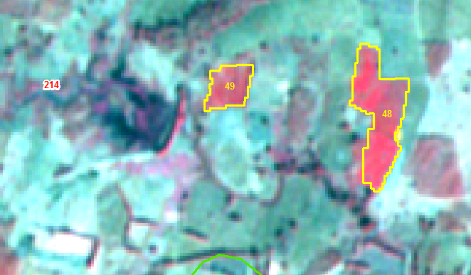
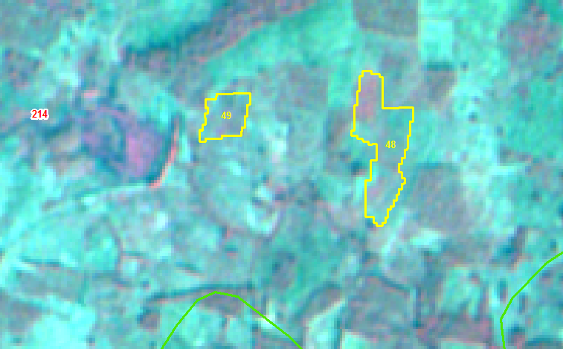
IRS R2 LISS IV Imagery 03 Feb 2018
IRS R2 LISS IV Imagery 05 Jan2019

Slide 49
IRS R2 LISS IV Imagery 03 Feb 2018
IRS R2 LISS IV Imagery 05 Jan2019

Slide 50
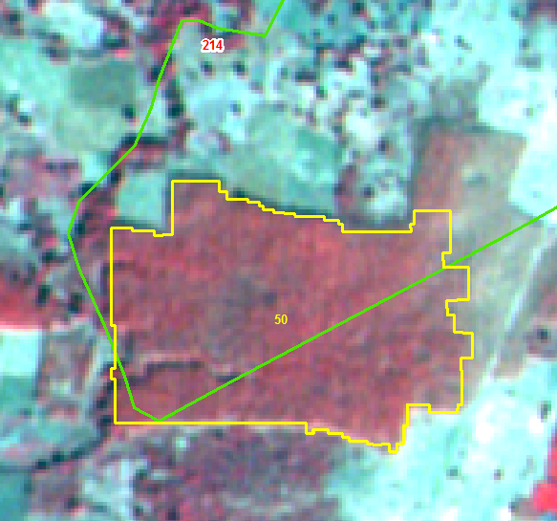
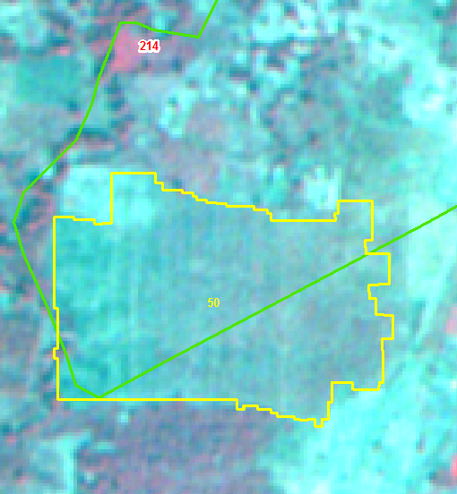
IRS R2 LISS IV Imagery 03 Feb 2018
IRS R2 LISS IV Imagery 05 Jan2019

Slide 51
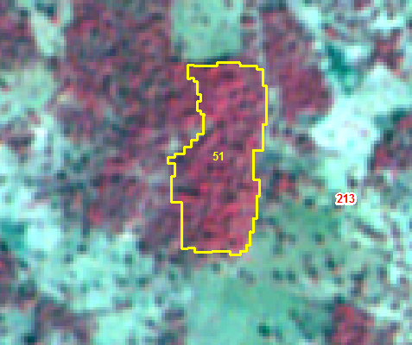
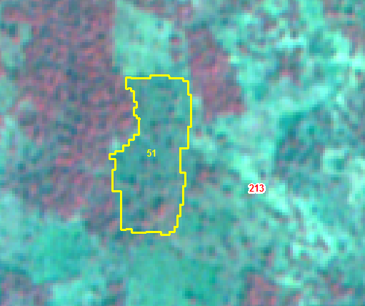
IRS R2 LISS IV Imagery 03 Feb 2018
IRS R2 LISS IV Imagery 05 Jan2019

Slide 52


IRS R2 LISS IV Imagery 03 Feb 2018
IRS R2 LISS IV Imagery 05 Jan2019

Slide 53
IRS R2 LISS IV Imagery 03 Feb 2018
IRS R2 LISS IV Imagery 05 Jan2019

Slide 54
IRS R2 LISS IV Imagery 03 Feb 2018
IRS R2 LISS IV Imagery 05 Jan2019

Slide 55


IRS R2 LISS IV Imagery 03 Feb 2018
IRS R2 LISS IV Imagery 05 Jan2019

Slide 56


IRS R2 LISS IV Imagery 03 Feb 2018
IRS R2 LISS IV Imagery 05 Jan2019

Slide 57


IRS R2 LISS IV Imagery 03 Feb 2018
IRS R2 LISS IV Imagery 05 Jan2019

Slide 58


IRS R2 LISS IV Imagery 03 Feb 2018
IRS R2 LISS IV Imagery 05 Jan2019

Slide 59
IRS R2 LISS IV Imagery 03 Feb 2018
IRS R2 LISS IV Imagery 05 Jan2019

Slide 60
IRS R2 LISS IV Imagery 03 Feb 2018
IRS R2 LISS IV Imagery 05 Jan2019

Slide 61
IRS R2 LISS IV Imagery 03 Feb 2018
IRS R2 LISS IV Imagery 05 Jan2019

Slide 62
IRS R2 LISS IV Imagery 03 Feb 2018
IRS R2 LISS IV Imagery 05 Jan2019

Slide 63
IRS R2 LISS IV Imagery 03 Feb 2018
IRS R2 LISS IV Imagery 05 Jan2019

Slide 64


IRS R2 LISS IV Imagery 03 Feb 2018
IRS R2 LISS IV Imagery 05 Jan2019

Slide 65
IRS R2 LISS IV Imagery 03 Feb 2018
IRS R2 LISS IV Imagery 05 Jan2019

Slide 66
IRS R2 LISS IV Imagery 03 Feb 2018
IRS R2 LISS IV Imagery 05 Jan2019

Slide 67
IRS R2 LISS IV Imagery 03 Feb 2018
IRS R2 LISS IV Imagery 05 Jan2019

Slide 68
IRS R2 LISS IV Imagery 03 Feb 2018
IRS R2 LISS IV Imagery 05 Jan2019

Slide 69
IRS R2 LISS IV Imagery 03 Feb 2018
IRS R2 LISS IV Imagery 05 Jan2019

Slide 70
IRS R2 LISS IV Imagery 03 Feb 2018
IRS R2 LISS IV Imagery 05 Jan2019

Slide 71


IRS R2 LISS IV Imagery 04 Mar 2018
IRS R2 LISS IV Imagery 15 Feb 2019

Slide 72


IRS R2 LISS IV Imagery 04 Mar 2018
IRS R2 LISS IV Imagery 15 Feb 2019

Slide 73


IRS R2 LISS IV Imagery 03 Feb 2018
IRS R2 LISS IV Imagery 05 Jan2019

Slide 74


IRS R2 LISS IV Imagery 03 Feb 2018
IRS R2 LISS IV Imagery 05 Jan2019

Slide 75


IRS R2 LISS IV Imagery 03 Feb 2018
IRS R2 LISS IV Imagery 05 Jan2019

Slide 76


IRS R2 LISS IV Imagery 04 Mar 2018
IRS R2 LISS IV Imagery 15 Feb 2019

Slide 77
IRS R2 LISS IV Imagery 04 Mar 2018
IRS R2 LISS IV Imagery 15 Feb 2019

Slide 78


IRS R2 LISS IV Imagery 04 Mar 2018
IRS R2 LISS IV Imagery 15 Feb 2019

Slide 79


IRS R2 LISS IV Imagery 03 Feb 2018
IRS R2 LISS IV Imagery 05 Jan2019

Slide 80


IRS R2 LISS IV Imagery 03 Feb 2018
IRS R2 LISS IV Imagery 05 Jan2019

Slide 81


IRS R2 LISS IV Imagery 03 Feb 2018
IRS R2 LISS IV Imagery 05 Jan2019

Slide 82


IRS R2 LISS IV Imagery 03 Feb 2018
IRS R2 LISS IV Imagery 05 Jan2019

Slide 83


IRS R2 LISS IV Imagery 03 Feb 2018
IRS R2 LISS IV Imagery 05 Jan2019

Slide 84
IRS R2 LISS IV Imagery 03 Feb 2018
IRS R2 LISS IV Imagery 05 Jan2019

Slide 85


IRS R2 LISS IV Imagery 03 Feb 2018
IRS R2 LISS IV Imagery 05 Jan2019

Slide 86


IRS R2 LISS IV Imagery 03 Feb 2018
IRS R2 LISS IV Imagery 05 Jan2019

Slide 87


IRS R2 LISS IV Imagery 03 Feb 2018
IRS R2 LISS IV Imagery 05 Jan2019

Slide 88


IRS R2 LISS IV Imagery 03 Feb 2018
IRS R2 LISS IV Imagery 05 Jan2019

Slide 89


IRS R2 LISS IV Imagery 03 Feb 2018
IRS R2 LISS IV Imagery 05 Jan2019

Slide 90
IRS R2 LISS IV Imagery 03 Feb 2018
IRS R2 LISS IV Imagery 05 Jan2019

Slide 91
IRS R2 LISS IV Imagery 03 Feb 2018
IRS R2 LISS IV Imagery 05 Jan2019

Slide 92
IRS R2 LISS IV Imagery 03 Feb 2018
IRS R2 LISS IV Imagery 05 Jan2019

Slide 93


IRS R2 LISS IV Imagery 03 Feb 2018
IRS R2 LISS IV Imagery 05 Jan2019

Slide 94


IRS R2 LISS IV Imagery 03 Feb 2018
IRS R2 LISS IV Imagery 05 Jan2019

Slide 95


IRS R2 LISS IV Imagery 03 Feb 2018
IRS R2 LISS IV Imagery 05 Jan2019

Slide 96
IRS R2 LISS IV Imagery 03 Feb 2018
IRS R2 LISS IV Imagery 05 Jan2019

Slide 97


IRS R2 LISS IV Imagery 03 Feb 2018
IRS R2 LISS IV Imagery 05 Jan2019

Slide 98


IRS R2 LISS IV Imagery 03 Feb 2018
IRS R2 LISS IV Imagery 05 Jan2019

Slide 99
IRS R2 LISS IV Imagery 03 Feb 2018
IRS R2 LISS IV Imagery 05 Jan2019

Slide 100


IRS R2 LISS IV Imagery 03 Feb 2018
IRS R2 LISS IV Imagery 05 Jan2019

Slide 101


IRS R2 LISS IV Imagery 03 Feb 2018
IRS R2 LISS IV Imagery 05 Jan2019

Slide 102
IRS R2 LISS IV Imagery 03 Feb 2018
IRS R2 LISS IV Imagery 05 Jan2019

Slide 103


IRS R2 LISS IV Imagery 03 Feb 2018
IRS R2 LISS IV Imagery 05 Jan2019

Slide 104


IRS R2 LISS IV Imagery 03 Feb 2018
IRS R2 LISS IV Imagery 05 Jan2019

Slide 105


IRS R2 LISS IV Imagery 03 Feb 2018
IRS R2 LISS IV Imagery 05 Jan2019

Slide 106
IRS R2 LISS IV Imagery 03 Feb 2018
IRS R2 LISS IV Imagery 05 Jan2019

Slide 107


IRS R2 LISS IV Imagery 03 Feb 2018
IRS R2 LISS IV Imagery 05 Jan2019

Slide 108


IRS R2 LISS IV Imagery 03 Feb 2018
IRS R2 LISS IV Imagery 05 Jan2019

Slide 109


IRS R2 LISS IV Imagery 03 Feb 2018
IRS R2 LISS IV Imagery 05 Jan2019

Slide 110


IRS R2 LISS IV Imagery 04 Mar 2018
IRS R2 LISS IV Imagery 15 Feb 2019

Slide 111


IRS R2 LISS IV Imagery 04 Mar 2018
IRS R2 LISS IV Imagery 15 Feb 2019

Slide 112


IRS R2 LISS IV Imagery 04 Mar 2018
IRS R2 LISS IV Imagery 15 Feb 2019

Slide 113


IRS R2 LISS IV Imagery 04 Mar 2018
IRS R2 LISS IV Imagery 15 Feb 2019

Slide 114


IRS R2 LISS IV Imagery 04 Mar 2018
IRS R2 LISS IV Imagery 15 Feb 2019

Slide 115


IRS R2 LISS IV Imagery 04 Mar 2018
IRS R2 LISS IV Imagery 15 Feb 2019

Slide 116


IRS R2 LISS IV Imagery 04 Mar 2018
IRS R2 LISS IV Imagery 15 Feb 2019

Slide 117
IRS R2 LISS IV Imagery 04 Mar 2018
IRS R2 LISS IV Imagery 15 Feb 2019

Slide 118


IRS R2 LISS IV Imagery 04 Mar 2018
IRS R2 LISS IV Imagery 15 Feb 2019

Slide 119


IRS R2 LISS IV Imagery 03 Feb 2018
IRS R2 LISS IV Imagery 05 Jan2019

