Slide 1
IRS R2 LISS IV 22-02-2018
IRS R2 LISS IV 13-11-2018
SNO | Division | Range | Section | Beat | Block | Comp | Class | Change | Area_Ha | Longitude | Latitude | VSS | Sanctuary
1 | KADAPA | CUDDAPAH | BHAKARAPET | KANUMALOPALLI | KANUMALAPALLE RF | 565 | OF TO SF | NEGATIVE | 1.00 | 78.89683 | 14.44318
2 | KADAPA | CUDDAPAH | BHAKARAPET | KANUMALOPALLI | KANUMALAPALLE RF | 565 | OF TO SF | NEGATIVE | 1.15 | 78.89818 | 14.44306

Slide 2
IRS R2 LISS IV 22-02-2018
IRS R2 LISS IV 13-11-2018
SNO | Division | Range | Section | Beat | Block | Comp | Class | Change | Area_Ha | Longitude | Latitude | VSS | Sanctuary
1 | KADAPA | CUDDAPAH | BHAKARAPET | KANUMALOPALLI | KANUMALAPALLE RF | 565 | OF TO SF | NEGATIVE | 1.00 | 78.89683 | 14.44318
2 | KADAPA | CUDDAPAH | BHAKARAPET | KANUMALOPALLI | KANUMALAPALLE RF | 565 | OF TO SF | NEGATIVE | 1.15 | 78.89818 | 14.44306

Slide 3
IRS R2 LISS IV 22-02-2018
IRS R2 LISS IV 13-11-2018
SNO | Division | Range | Section | Beat | Block | Comp | Class | Change | Area_Ha | Longitude | Latitude | VSS | Sanctuary
3 | KADAPA | CUDDAPAH | BHAKARAPET | KANUMALOPALLI | KANUMALAPALLE EXTN A RF | 569 | SF TO NF | NEGATIVE | 1.78 | 78.94065 | 14.45665

Slide 4
IRS R2 LISS IV 22-02-2018
IRS R2 LISS IV 13-11-2018
SNO | Division | Range | Section | Beat | Block | Comp | Class | Change | Area_Ha | Longitude | Latitude | VSS | Sanctuary
4 | KADAPA | CUDDAPAH | BHAKARAPET | KANUMALOPALLI | KANUMALAPALLE EXTTN A RF | 567 | NF TO SF | POSITIVE | 0.88 | 78.87812 | 14.47083

Slide 5
IRS R2 LISS IV 22-02-2018
IRS R2 LISS IV 13-11-2018
SNO | Division | Range | Section | Beat | Block | Comp | Class | Change | Area_Ha | Longitude | Latitude | VSS | Sanctuary
5 | KADAPA | CUDDAPAH | MAMILLAPALLI | MAMILLAPALLI | PALKONDA EXTN A RF | 550 | SF TO NF | NEGATIVE | 40.38 | 78.88033 | 14.43569
6 | KADAPA | CUDDAPAH | MAMILLAPALLI | MAMILLAPALLI | PALKONDA EXTN A RF | 550 | SF TO OF | POSITIVE | 72.26 | 78.89307 | 14.43395
7 | KADAPA | CUDDAPAH | MAMILLAPALLI | MAMILLAPALLI | PALKONDA EXTN A RF | 550 | NF TO SF | POSITIVE | 24.03 | 78.88558 | 14.43347

Slide 6
IRS R2 LISS IV 22-02-2018
IRS R2 LISS IV 13-11-2018
SNO | Division | Range | Section | Beat | Block | Comp | Class | Change | Area_Ha | Longitude | Latitude | VSS | Sanctuary
5 | KADAPA | CUDDAPAH | MAMILLAPALLI | MAMILLAPALLI | PALKONDA EXTN A RF | 550 | SF TO NF | NEGATIVE | 40.38 | 78.88033 | 14.43569
6 | KADAPA | CUDDAPAH | MAMILLAPALLI | MAMILLAPALLI | PALKONDA EXTN A RF | 550 | SF TO OF | POSITIVE | 72.26 | 78.89307 | 14.43395
7 | KADAPA | CUDDAPAH | MAMILLAPALLI | MAMILLAPALLI | PALKONDA EXTN A RF | 550 | NF TO SF | POSITIVE | 24.03 | 78.88558 | 14.43347

Slide 7
IRS R2 LISS IV 22-02-2018
IRS R2 LISS IV 13-11-2018
SNO | Division | Range | Section | Beat | Block | Comp | Class | Change | Area_Ha | Longitude | Latitude | VSS | Sanctuary
5 | KADAPA | CUDDAPAH | MAMILLAPALLI | MAMILLAPALLI | PALKONDA EXTN A RF | 550 | SF TO NF | NEGATIVE | 40.38 | 78.88033 | 14.43569
6 | KADAPA | CUDDAPAH | MAMILLAPALLI | MAMILLAPALLI | PALKONDA EXTN A RF | 550 | SF TO OF | POSITIVE | 72.26 | 78.89307 | 14.43395
7 | KADAPA | CUDDAPAH | MAMILLAPALLI | MAMILLAPALLI | PALKONDA EXTN A RF | 550 | NF TO SF | POSITIVE | 24.03 | 78.88558 | 14.43347

Slide 8
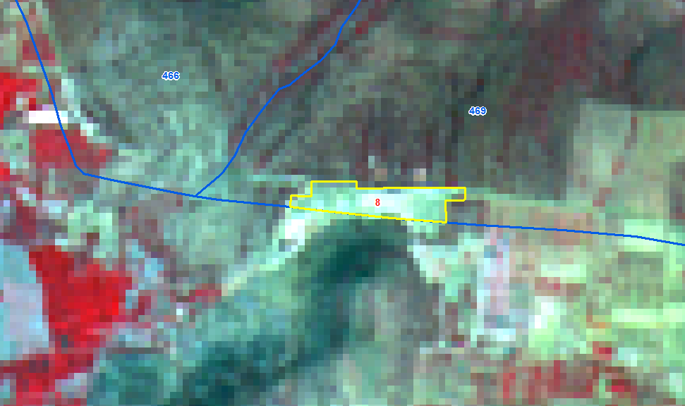
IRS R2 LISS IV 22-02-2018
IRS R2 LISS IV 13-11-2018
SNO | Division | Range | Section | Beat | Block | Comp | Class | Change | Area_Ha | Longitude | Latitude | VSS | Sanctuary
8 | KADAPA | VONTIMITTA | CHINTARAJUPALLI | NANDALUR | KANIKAL KONDA EXTN. R.F | 469 | OF TO NF | NEGATIVE | 6.53 | 79.13668 | 14.27838

